Slide 1
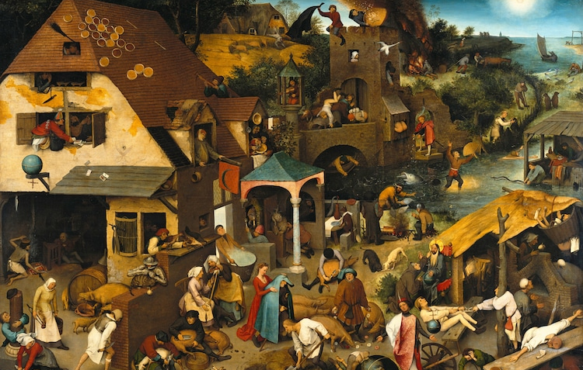
Being Someone: Language and Selfhood 30 April 2021, 13:00-14:00
1
Being Someone:
Language and Selfhood
A look at the Seven Selves hypothesis
Martin Edwardes
BSc MA PhD, FRAI
martin.1.edwardes@kcl.ac.uk

Slide 2
The core text
https://www.uclpress.co.uk/collections/anthropology/products/125998
2

Slide 3
About the currently speaking self
3
Martin P.J. Edwardes
He/she/they/whatever
Educationally defined as …
Self-defined as …
Economist
Linguist
Anthropologist
Left-handed
Civil Partnered
Gay
Agendered
Mild Aspergers
Professionally defined as …
Writer
Editor
Lecturer
Researcher
Technologist
Designer
Manager
Retired
Academically defined as …
Anthropological Linguist
Cognitive Linguist
Grammatician
Evolutionary Anthropologist
Language Origins Researcher

Slide 4
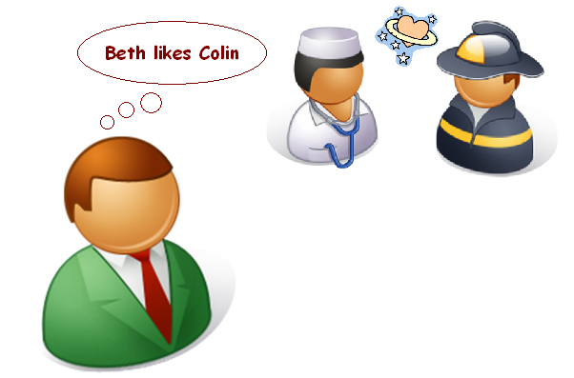
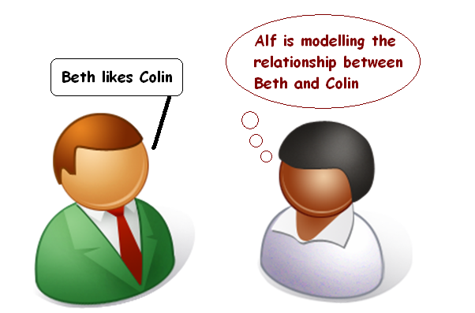
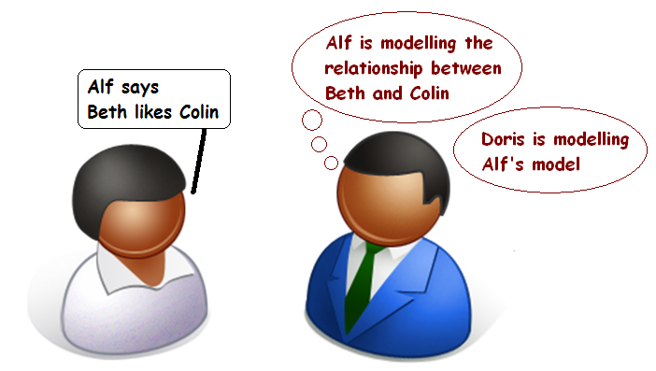
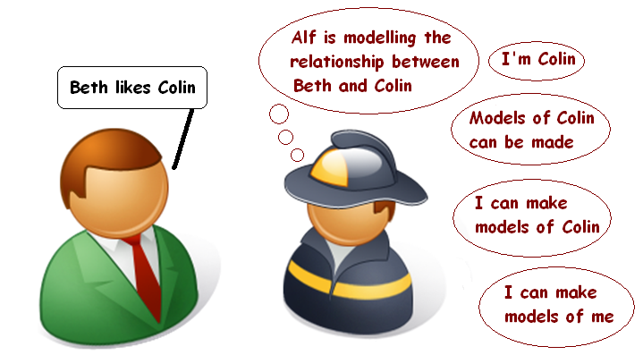
The peculiarity of human selfhood
Is self-modelling an unavoidable consequence of
4
A
shared social modelling?
B
C
D

Slide 5
Types of self
Types of self
We now skip a few chapters in The Origins of Self and go on to chapter 8, which looks at the way selfhood may be functionally managed in the human brain.
The hypothesis considered here is called the Seven Selves Hypothesis, or SSH.
This is not a biological or mechanical hypothesis, it considers the types of self needed to make human selfhood work, and the processes by which internal representations and external presentations are achieved.
5
Social selves
The self others believe me to be
Episodic selves
The self as modelled in individual past events
Self-model
The self I believe me to be
Actual self
Unknowable
Cultural self
The self I should be
Projected self
The self I want others
to believe me to be
Narrative self
Remembered self,
the self with history

Slide 6
Types of self: Actual self
Actual self
The Actual self is the physical self, without which there can be no selfhood. It is directly governed by the twin genetic imperatives to survive and thrive.
Unlike the other selves, the Actual self is not a conscious representation of the self; and, because of this, it is essentially unknowable: I can know that I have an Actual self, but I cannot consciously inspect it or accurately model it. It equates to the Sense of self in the evolutionary hypothesis.
6
Actual self
Unknowable

Slide 7
Types of self: Social selves
Social selves
This is the first self of which I am consciously aware: the model of my self offered by others as part of the exchange of social calculus. Unlike most of the other selves, therefore, it is provided wholly from outside the self.
It is possible for me to receive many modelled Social selves. Each is a different opinion of who I am and, if I receive sufficient of them, I can start to form my own opinion of me.
7
Social selves
The self others believe me to be
Actual self
Unknowable

Slide 8
Types of self: Self-model
Self-model
Each of my Self-models is integrated from sets of social selves received from others. I can therefore have many possible Self-models, but usually only one at a time. However, because my currently-active Self-model changes over time, I have some conscious control over it – being the me they believe me to be. This protean nature of the self can become a source of self- anxiety: do my inconsistencies represent a failure or fraying of my integrated selfhood? There is only one actual, physical me, so why do there seem to be several real “me”s?
8
Social selves
The self others believe me to be
Self-model
The self I believe me to be
Actual self
Unknowable

Slide 9
Types of self: Episodic selves
Episodic selves
When I remember my self, I do not remember my Self-model as it was when the memory was laid down; rather, I construct a current Self-model to represent my previous self. This means that I am continually pathologising my memories: recalling a memory involves copying the memory engram into working memory, adjusting the memory and then writing it back. This is an important fallibility: each time I recall a memory I model the past event in relation to my current Self-model, giving an illusion of permanence of selfness.
9
Social selves
The self others believe me to be
Episodic selves
The self as modelled in individual past events
Self-model
The self I believe me to be
Actual self
Unknowable

Slide 10
Types of self: Narrative self
Narrative self
This is the most controversial of the selves. It may be no more than a series of episodic selves which we treat as continuous when they do not need to be.
Some people say that they do not have a Narrative self, and we cannot dismiss their feelings about their own self as self-delusion.
However, even if the Narrative self is not actually instantiated in the brain, it still works as a metaphor of a continuous self, and that may be enough.
10
Social selves
The self others believe me to be
Episodic selves
The self as modelled in individual past events
Self-model
The self I believe me to be
Actual self
Unknowable
Narrative self
Remembered self,
the self with history

Slide 11
Types of self: Cultural self
Cultural self
Like the Social selves, the Cultural self is is a model offered to the individual by others; but, unlike the Social selves, it is a model of an ideal individual in a particular culture, explicitly the ideal self that the self can be. It is the cause of much misery if it is treated as a target to be attained.
The Cultural self acts as a brake or governor on self-modelling; but it can also give permission to act outside the moral code of the culture. For example, QAnon’s (and the ex-President’s) “permission” to join a riotous assembly.
11
Social selves
The self others believe me to be
Episodic selves
The self as modelled in individual past events
Self-model
The self I believe me to be
Actual self
Unknowable
Cultural self
The self I should be
Narrative self
Remembered self,
the self with history

Slide 12
Types of self: Projected self
Projected self
The Projected self is an emergent feature of the social models I receive, moderated through three routes: first, via Self-modelling, Episodic self and Narrative self; second, directly via Self-modelling; and third, via Cultural self.
The Projected self is an amalgam of my internal representations of myself and the expectations that others put upon me.
12
Social selves
The self others believe me to be
Episodic selves
The self as modelled in individual past events
Self-model
The self I believe me to be
Actual self
Unknowable
Cultural self
The self I should be
Projected self
The self I want others
to believe me to be
Narrative self
Remembered self,
the self with history

Slide 13
Types of self: The role of the subconscious?
The role of the subconscious?
There is one unexplored input to the Self-model: that from the unknowable Actual self. To explore this, the Actual self must become consciously knowable in some way; and I believe that dreams, guided analysis and psychoactive substances may help conscious attention to interpret the subconscious Actual self.
The Actual self may not have consciousness, but it remains the source for most of our cogitation; so accessing and interpreting it is important.
13
Social selves
The self others believe me to be
Episodic selves
The self as modelled in individual past events
Self-model
The self I believe me to be
Actual self
Unknowable
Cultural self
The self I should be
Projected self
The self I want others
to believe me to be
Narrative self
Remembered self,
the self with history

Slide 14
Thank you for listening
14
Being Someone:
Language and Selfhood
Any Questions, Comments,
Expressions of disbelief?
Martin Edwardes
BSc MA PhD, FRAI
martin.1.edwardes@kcl.ac.uk

