Slide 1
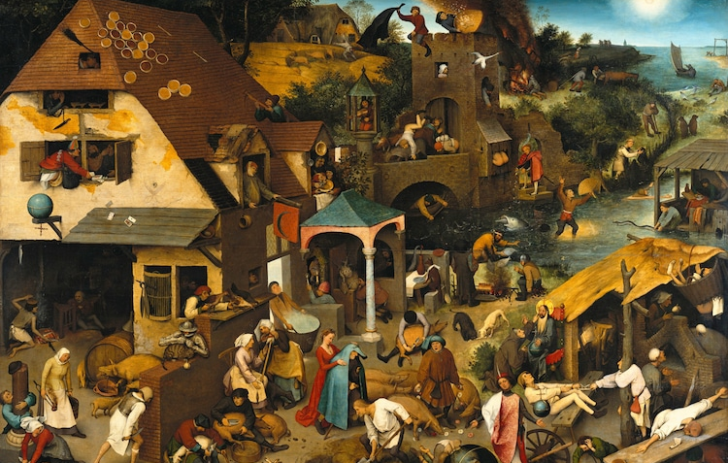
Building up to selfhood Thursday 6 May 2021, 6pm
1
Building up to selfhood
An anthropological perspective on
where selfhood came from,
and the selves humans have
Because…
before you can break down the self
you need a self to break down
Martin Edwardes
BSc MA PhD, FRAI
martin.1.edwardes@kcl.ac.uk

Slide 2
The core text
https://www.uclpress.co.uk/collections/anthropology/products/125998
2

Slide 3
About the currently speaking self
3
Martin P.J. Edwardes
He/she/they/whatever
Educationally defined as …
Self-defined as …
Economist
Linguist
Anthropologist
Left-handed
Civil Partnered
Gay
Agendered
Mild Aspergers
Professionally defined as …
Writer
Editor
Lecturer
Researcher
Technologist
Designer
Manager
Retired
Academically defined as …
Anthropological Linguist
Cognitive Linguist
Grammatician
Evolutionary Anthropologist
Language Origins Researcher

Slide 4
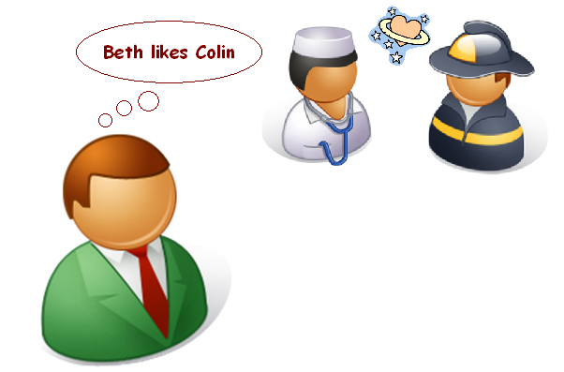
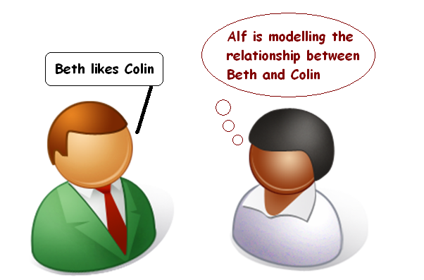
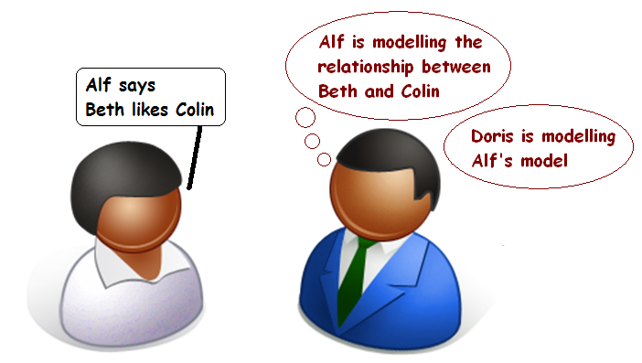
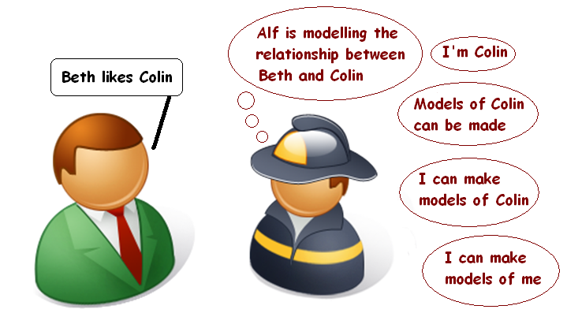
The peculiarity of human selfhood
Is self-modelling an unavoidable consequence of
4
A
shared social modelling?
B
C
D

Slide 5
The development of selfhood
The development of selfhood
To be human is to
be, somehow, more aware of yourself than any other species can be. We can know who we were, who we are, and that our self has been changed between then and now. How do we do this?
The hypothesis set out here is discussed in detail in chapter 2 of
The Origins of Self: An anthropological perspective.
It looks at how life has dealt with selfhood from single-celled animals down to modern-day humans. This is an extensive and ambitious timescale, but it is necessary if we are to understand human selfness as an evolutionary outcome.
5
Sense of Not-Self
Cellular Life
Will to Survive
Multi-cellularity
Central Nervous System
Awareness
Machiavellian Intelligence
Theory of Mind
Social Calculus
Shared Social Calculus
Altruistic Self-sacrifice
Sense of Almost-Self
Sense of Other
Sense of Self
Awareness of Other
Group Co-operation
Joint Enterprise
Awareness of Self
Awareness of Selfness

Slide 6
The development of selfhood:
Sense of not-self
Sense of not-self
The amoeba is a set of mechanisms within a flexible cell membrane, and this membrane marks the boundary between the ends of existence (movement, feeding and division) and the means by which that existence is maintained. Things outside the amoeba’s cell membrane have the potential to support or damage its existence; everything inside it is (theoretically) already devoted to the amoeba’s existence.
It is therefore useful to the amoeba to be able to detect and react differently to items outside its cell membrane than to items inside it, giving it, for all practical amoeboid purposes, a sense of not- self.
6
Sense of Not-Self
Cellular Life
Will to Survive
Multi-cellularity
Central Nervous System
Awareness
Machiavellian Intelligence
Theory of Mind
Social Calculus
Shared Social Calculus
Altruistic Self-sacrifice

Slide 7
The development of selfhood:
Sense of almost-self
Sense of almost-self
Cell differentiation generates, and relies on, a system of communication between cells; and this, in turn, requires a cell to have a sense of almost-self about other cells in the multi-cellular organism. Each cell has to react to its clones cooperatively and to alien cells inimically – there has to be an autonomic and concerted reaction by the clonal colony to non-colony cells to prevent them invading the colony.
The apparently cooperative sense of almost-self at the cellular level is sufficient to generate the appearance of a sense of not-self at the colony level, as the colony itself appears to have an ‘inside’ and an ‘outside’.
7
Sense of Not-Self
Cellular Life
Will to Survive
Multi-cellularity
Central Nervous System
Awareness
Machiavellian Intelligence
Theory of Mind
Social Calculus
Shared Social Calculus
Altruistic Self-sacrifice
Sense of Almost-Self

Slide 8
The development of selfhood:
Sense of other and Sense of self
Sense of other and
Sense of self
Sense of self and sense of other are not directly related phenomena. Sense of other is not a product of sense of self, or vice versa; they are separate cognitive representations of the means and ends of survival and are ideationally very different. They both have their roots in the relationship between sense of not- self and sense of almost- self, but they elaborate these bases in different ways. Sense of other addresses the external differences between the organism’s clonal cells and different parts of the rest of the universe; sense of self addresses the internal cohesion of the organism’s cells. They both, however, rely on a central nervous system.
8
Sense of Not-Self
Cellular Life
Will to Survive
Multi-cellularity
Central Nervous System
Awareness
Machiavellian Intelligence
Theory of Mind
Social Calculus
Shared Social Calculus
Altruistic Self-sacrifice
Sense of Almost-Self
Sense of Other
Sense of Self

Slide 9
The development of selfhood:
Awareness of other
Awareness of other
The main fitness advantage that awareness offers is that it allows the individual to keep up in the strategy– counterstrategy competition to survive and thrive.
However, the capacity to second- guess the actions of others also introduces a new,
reflective and reflexive type of cognition: not only does an organism have an enhanced range of responses to others, it also has an enhanced range of responses to the responses of other organisms. It is no longer the fastest response that is most effective, it is the response with the least effective counter-response.
9
Sense of Not-Self
Cellular Life
Will to Survive
Multi-cellularity
Central Nervous System
Awareness
Machiavellian Intelligence
Theory of Mind
Social Calculus
Shared Social Calculus
Altruistic Self-sacrifice
Sense of Almost-Self
Sense of Other
Sense of Self
Awareness of Other

Slide 10
The development of selfhood:
Awareness of self and
Awareness of selfness
Awareness of self and
Awareness of selfness
For whatever reason, humans
became able to share social information; in the sharing of social information, we exchanged cognitive models of other members of our social group, as both senders and receivers; among the models we received there inevitably would have been models of our self; and, to incorporate these into our social calculus, we would have needed to model our self as if it were another self. From sense of not- self to awareness of selfness is long but linear: each new capacity develops naturally from the one before, and the senses and awarenesses of other and self emerge unremarkably from the previous capacities.
10
Sense of Not-Self
Cellular Life
Will to Survive
Multi-cellularity
Central Nervous System
Awareness
Machiavellian Intelligence
Theory of Mind
Social Calculus
Shared Social Calculus
Altruistic Self-sacrifice
Sense of Almost-Self
Sense of Other
Sense of Self
Awareness of Other
Group Co-operation
Joint Enterprise
Awareness of Self
Awareness of Selfness

Slide 11
Types of self
Types of self
We now skip a few chapters in The Origins of Self and go on to chapter 8, which looks at the way selfhood may be functionally managed in the human brain.
The hypothesis considered here is called the Seven Selves Hypothesis, or SSH.
This is not a biological or mechanical hypothesis, it considers the types of self needed to make human selfhood work, and the processes by which internal representations and external presentations are achieved.
11
Social selves
The self others believe me to be
Episodic selves
The self as modelled in individual past events
Self-model
The self I believe me to be
Actual self
Unknowable
Cultural self
The self I should be
Projected self
The self I want others
to believe me to be
Narrative self
Remembered self,
the self with history

Slide 12
Types of self: Actual self
Actual self
The Actual self is the physical self, without which there can be no selfhood. It is directly governed by the twin genetic imperatives to survive and thrive.
Unlike the other selves, the Actual self is not a conscious representation of the self; and, because of this, it is essentially unknowable: I can know that I have an Actual self, but I cannot consciously inspect it or accurately model it. It equates to the Sense of self in the evolutionary hypothesis.
12
Actual self
Unknowable

Slide 13
Types of self: Social selves
Social selves
This s the first self of which I am consciously aware: the model of my self offered by others as part of the exchange of social calculus. Unlike most of the other selves, therefore, it is provided wholly from outside the self.
It is possible for me to receive many modelled Social selves. Each is a different opinion of who I am and, if I receive sufficient of them, I can start to form my own opinion of me.
13
Social selves
The self others believe me to be
Actual self
Unknowable

Slide 14
Types of self: Self-model
Self-model
Each of my Self-models is integrated from sets of social selves received from others. I can therefore have many possible Self-models, but usually only one at a time. However, because my currently-active Self-model changes over time, I have some conscious control over it – being the me they believe me to be. This protean nature of the self can become a source of self- anxiety: do my inconsistencies represent a failure or fraying of my integrated selfhood? There is only one actual, physical me, so why do there seem to be several real “me”s?
14
Social selves
The self others believe me to be
Self-model
The self I believe me to be
Actual self
Unknowable

Slide 15
Types of self: Episodic selves
Episodic selves
When I remember my self, I do not remember my Self-model as it was when the memory was laid down; rather, I construct a current Self-model to represent my previous self. This means that I am continually pathologising my memories: recalling a memory involves copying the memory engram into working memory, adjusting the memory and then writing it back. This is an important fallibility: each time I recall a memory I model the past event in relation to my current Self-model, giving an illusion of permanence of selfness.
15
Social selves
The self others believe me to be
Episodic selves
The self as modelled in individual past events
Self-model
The self I believe me to be
Actual self
Unknowable

Slide 16
Types of self: Narrative self
Narrative self
This is the most controversial of the selves. It may be no more than a series of episodic selves which we treat as continuous when they do not need to be.
Some people say that they do not have a Narrative self, and we cannot dismiss their feelings about their own self as self-delusion.
However, even if the Narrative self is not actually instantiated in the brain, it still works as a metaphor of a continuous self, and that may be enough.
16
Social selves
The self others believe me to be
Episodic selves
The self as modelled in individual past events
Self-model
The self I believe me to be
Actual self
Unknowable
Narrative self
Remembered self,
the self with history

Slide 17
Types of self: Cultural self
Cultural self
Like the Social selves, the Cultural self is is a model offered to the individual by others; but, unlike the Social selves, it is a model of an ideal individual in a particular culture, explicitly the ideal self that the self can be. It is the cause of much misery if it is treated as a target to be attained.
The Cultural self acts as a brake or governor on self-modelling; but it can also give permission to act outside the moral code of the culture. For example, QAnon’s (and the ex-President’s) “permission” to join a riotous assembly.
17
Social selves
The self others believe me to be
Episodic selves
The self as modelled in individual past events
Self-model
The self I believe me to be
Actual self
Unknowable
Cultural self
The self I should be
Narrative self
Remembered self,
the self with history

Slide 18
Types of self: Projected self
Projected self
The Projected self is an emergent feature of the social models I receive, moderated through three routes: first, via Self-modelling, Episodic self and Narrative self; second, directly via Self-modelling; and third, via Cultural self.
The Projected self is an amalgam of my internal representations of myself and the expectations that others put upon me.
18
Social selves
The self others believe me to be
Episodic selves
The self as modelled in individual past events
Self-model
The self I believe me to be
Actual self
Unknowable
Cultural self
The self I should be
Projected self
The self I want others
to believe me to be
Narrative self
Remembered self,
the self with history

Slide 19
Types of self: The role of the subconscious?
The role of the subconscious?
There is one unexplored input to the Self-model: that from the unknowable Actual self. To explore this, the Actual self must become consciously knowable in some way; and I believe that dreams, guided analysis and psychoactive substances may help conscious attention to interpret the subconscious Actual self.
The Actual self may not have consciousness, but it remains the source for most of our cogitation; so accessing and interpreting it is important.
19
Social selves
The self others believe me to be
Episodic selves
The self as modelled in individual past events
Self-model
The self I believe me to be
Actual self
Unknowable
Cultural self
The self I should be
Projected self
The self I want others
to believe me to be
Narrative self
Remembered self,
the self with history

Slide 20
Thank you for listening
20
Building up to selfhood
Any Questions, Comments,
Expressions of disbelief?
Martin Edwardes
BSc MA PhD, FRAI
martin.1.edwardes@kcl.ac.uk

