Slide 1
Polari
Ow yer Queer Dowryfolk
use ter palaver
Avec les comperes du jour (that’s yer actual French),
the Fantabulosa Martha & Phyllis

Slide 2
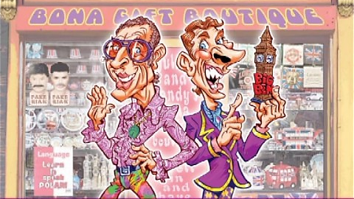
Polari is not just a code
Primero, a mince down to Memory Cottage:
https://www.youtube.com/watch?v=S_WSligSPRc
This shows us that:
1. Innuendo is a vital part of Polari.
2. So is sarcasm.
3. And a camp London accent helps.
BUT:
4. Polari is mostly a way to code queer in-group goss so the naffs don’t know what we’re cacklin about.

Slide 3
Sources of Polari
Thieves Cant
Rhyming Slang
Back- slang
Yiddish & Romani
French, Italian, German,
etc.
Mollyhouse Cant
Cockney
Sailor Slang
(Lingua Franca)
Theatre Slang
(Parlyaree)
Polari
(Palari, Palare)

Slide 4
Dialects of Polari
Not all Polari is the same:
Local dialects affect local Polari, creating local dialects of Polari.
Polari dialects are difficult to document,
But some dialect terms have been anecdotally identified.
Polari
(Palari, Palare)
Scouser Polari
[nosh, jarry]
Manky Polari
[mint, ginnel]
Brizzle Polari
[goin Egypt,
gert lush]
“Siarad Hoyw”
[cwtsh cwn,
clecs rhyw]
“Pink Triangle Scots”
[buftie, gey]
Oxford Polari

Slide 5
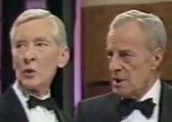
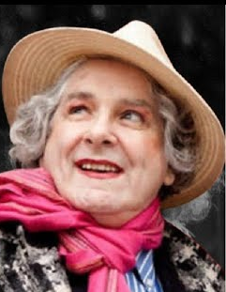
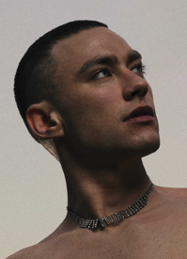
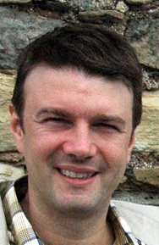
Some Polari Utterances
Bona to vaada yer, heartface
Where does ee spend is evenins?
We’ve all got your number, ducky
Seems like a nice boy
Strides for the naff syrup omi
I vaada’d er mince at the sweat chovey, an clocked she’s mauve
Shorts weather
As feely omies...we would zhoozh our riah, powder our eeks, climb into our bona new drag, don our batts an troll off to some bona bijou bar … we would loll around with our sisters an vaada the bona cartes on the butch omi ajax who, if we fluttered our ogle riahs at him sweetly, might just troll over an offer a light for the unlit vogue clenched between our pots.
…from Parallel Lives, the memoirs of renowned gay journalist Peter Burton

Slide 6
A Bijou Notette about
Polari Grammar
When in doubt, use English word order and English grammar rules
BUT:
[English ↓ English in Polari word order ↓ Polari]
Grand piano ↓ Piano grand ↓ Strillers bona
Get ready to [play or type] ↓ Prepare well your fingers ↓ Order lau yer luppers
Don’t wear the glasses ↓ Negative on the spectacles ↓ Nishta on the oglefakes
He is left-handed ↓ She’s a left hand ↓ Er’s a dry martini
Short film, Quick feel, Small hands, etc. ↓ Filmette, Reefette, Lillettes, etc.
It’s sad my youthfulness is gone ↓ Sharda nanti feelyness now
An insignificant genital bulge ↓ Nanti ter vaada in the larder

Slide 7
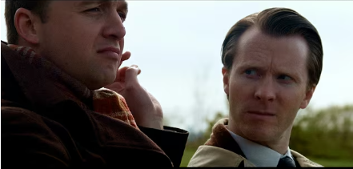
Putting on the Dish
Yes, in the 1960s, there were folk who really talked Polari like this.
https://www.youtube.com/watch?v=Y8yEH8TZUsk
Vaada the bijou filmette an screeve down any polari you nishta savvy.
This time the subtitles are bona!
I will endeavour to answer questions after the film has completed.

Slide 8
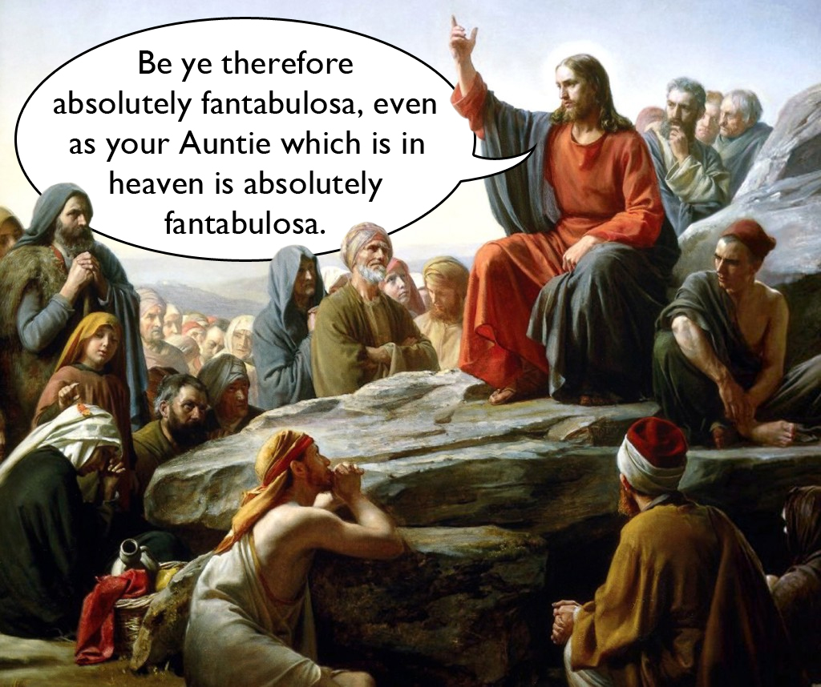
Any Questions …
?
… About the film
Or about anything else in this talk
And now, a bijou testette:
WHAT AM I DOIN?
I done the screevin an I laued it off to the glossy latty for the vaada omi ter zhoozh up the lavs. I ope they think its bona, cos it’s a dowry fakement ter get inter this glossy. Nishta primero, but in the top chinker. This cackle could get me an actin dicky in a bona latty of savvy, like the Dowriest Ducky’s Great Wen Brainery; which means not avin ter lube fambles in the Land of the Fees.

Slide 9
And Finally …
We hope you have enjoyed
your sojourn in the land of Polari
Your Aunties on this linguistic trollette were
The Fantabulosa Martha
an er bijou aide de camp, Phyllis
REMEMBER:
An alpha male leaves and never says goodbye;
A queen says goodbye and never leaves.
MEMORY FAKEMENT:
A butch omi scarpers an nishta screechin taara;
An omi-palone screeches taara an nishta scarperin.
Taaras fer the nonce
(Goodbye for now)

Slide 10
And Finally Finally …
Email:
Martin.Edwardes@btopenworld.com
Website:
http://martinedwardes.me.uk/academia_sundry.html
Taaras fer Omis, Palones, Palone-omis & Omi-palones
Taaras fer totes
No, really, Taaras

