Slide 1
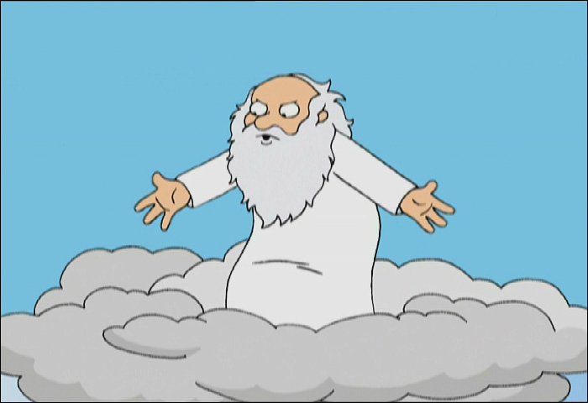
5SSEL026 Language Construction
Why did I give them the Interweb? Because when I gave them language, all they did was whinge at me.
Now they can whinge at each other; let’s see how that works out.

Slide 2
What you do
EITHER
Create a language
Lexis
Imagination,
Experiments,
Ideas,
Construction,
Engagement,
Discovery
Grammar
Phonology
Culture
OR
Create another essay
Reading, Composition, Argumentation, Structure, Breadth, Completeness, Referencing …

Slide 3
How you get there
Project 1:
A report of your created language
PLUS
A translation into your created language
Any questions, just ask
Feel free to interrupt
Read the
module guide
PRODUCE:
OR
Project 2:
An essay on language creation
Feel free to come & go
RESOURCES:
Lectures
Plus Tasks
Plus Handouts
Plus KEATS
Lecture capture
Personal recording

Slide 4
How to contact the lecturer
Office Hour:
Tuesdays
13:00-16:00
Room WBW 3/2
Email:
martin.1.edwardes@kcl.ac.uk
k1216036@kcl.ac.uk
(Checked at least once a day)
By Appointment:
Email me and we’ll arrange something
When you see me around:
I’m sometimes in the Bite Café or restaurant in FWB, or in WBW 3/2, and
I’m always willing to talk
Phone/Text:
07588 730403
(I’m not good at answering the phone, but I try to check for messages at least once a day)

Slide 5
And now …
On with the show …

