Slide 1
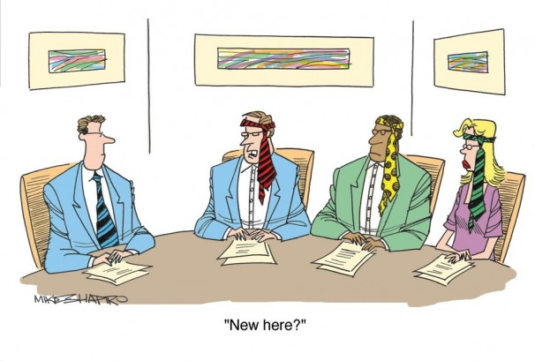
5SSEL026 – Language Construction Lecture 10 Language and Culture

Slide 2
What is Culture?
Culture
Social Organisation
Aesthetics
Values and Attitudes
LANGUAGE
LANGUAGE
LANGUAGE
Law and Politics
Education
LANGUAGE
LANGUAGE
LANGUAGE
Religion and Tradition
Technology and Material Culture
Language
LANGUAGE
LANGUAGE

Slide 3
Identifying a Culture
The Causes of a Culture
The Users of a Culture
The Purpose of a Culture
When
Past? Future? Now?
How long has it existed?
Expanding or declining?
Who
Tribe, nation or empire?
Type of governance?
Friendly or xenophobic?
Restrictive or heterocultural?
Militarist or peaceful?
What
… is sacred?
… is mundane?
… is taboo?
… is disgusting?
… is attractive?
… is expected?
Where
Range of environments?
Size of territory?
Neighbours?
How
… does the culture sustain itself:
Food
Happiness
Cohesion
Reproduction
Why
Religion and tradition?
Ethnicity?
Charismatic leadership?
But remember, you don’t need all of these
just to translate a short text!

Slide 4
Culture & Language: Links
Culture
Language
The Classical model
Language
Culture
The Sapir-Whorf model
Culture
Language
The Modern Synthesis
Culture
Language
The Generativist model
Linguistic Culture
The Integrated model

Slide 5
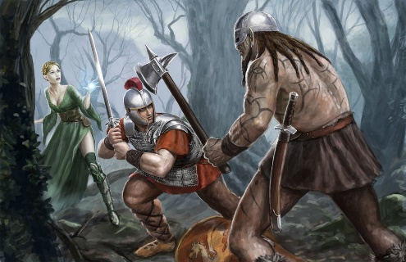
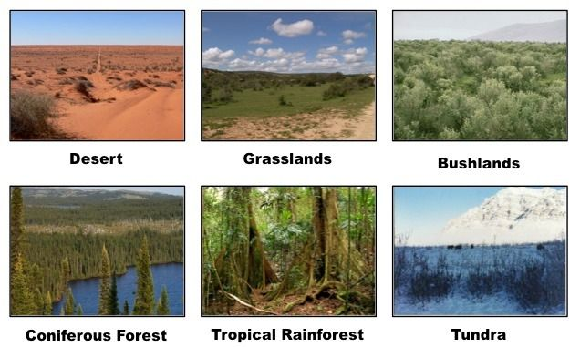
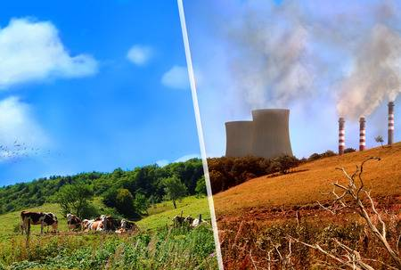
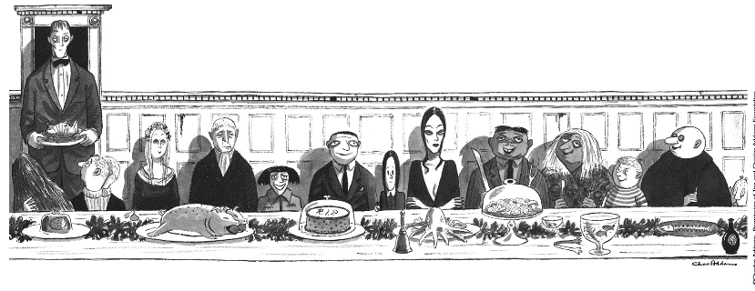
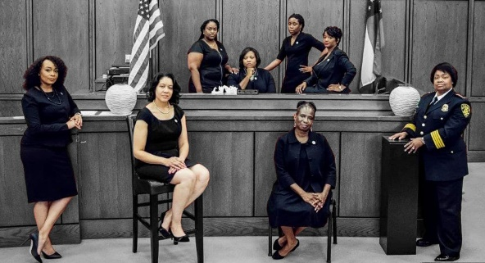
Defining your Culture: Norms
Are they the Good Guys or the Bad Guys?
Environmental context?
How do your speakers behave?
Basic family unit?
Gender roles and relationships?
Stratified Society?

Slide 6
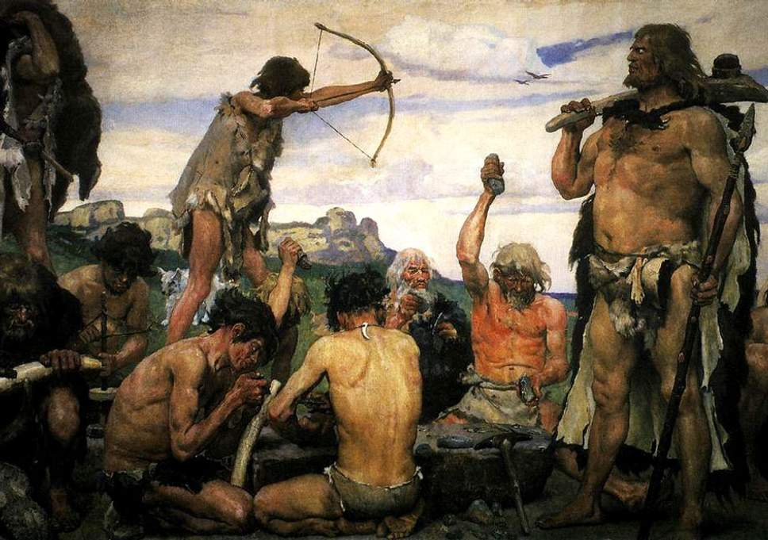
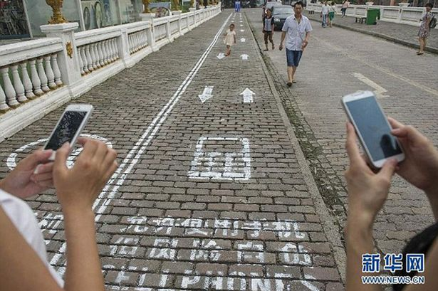
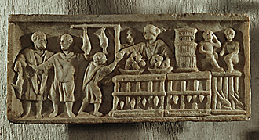
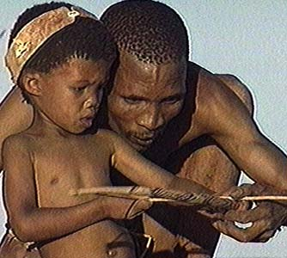
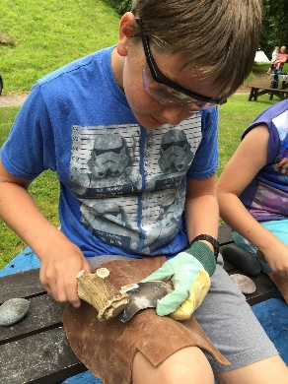
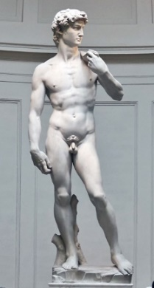
Defining your Culture: Technology
Level of technology
What do your speakers know?
Work & careers
Education & training
Value and worth

Slide 7
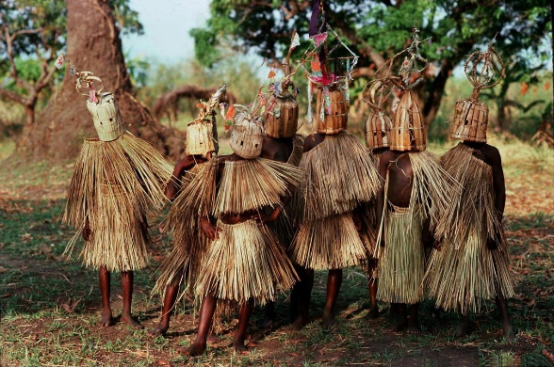
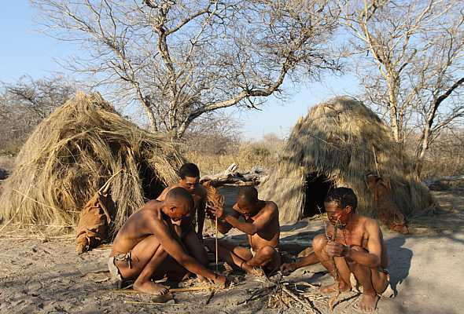
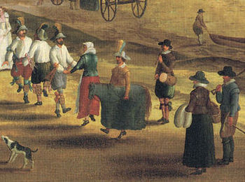
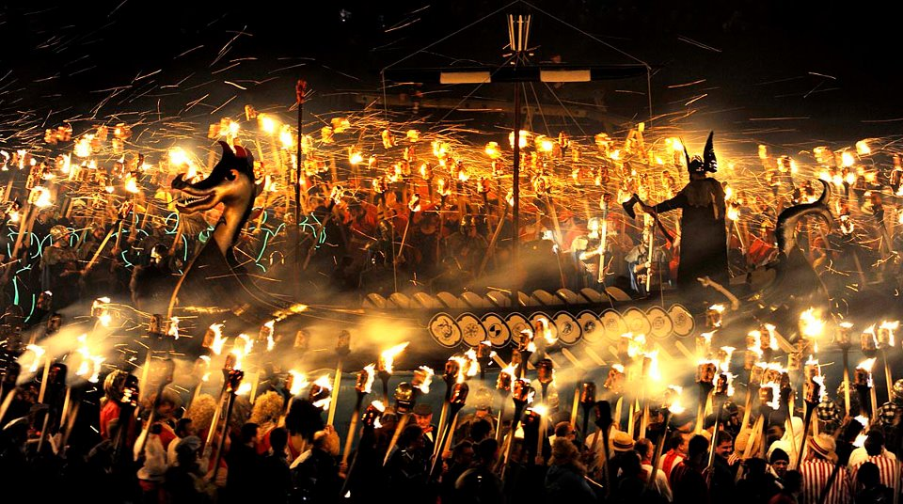
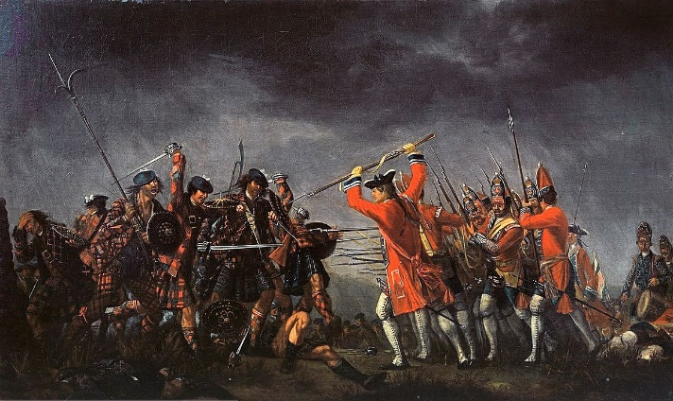
Defining your Culture: Morality
Sacred, mundane and profane
How do your speakers judge others?
Pointless traditions?
Markers of
belonging/
group
membership
Treatment
of strangers

Slide 8
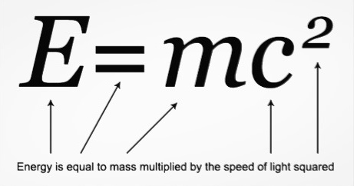
Defining your Culture: What not to include
What not to include
Too much History
Too much theory
Too much Language comparison
Too much language
Too many references
A special script

Slide 9
THIS IS NOT THE END!
The lectures are over.
BUT
The hard work of language creation is still ahead of you.
SO
Keep in contact!
If you have any questions about your language,
ASK ME
If you have any questions about presentation,
ASK ME
If you have any questions about processes,
ASK ME
(although I may refer you to Thomas)
I am not going into hibernation, I am available.
I try to give a same-day email service,
And I can Skype or Zoom or Team.
SO JUST ASK ME!

Slide 10
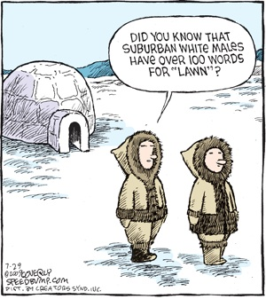
And finally ...

