Slide 1
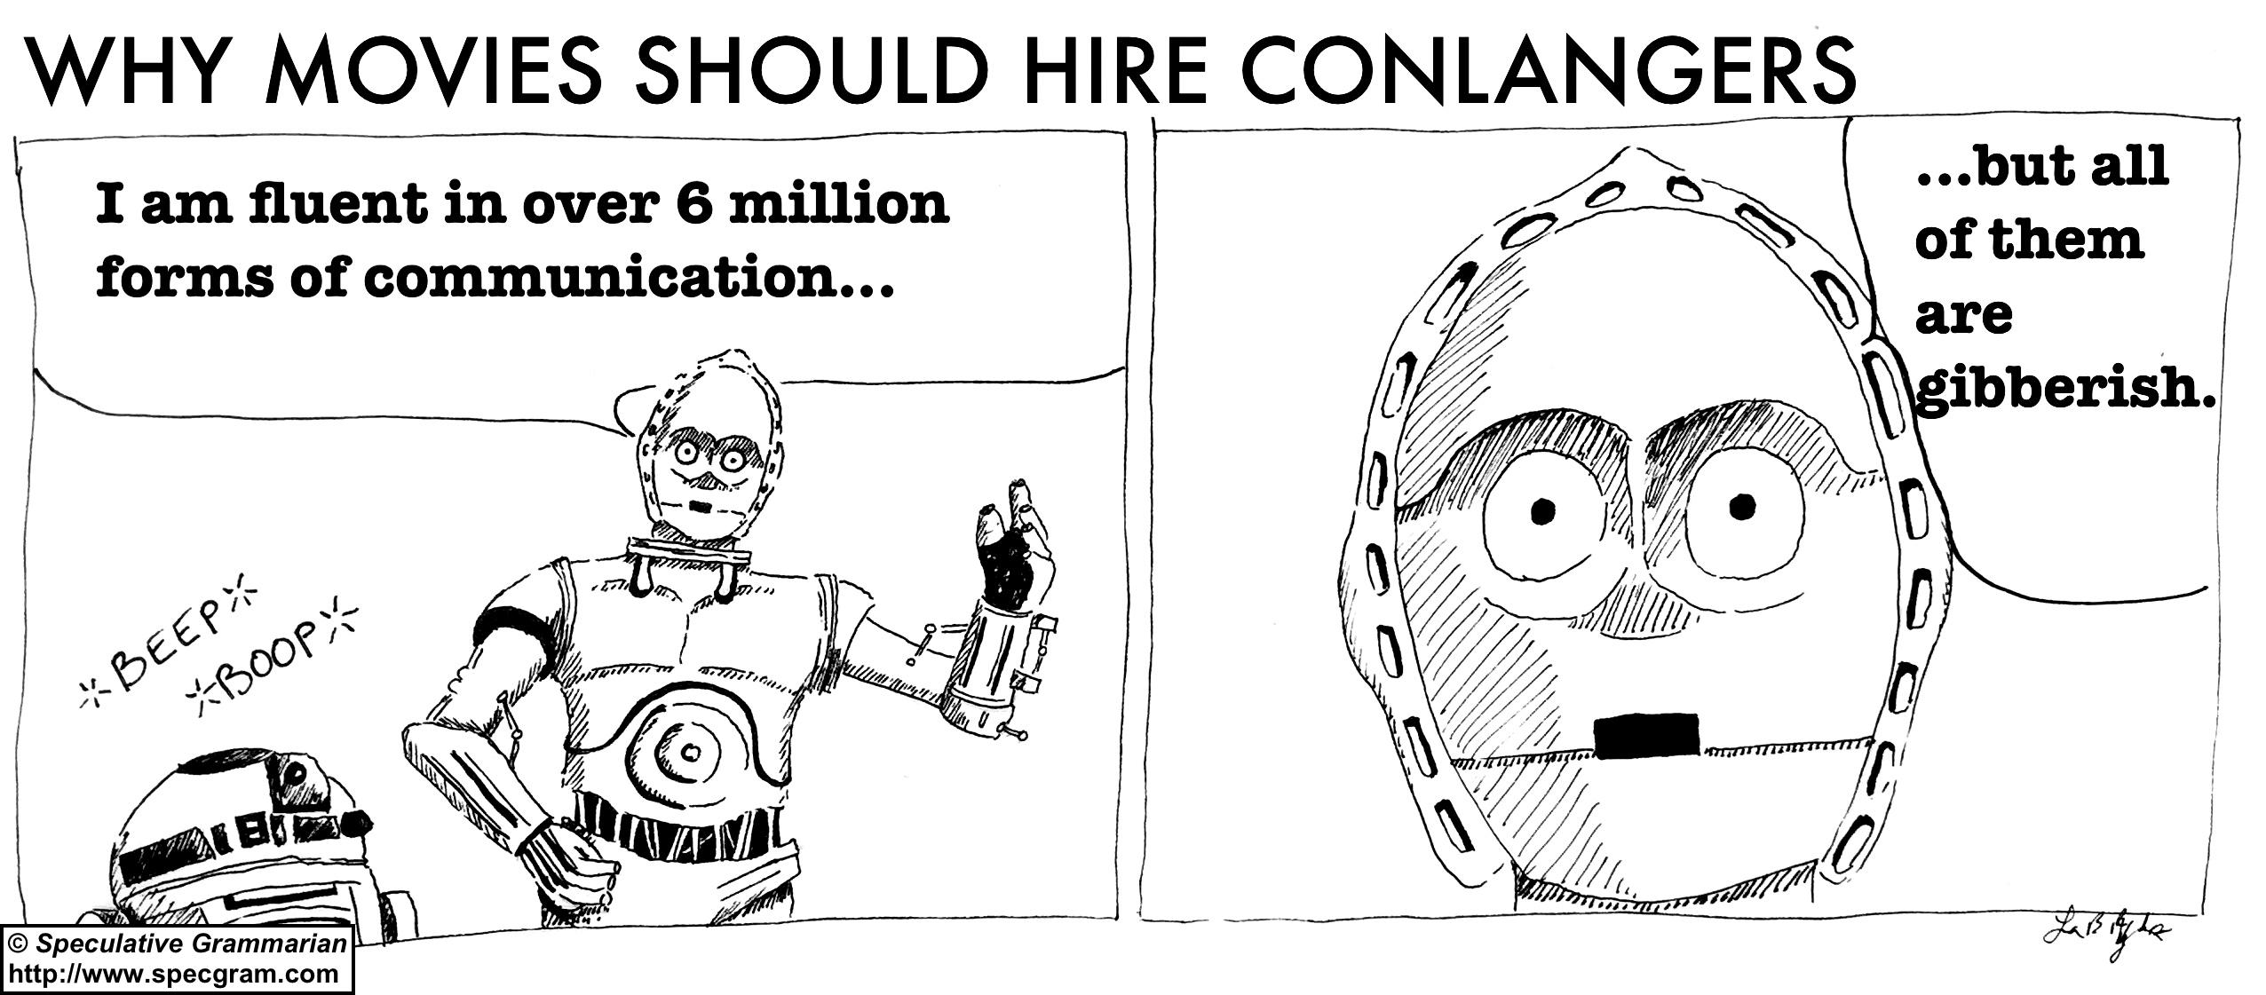
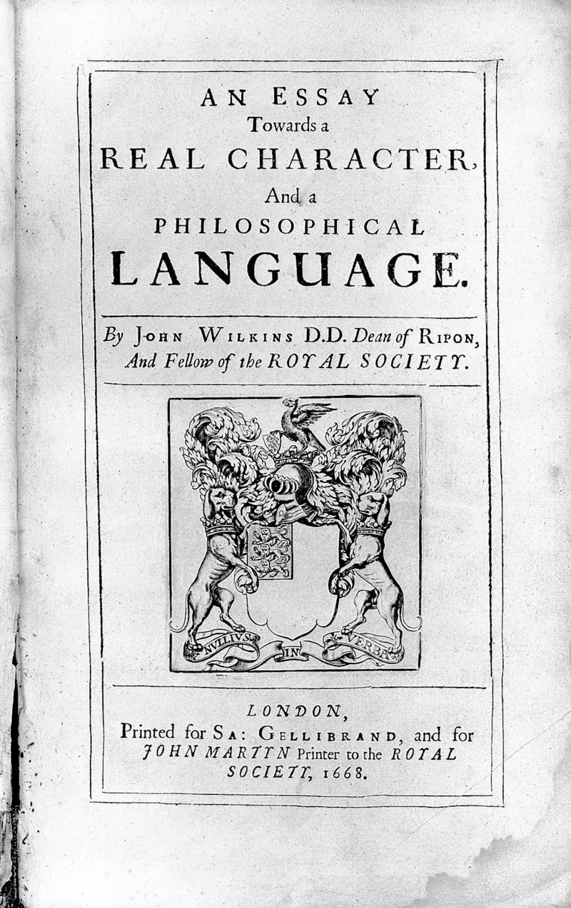
5SSEL026 – Language Construction Lecture 1 The Psychology of Language Creation
One of the first conlangs:
John Wilkins, 1668
No language, not even languages that don’t really exist, should suffer the indignity
of being reduced to sounds with no meanings

Slide 2
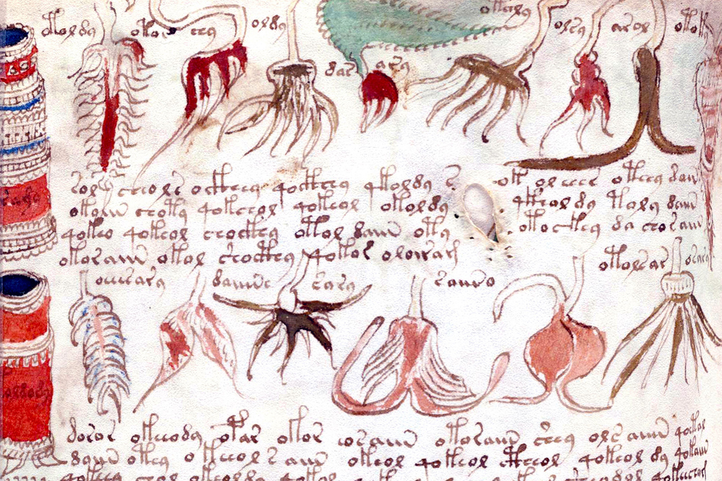
What makes a language: 1
Lexis
Types of words?
Meaning ranges?
Elision & blending?
Specialised word sets?
Excerpt from the Voynich manuscript: is it a real secret script or is it a scam?

Slide 3
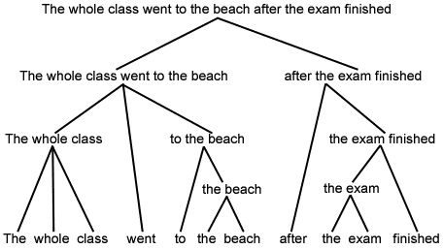
What makes a language: 2
Structure
Two-argument sentence order?
Indirect objects & Multi-argument sentences?
Synthetic or isolating?
Noun declension, Verb conjugation?
One way of analysing the structure of a text

Slide 4
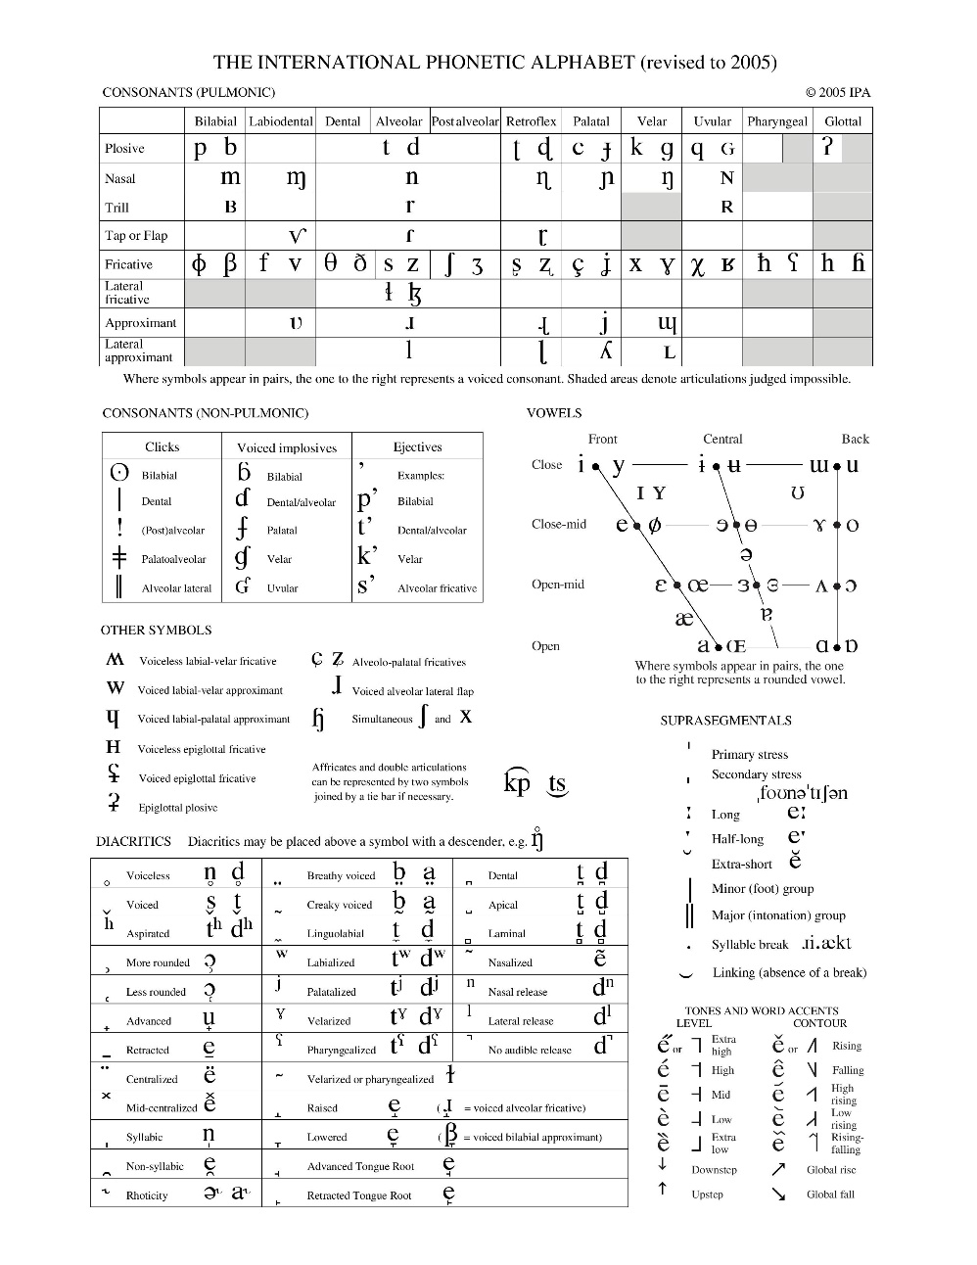
What makes a language: 3
Phonology
What sounds does & doesn’t the language use?
What happens to sounds when they combine?
What effect does nature have on the range of sounds?
Do tones change phatic or semantic meaning?

Slide 5
What makes a language: 4
Function
What defines these speakers as a group?
What needs to be said in this language?
Is the language a subset of another language?
How does it work outside its specialisation?
“There's an old little jingle: 'The chief use of slang is to show that you're one of the gang.' What that means is that every social group has its own linguistic bonding mechanism. If there's a group of lawyers, they have their own slang. If there's a group of doctors, they have their own slang, and so on.”
David Crystal

Slide 6
What makes a language: 5
Culture
Taboos and cultural differences?
Ideological constraints?
Castes and classes?
Official or conventional control?
“The point of my work is to show that culture and education aren't simply hobbies or minor influences. They are hugely important in the affirmation of differences between groups and social classes and in the reproduction of those differences.”
Pierre Bourdieu

Slide 7
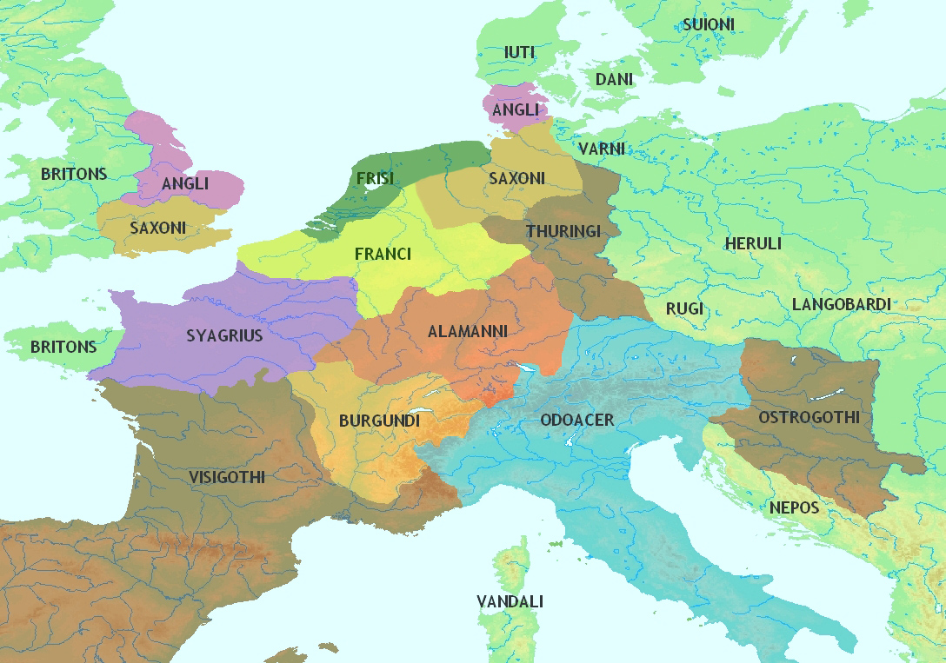
What makes a language: 6
Geography
Neighbourhood effects?
Agricultural fertility?
Geology?
Tonal languages need humidity?
Western Europe ~480CE

Slide 8
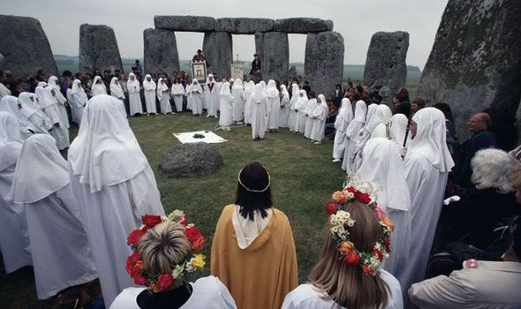
What makes a language: 7
In-group v. Out-group
Is it a secret language?
Shibboleths and complexities?
Movement from out to in: initiation
What makes the in-group special?
“Secrecy is the element of all goodness; even virtue, even beauty is mysterious.”
Thomas Carlyle

Slide 9
What makes a language
Lexis
Types of words?
Meaning ranges?
Elision & blending?
Specialised word sets?
Structure
Two-argument sentence order?
Indirect objects & Multi-argument sentences?
Synthetic or isolating?
Noun declension, Verb conjugation?
Phonology
What sounds does & doesn’t the language use?
What happens when sounds could combine?
What effect does nature have on the range of sounds?
Do tones change phatic or semantic meaning?
Function
What defines these speakers as a group?
What needs to be said in this language?
Is the language a subset of another language?
How does it work outside its specialisation?
Culture
Taboos and cultural differences?
Ideological constraints?
Castes and classes?
Official or conventional control?
Geography
Neighbourhood effects?
Agricultural fertility?
Geology?
Tonal languages need humidity?
In-group v. Out-group
Is it a secret language?
Shibboleths and complexities?
Movement from out to in: initiation?
What makes the in-group special?

Slide 10
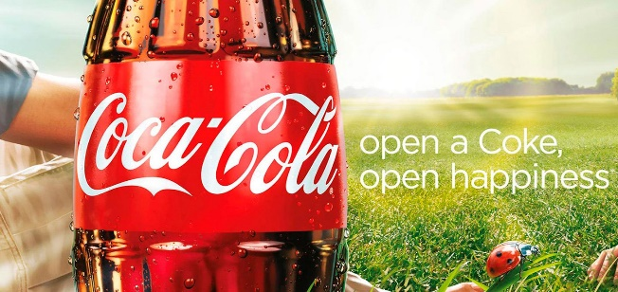
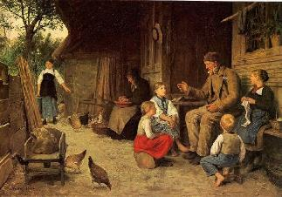
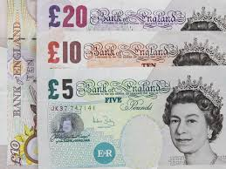
What is language for?
Signalling?
Thinking?
Communication?
Socialisation?
Social Instrument?

Slide 11
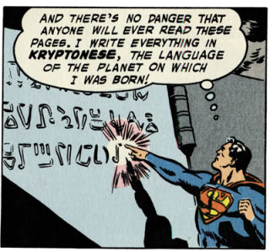
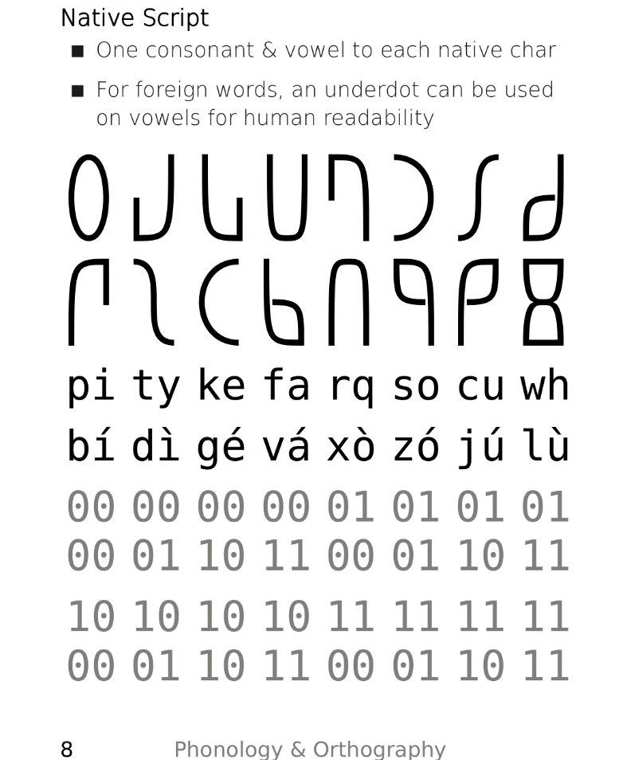
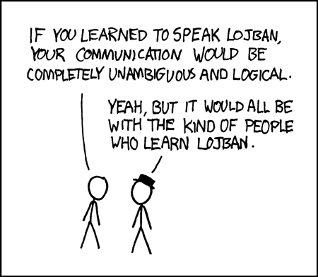
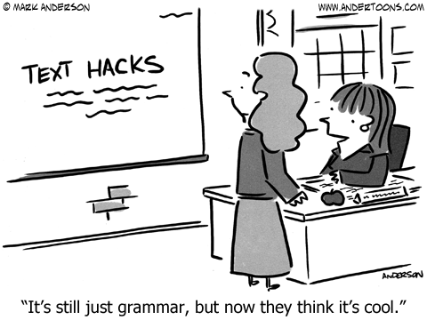
Why create a language
To experiment with structure
To experiment with culture
To experiment with phonology
To make a more effective
method of communication
To experiment with grammar

Slide 12
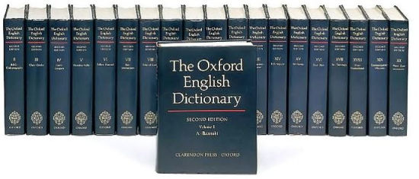
What a conlang cannot do
Become a full language
Explore alien logic
Become a language

Slide 13
Becoming a language creator
Meaning - Lexicosemantics
Iteration
Sounds – Phonetics
Iteration
Iteration
Structure – Grammar & Syntax
Purpose – what, how
Users – who
Meaning Morphs
Culture – when, where, why
Iteration
Structure – Grammar & Syntax
Testing
Acceptance

Slide 14
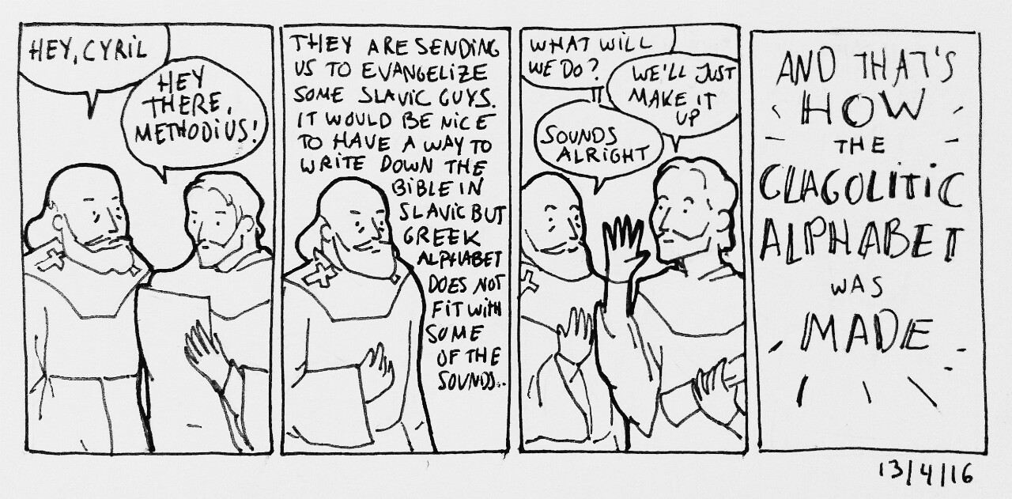
And finally ...
Cyrillic is a conlang script …
But so are the letters J & W, and any language which uses the standard Latin alphabet with diacritics.

