Slide 1
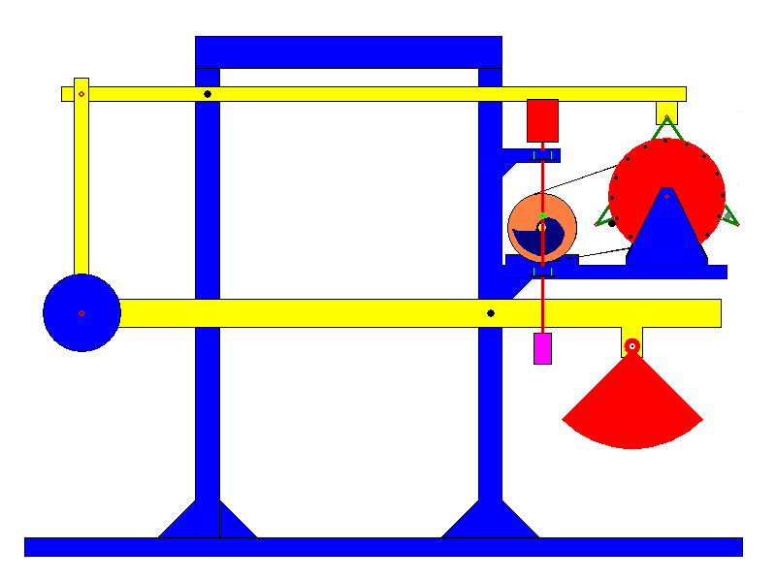
5SSEL026 – Language Creation Lecture 2 Continuous Creation

Slide 2
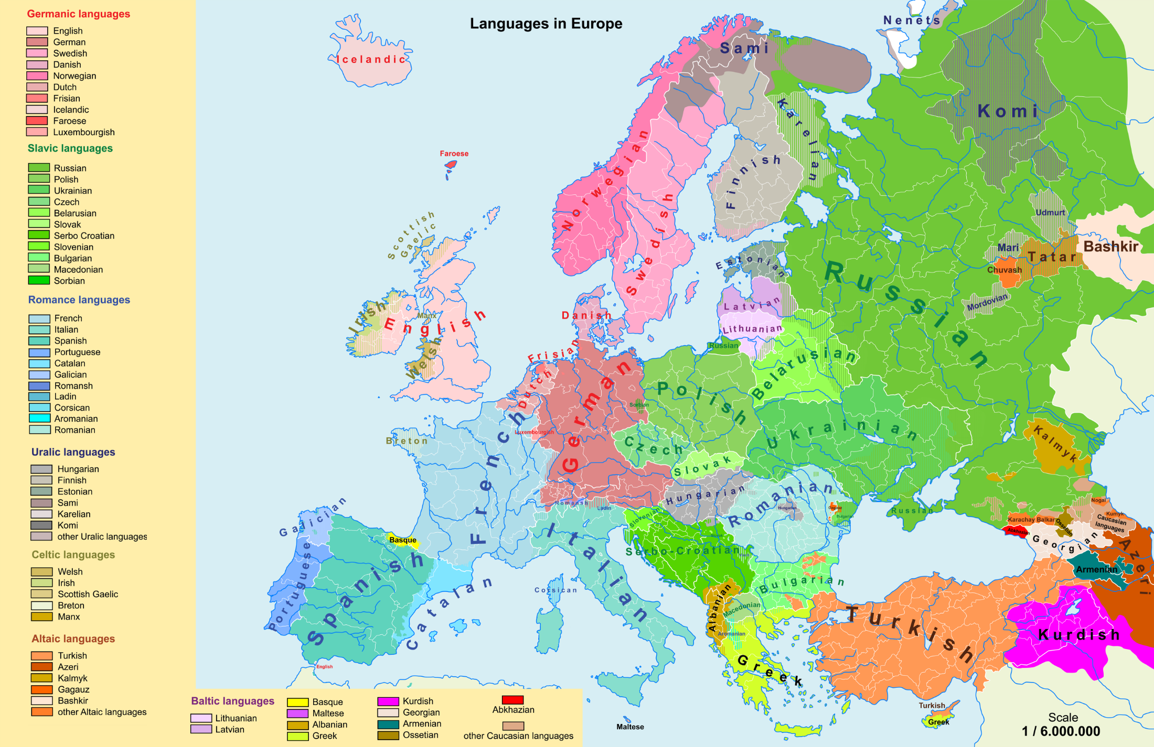
What counts as a language?

Slide 3
Grammaticalization
Agglutinating
Latin
Flavia
Romae
To + Rome
Advenit
Towards + Go + tense
Fusional
English
Flavia
Went
Go + tense
To
Rome
Isolating
BSL
Flavia
Go to
Rome
Before
English
External influence
e.g. Norman French
English has undergone:
Internal Subgrouping
e.g. Regional dialects
Language Drift
e.g. Great Vowel Shift
Cultural Constraint
e.g. Standard English

Slide 4
Typing of Languages
Isolating:
Book (N) = Book (N)
Analytic:
Book (N) ⇨ Book (V)
Over + book (Adj + V) = Overbook (V)
Synthetic - Agglutinative:
Over + book + ed (Adj + N + [past]) = Overbooked (V-past)
Synthetic - Fusional:
Joan’s overbooked (’s represents is AND indicates intransitivity)
Synthetic - Polysynthetic:
In + dubious - ious + it + able – e + y = Indubitably (holistic utterance)
Synthetic - Oligosynthetic:
Un + prove - e + able = Unprovable
English is an isolating, analytic, agglutinative, fusional, polysynthetic, and possibly oligosynthetic language
Or, to put it another way, these are not types of language, they are strategies that languages can use

Slide 5
Gender
Different languages divide up
the gender space differently
Feminine
Neuter
Masculine
French
Animate
Person
Woman
Child,
Person
Man
Other animal
Mare
Foal,
Horse
Stallion
German
Inanimate
Concrete inanimate
House
Brick,
Town
Wall
Abstract
Actuality,
Difficulty
Whole,
Nothing
Ideal,
Hope
Euskera
Feminine and Masculine are conventional terms for how we divide up the lexical landscape. They do not necessarily correspond to logical sexes – or even genders, in the conventional meaning of the word gender.
Latin

Slide 6
Case
Alf,
your dog
chased
Beth’s
cat
Vocative
(listener)
Nominative
(subject)
Genitive
(attributee)
Accusative
(object)
with
alacrity
into
the barn
Instrumental
(type of chase)
Dative
(recipient of chase)
out of
spite
before
lunch
Ablative
(movement away)
Locative
(position in time or space)

Slide 7
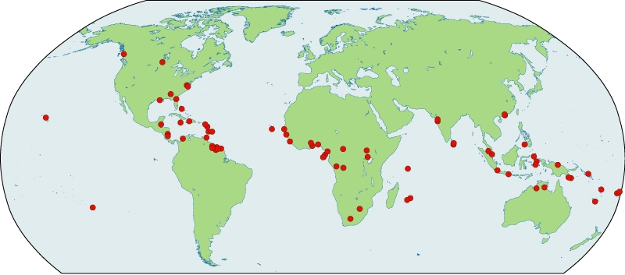
Contact Languages
Current pidgins and creoles shown in red
This?
Or this?

Slide 8
Negotiation toward Meaning
Does he believe that I intend that he believes that I intend that he believes what I am saying?
Is he listening?
Does he understand?
I don’t understand!
ghfb
ghfb
Pardon?
Scott-Phillips’ Signalling of Signalhood
Negotiation toward Meaning

Slide 9
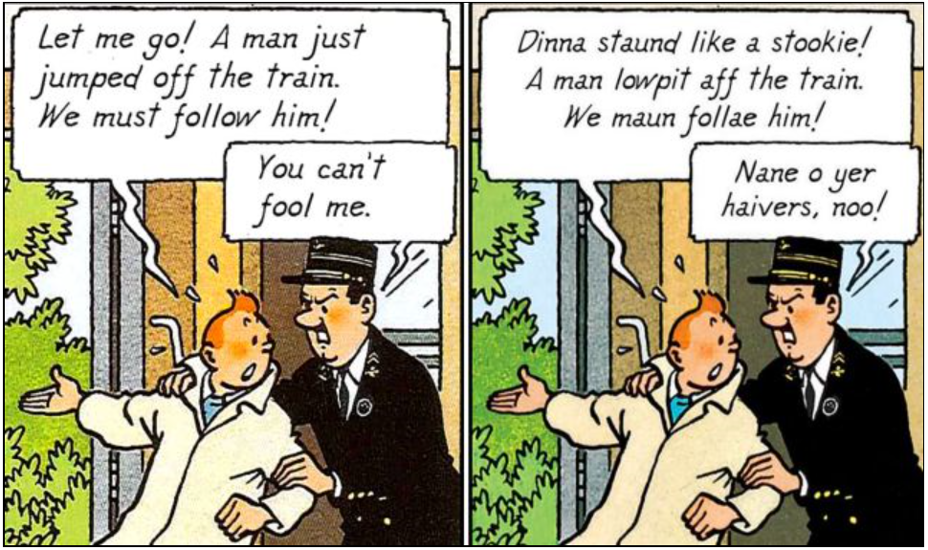
And finally ...

