Slide 1
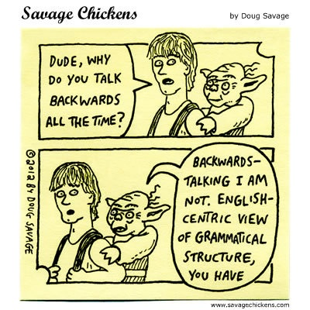
5SSEL026 – Language Construction Lecture 3 Grammar 1

Slide 2
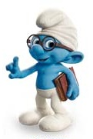
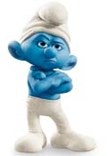
Dilemmas of Language
The Sender’s Dilemma
This guy is offering information voluntarily
Why should I give away valuable information?
This information could be true or false
Valuable Information
Valuable Information!
If true, I gain; if false, he gains
Why should I believe him?
The Receiver’s Dilemma
No Smurfs were harmed in the making of this slide

Slide 3
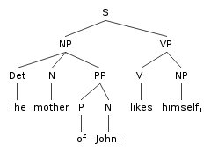
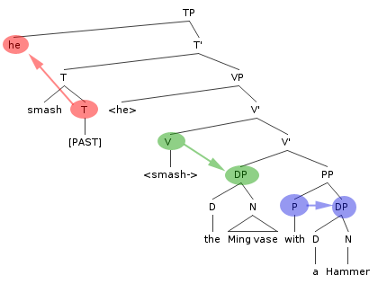
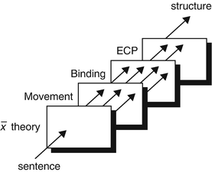
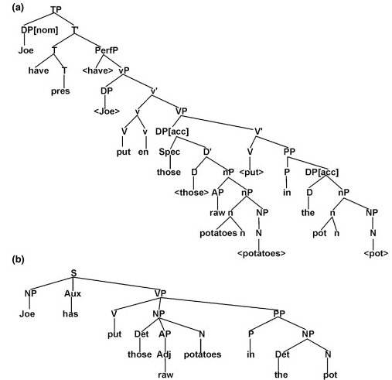
What is Grammar (1)?
Principles & Parameters
Deep to Surface Structure
Government and Binding

Slide 4
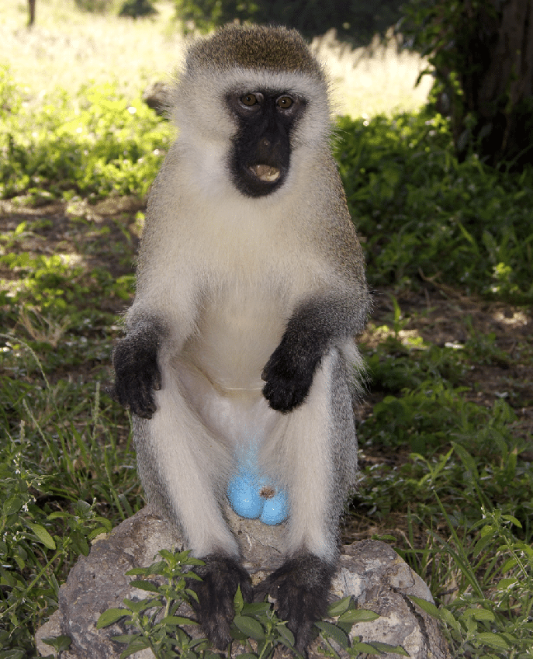
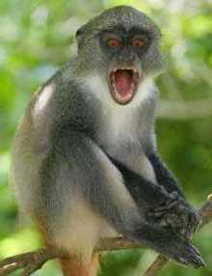
What is Grammar (2)?
Vervet Monkey
Bark = leopard
Grunt = eagle
Chutter = snake
Campbell’s Monkey
Krak = leopard
Hok = eagle
Krak’oo = leopard, probably
Hok’oo = eagle, probably
Blue Monkey
Warnings = pyows & hacks
Pyows only = leopard
Hacks and pyows = eagle
More hacks than pyows= eagle near
Longer delays between pyows =
eagle or leopard far away
Each call relates to a single predator (the object), so no syntax or grammar is needed

Slide 5
The Basic Components
Nouns:
Objects;
People;
States
Verbs:
Processes which can be initiated by, or act upon, nouns
One-argument form
Two-argument form
Noun
Verb
Noun
Verb
Noun
Summary of events

Slide 6
Nouns, Compounds & Phrases
Types of Noun
Proper noun:
Names a specific thing: a person, place, time or object (but is a process like Brexit proper enough?)
Concrete noun:
Something you can touch, see, hear, taste or smell
(but you can smell fear; is fear concrete?)
Abstract noun:
An idea, quality or state; an intangible concept
(but a unicorn is an intangible concept; does that make it abstract?)
Common noun:
Any other noun.
Noun Compounds
A noun compound consists of more than one word, all of which are nouns, e.g. book shelf. You can differentiate noun compounds from noun phrases with two tests.
The B is/are A: e.g. the shelf is book. If this sounds strange, it is probably a noun compound.
B of As: e.g. shelf of books. If this sounds OK, it is probably a noun compound.
But English word classes are breaking down; e.g. is mammal in mammal species a noun or an adjective? These tests are not perfect.
Noun Phrases
Coming soon to a lecture room near you:
Qualifiers Awake!
Thrill to the versatility of the Adjective! Be amazed by the sheer raw power of the Determiner! Marvel at the strange Deictic Force unleashed in …
Qualifiers Awake!

Slide 7
Noun Clauses
MERGE
Joan
saw
the man
the man
was wearing
the hat
Joan
had bought
the hat
MOVE
Joan
saw
the man
was wearing
the hat
Joan
had bought
the hat
MOVE
the man
Joan
saw
was wearing
the hat
Joan
had bought
the hat
MERGE
the man
Joan
saw
was wearing
the hat
the hat
Joan
had bought
the man
Joan
saw
was wearing
the hat
Joan
had bought

Slide 8
Nouns and Number
English has singular and plural affixes
Does your language have more?
Or less?
Or the same?
English has an open-ended adjectival number system
Is your number system open or closed?
What is the counting base?
Do you put bigger numbers to left or right?
Do you have words for larger numbers?
English has cardinal and ordinal number systems
Does your language have both counting (cardinal)
and ordering (ordinal) words?
Does it have culturally significant numbers?
Does it have genetically significant numbers?
English has some number affixes
(bi-, duo-, tri-, quadri-, penta-…)
Does your numbering system use number affixation?
Is it open or closed? (In one open system, new chemical elements are initially given number names, e.g. ununtritium = 113, ununquadrium = 114.)

Slide 9
Verbs and Verb Types
Some English verbs can work with one argument, some need two arguments, some need three.
English verbs are of four types: main, linking, auxiliary and modal.
While English is generally a fusional language, the verb system is mostly isolating.
Modal
Can
Could
May
Might
Must
Shall
Should
Would
Auxiliary
Be
Do
Have
Will
Going to
Linking
Appear
Be
Become
Feel
Get
Look
Remain
Etc.
Main
All the other verbs, which can be:
Actions;
Events;
States.
How does your language handle verbs?

Slide 10
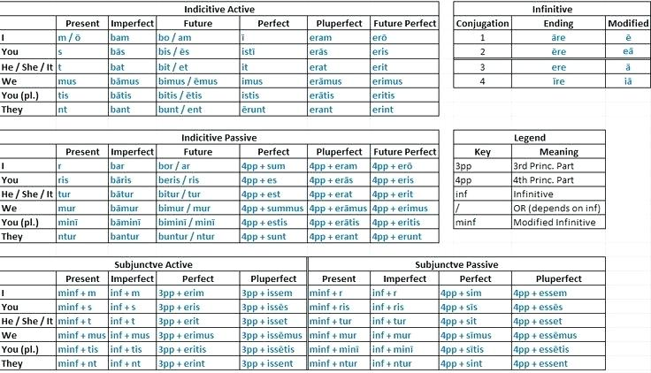
Conjugation of Verbs
Latin Master Verb Chart
Imperfect = “is going”
Perfect = “went”
Pluperfect = “had gone”
Future Perfect = “will have gone”
Subjunctive = Modal, Conditional
Videssemus:
We may have been previously seen

Slide 11
Features of Tense
Which tense system
Systemic Functional tense system?
Reichenbachian tense system?
Something else?
Forming a tense
Point of Speech: When the utterance is made. Almost always treated as the Present.
Point of Reference: The point in time from which the speaker observes the event of the verb.
Point of Event: The point in time when the event happens, relative to point of reference, not point of speech.
Modality: The point in probability space where the event happens.
Continuity
The event of the verb may be ongoing at the Point of Event. In English this is marked by the present participle, x-ing; e.g. I am going, I will have been sleeping.
Imminence
The distances between the Points of Speech, Reference and Event. English can introduce imminence with adverbials; e.g. I will soon have previously done it.
Connectiveness
The temporal relationship between this utterance and other utterances; the ordering of events in a tale; e.g. She went to the market and ate a pie after she had bought it.

Slide 12
Grammar is …
Like everything metaphysical, the harmony between thought and reality is to be found in the grammar of the language.
Ludwig Wittgenstein
No important national language, at least in the Occidental world, has complete regularity of grammatical structure, nor is there a single logical category which is adequately and consistently handled in terms of linguistic symbolism.
Edward Sapir
Forming grammatically correct sentences is for the normal individual the prerequisite for any submission to social laws. No one is supposed to be ignorant of grammaticality; those who are, belong in special institutions. The unity of language is fundamentally political.
Gilles Deleuze
He just keeps saying “getbrexitdone”, as if it were a magic formula to resolve all ills. It is typical of the man that he uses an imperative, where the responsibility to “getbrexitdone” is everyone’s and no one’s, but most definitely not his.”
Anon

Slide 13
And finally ...

