Slide 1
2020 BA ELL Poster Competition
WHAT YOU DO
Create a dynamic and informative poster reflecting any area of linguistics
PRIZES
For each year group:
1st prize of £125
and
2nd prize of £75
Posters can be viewed on
Tuesday 11th February
12:30 to 1:30pm
in FWB 1.60
TO TAKE PART
send an email to l.sankaran@kcl.ac.uk before 5th February, giving:
The title of the poster
Name(s) of participant(s)
Type of poster (digital or printed)
Individual and group entries are welcome
If you produce a printed poster you will be reimbursed for your printing costs.
You can submit a poster even if you cannot attend the poster competition itself.

Slide 2
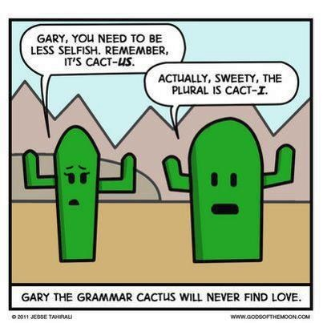
5SSEL026 – Language Construction Lecture 4 Grammar 2

Slide 3
From Two- to Three-argument Forms
Merging and moving two-argument forms
Joan saw the man;
the man was wearing the hat;
Joan had bought the hat

The man Joan saw was wearing the hat Joan had bought

You can merge objects with subjects, or objects with objects, but not subjects with subjects – because the two subjects are performing different actions; and you can only merge two noun phrases, not three.
Ditransitives & Three-argument Forms:
Don’t look for regularity in English
I gave a biscuit to Joan
⇨ I gave Joan a biscuit
I made a biscuit for Joan
⇨ I made Joan a biscuit
I elected Joan as Captain
⇨ I elected Joan Captain
BUT
I introduced a friend to Joan
⇨  I introduced Joan a friend
I made a biscuit for lunch
⇨  I made lunch a biscuit
I introduced Joan as a friend
⇨  I introduced Joan a friend

Slide 4
The Obligatory Three-argument Form
Joan
[Event]
put
the book
[Event]
on
the table
Subject
Verb
Direct Object
Adposition
Indirect Object

Slide 5
Segmentation, Differentiation, Hierarchy
put
Verb
Action
Past
The
Determiner
Belongs to…
cat
Noun
Concrete
Animate
a
Determiner
Belongs to…
paw
Noun
Concrete
Animate?
on
Adposition
Spatial
Relation
But … is Hierarchy a true feature of language,
or is it imposed on language by post hoc human analysis?
the
Determiner
Belongs to…
mat
Noun
Concrete
inanimate

Slide 6
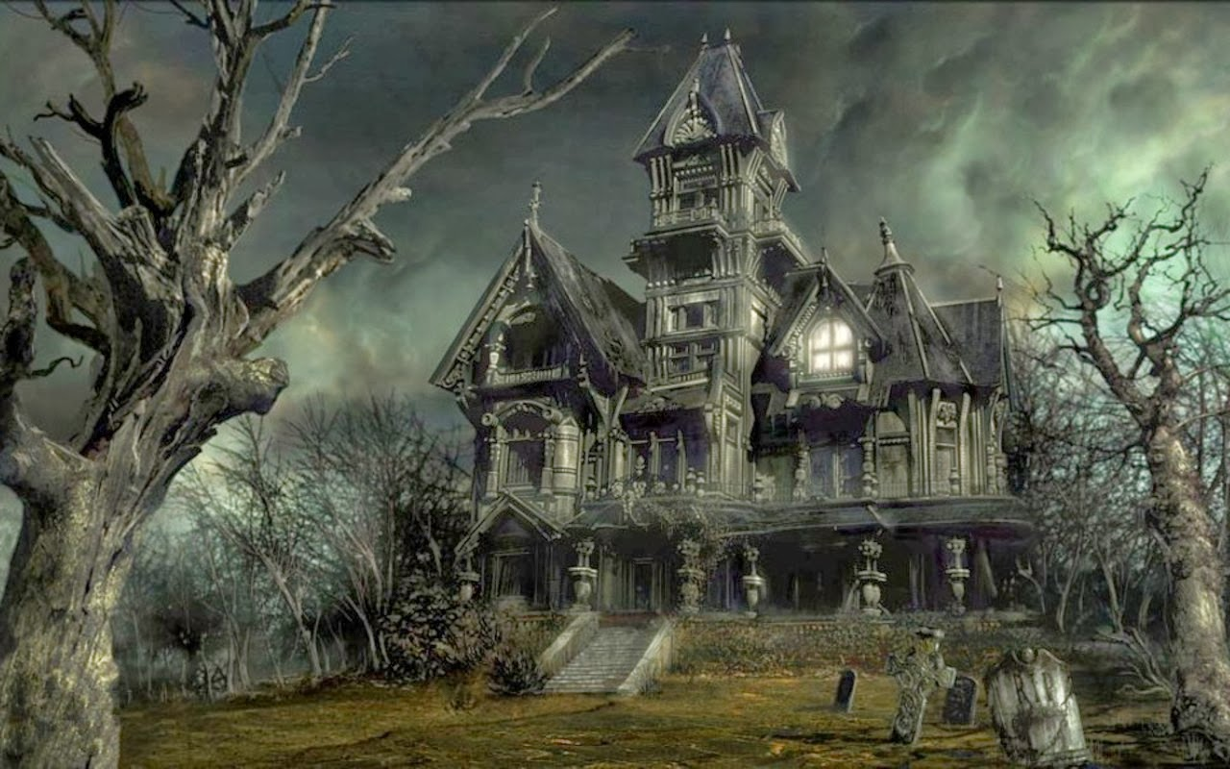
The Language You Couldn’t Make Up
English does not have postpositions, only prepositions
However …
I am warming towards the idea ⇨ This is the idea I am warming towards
In despair at this flagrant flouting of their prescriptive rule some grammarians insist:
You cannot end a sentence with a preposition
So:
This is the idea towards which I am warming
… and everyone lived happily ever after.
Until:
I am putting out the fire ⇨ This is the fire I am putting out
⇨ This is the fire out which I am putting
The moral of this story is:
English is not A set of regulations,
it is a living nightmare language

Slide 7
Adpositions: Making the Connection
Haven’t I seen this somewhere before?
I saw a cottage with binoculars
I saw a cottage with chimneys
I saw a cottage with Snow White
I saw a cottage with surprise
Yes, and you’ll be seeing it again …

Slide 8
Ganged up on by Adpositions
Joan
put
the book
on
the table
Subject
Verb
Direct Object
Adposition
Indirect Object
Made into a passive by
The book
was put
on
the table
by
Joan
Grammatical Subject
(Logical Direct Object)
Passive Verb
Adposition
Grammatical Indirect Object
(Logical Indirect Object)
Passive Adposition
Grammatical Indirect Object
(Logical Subject)
Be careful with Phrasal Verbs
Where does the verb end and the adpositions begin?
[Joan went out] [in a coat]
[Joan stayed out] [for the night]
BUT
[Joan put up] [with a lot] OR [Joan put up with] [a lot]?
[[[Joan got] down] out] [of] [the carriage]???
Does your language have phrasal verbs or would get down out of be a single verb?

Slide 9
Adjectivals: Describing Nouns
Attentional Interpretation
Hearing
Sight
Smell
Taste
Touch
Affects (emotions)
Senses
Functions
Adjectives
Differentiate Nouns
Describe Nouns
Describe Adjectives
Initiate Metaphors

Slide 10
Adverbs: Qualifying and Modifying
Adverbs
Manner
Place
Time
Frequency
Certainty
Emphasis
Degree
Negation
Verb
Verb
Verb
Verb
Adjective
Adjective
Deixis
Noun
Noun
Tense System
This is the English system of adverbs.
Other languages have other systems (see Wikipedia – Adverbs).
Feel free to adopt your own system of adverbials in your language.

Slide 11
Deixis and Determining
Deixis means pointing.
You can point with the finger, the elbow, the nose, the foot, your gaze, head movements … or sounds.
Language is embodied: if you can do it with your body, you can do it with words.
Deixis is a major tool of human communication.
It establishes joint attention, enhances negotiation toward meaning, and enables joint enterprise.
Deixis can use …
Verbs
Move, Place, Drop, Gather, Include, etc.
Deixis can use …
Adpositions
Into, Between, Over, Beside, Towards, etc.
Deixis can use …
Adjectives
Left, Far, Early, Underground, Sitting, etc.
Deixis can use …
Nouns
Any named object used as a landmark
Deixis can use …
Adverbs
Here, There, Now, Today, Eventually, etc.
Go
up
the
Left-hand
pathway
there
Determiners are just another form of adjectival deixis.
They are not available in all languages.
Should you wish, you can scrap articles (a, some, the)
and treat other determiners (e.g. this, that, yon) as adjectives.

Slide 12
A Simpler System
really incredibly sweet blackberries
⇩
[really [incredibly [sweet [blackberries]]]]
⇩
[adverb [adverb [adjective [noun]]]]
really
incredibly
sweet
blackberries
Becomes
Reality-c
[thing not believed]-b
Sweetness-a
blackberries
All qualifiers are nouns
It is extensible:
Really very incredibly sweet and juicy blackberries
Becomes
Reality-c
[large set]-c
[thing not believed]-b
Sweetness-a
juiciness-a
blackberries

Slide 13
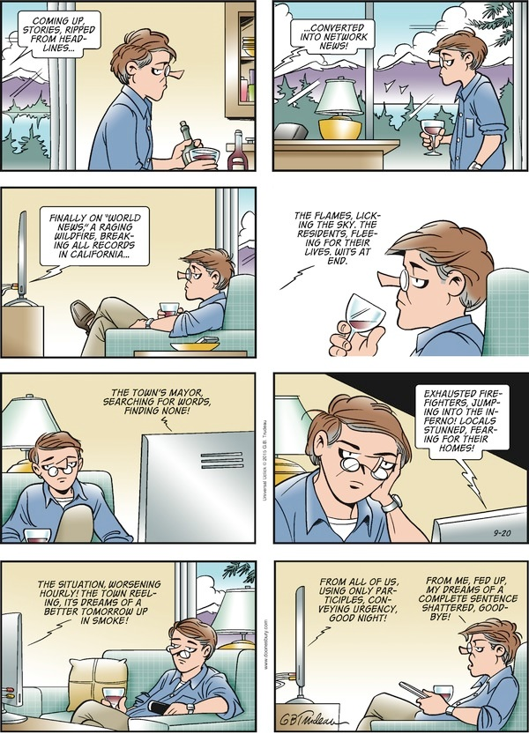
And finally ...

