Slide 1
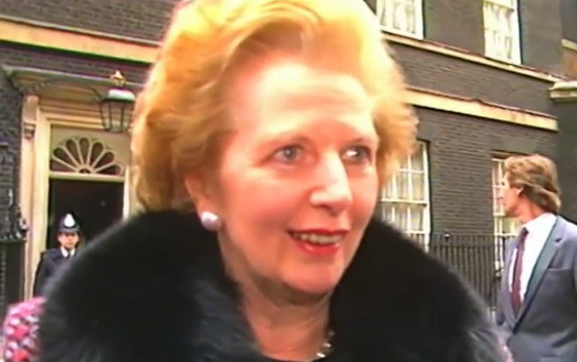
5SSEL026 – Language Construction Lecture 5 Grammar 3
“We are a Grandmother.”

Slide 2
Pronouns: The roles in communication
The Event
The Process
The Communication
The Roles
The Language
Instigator
Source
Speaker
First person
Subject
Action
Relationship
Message
Utterance
Verb + Adposition
Recipient
Destination
Listener
Second person
Object
Event
Cause
Referent
Third person
Indirect object

Slide 3
Pronouns: Where they came from
Third Person Singular
Object
Her/Him/It
Communication
Third Person Singular
Subject
Joan/He/It
Third Person Plural
Subject/Object
They/Them
Second Person Singular
Object
You
Second Person Plural
Subject/Object
You
Second Person Singular
Subject
You
First Person Singular
Subject
I
First Person Plural
Subject/Object
We/us
… but there are seven types of we
First Person Singular
Object
Me

Slide 4
Pronouns: The English Choices
Person | Subject Singular | Object Singular | Subject Plural | Object Plural
Third | Joan/He/It | Her/Him/It | ---/---/They | ---/---/Them
Second | ---/---/You | ---/---/You | [You & one other] You | [You & one other] You
 |  |  | [You & your group] You | [You & your group] You
First | I | Me | [Me & You] We | [Me & You] Us
 |  |  | [Me & another, not You] We | [Me & another, not You] Us
 |  |  | [Me & our group] We | [Me & our group] Us
 |  |  | [Me & my group, not You] We | [Me & my group, not You] Us
 |  |  | [Everyone] We | [Everyone] Us
The gendering used here is a particular interpretation.
If your culture marks gender in other ways, your chart will be different.
If your culture is heavily gendered you can also mark gender on the plurals, giving you up to four plural forms (male, female, ungendered, mixed). You can even mark gender on first person singular.

Slide 5
Pronouns: Possession
Person | Adjectival Singular | Nominal Singular | Adjectival Plural | Nominal Plural
Third | Her/His/Its | Hers/His/Its | ---/---/Their | ---/---/Theirs
Second | ---/---/Your | ---/---/Yours | [You & one other] Your | [You & one other] Yours
 |  |  | [You & your group] Your | [You & your group] Yours
First | My | Mine | [Me & You] Our | [Me & You] Ours
 |  |  | [Me & another, not You] Our | [Me & another, not You] Ours
 |  |  | [Me & our group] Our | [Me & our group] Ours
 |  |  | [Me & my group, not You] Our | [Me & my group, not You] Ours
 |  |  | [Everyone] Our | [Everyone] Ours
Adjectival forms acknowledge ownership.
Nominal forms establish ownership.
If your culture does not acknowledge possession, your language is unlikely to have possessives (e.g. Pravic).

Slide 6
Pronouns: Reflexive & Interrogative
Interrogative Pronouns
Reflexive Pronouns
She, He, They
Who, Whom, Whose
Person | Singular | Plural
Third | Herself/Himself/Itself/Themself | ---/---/Themselves
Second | ---/---/Yourself | [You & one other] [You & your group] Yourselves
First | Me, Myself | [Me & You] [Me & another, not You] [Me & our group] [Me & my group, not You] [Everyone] Ourselves
It, They
What, Which
But what about…
Today, Yesterday,
in a minute
When
Here,
There,
Yon
Where
Because?
Like this?
Why and How

Slide 7
Conjunctions
Coordinating Conjunctions
Join two items of equal grammatical weight
Provide a balance point between the two items
Subordinating Conjunctions
Make the first item dependent upon the second item
Link the two items into a chain of events
Correlative Conjunctions
Act as a two-argument/component conjunction
Link the two items in a co-dependent relationship

Slide 8
Conjunctions: Coordinating
Coordinating Conjunctions
There are only seven of these:
for, and, nor, but, or, yet, so
Represented by the acronym FANBOYS
Coordinating Conjunctions can also occur between:
Noun Phrases
Joan ate [the pear]
but [not the apple]
Coordinating Conjunctions can occur between:
Verb Phrases
The dog [was tired]
so [went to sleep]
Nouns
Joan or Mary
Adposition’l Phrases
They left [without a farewell]
but [with the takings]
Joan and her
Pronouns
her and them
Main Clauses
[The dog was tired]
so [it went to sleep]
Adjectives
silent and deadly gas
Subordinate Clauses
We saw the dog [which was tired] yet [which did not sleep]
Adverbs
go quietly and stealthily
Verbs
I must stop and look
Don’t forget that a noun or pronoun can also be a noun phrase,
and a verb can also be a verb phrase;
but an adposition cannot be an adpositional phrase.
Adpositions
up and down the road

Slide 9
Conjunctions: Subordinating
Subordinating Conjunctions
There are many of these, for example:
after, although, as, as if/though, because, before, by the time, even if/though, if, in order that, in order to, in case, lest, once, only if, provided that, since, so that, than, that, though, till, unless, until, when, whenever, where, wherever, while
Most subordinating conjunctions work the same way as coordinating conjunctions: they link language units of the same type but not of different types. However, there is a subset of conjunctions which break this rule, for example:
after, as, before, if, since, than, until, when, while
Joan ate the apple after/before the pear
Joan ate the apple although/because/in case/since/whenever/where/wherever/while she ate the pear
Joan ate the apple as an appetiser
Joan would eat the apple as if/even if it tasted sour
Joan had eaten the apple by the time/when she ate the pear
Joan could eat the apple if/only if/provided that it tasted sour
Joan ate the apple in order that/so that/until she could eat the pear
Joan ate the apple in order to eat the pear
Joan ate the apple once/though she had eaten the pear
Joan has eaten the apple since she ate the pear

Slide 10
Conjunctions: Correlative
Correlative Conjunctions
These are used in pairs, for example:
as ... as
both ... and
either ... or
just as … so
neither ... nor
not ... but
not only ... but also
such … that
whether ... or
As good as gold
(adjectival phrase/noun phrase)
Both happy and sad
(equal items)
Either coming or going
(equal items)
Just as he arrived, so he left
(equal items)
Neither fish nor fowl
(equal items)
Not a fever but feverish
(mix-n-match)
Not only did they make the bed, [but] they also tidied the bedroom (it’s complicated)
She made such a mess that nobody could clean it up
(noun phrase/main clause)
Whether the weather was good or bad; Whether it was day or night
(main clause/adjective; main clause/noun)

Slide 11
Discourse Features
Syntax & Grammar
Lexical choices
Context
DISCOURSE
Subtext
Culture & Pragmatics
Genre
Interpersonal relationships

Slide 12
And finally …

