Slide 1
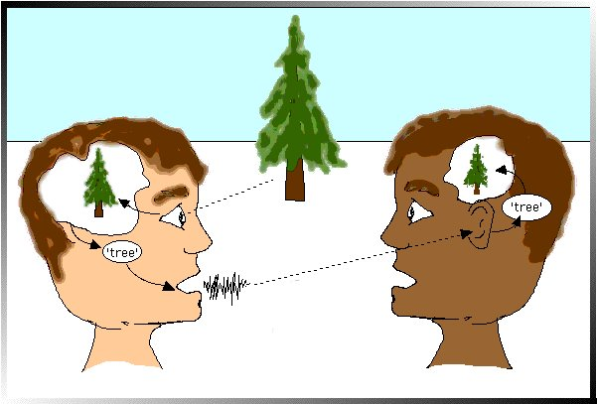
5SSEL026 – Language Construction Lecture 6 Doing Things with Words
This is how language doesn’t work

Slide 2
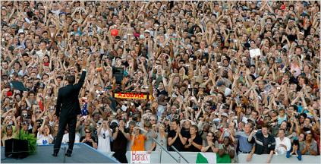
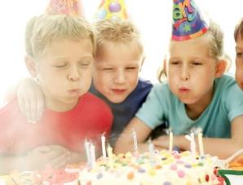
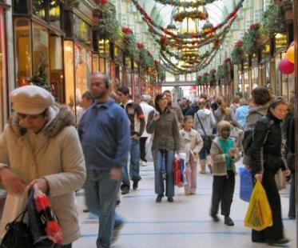
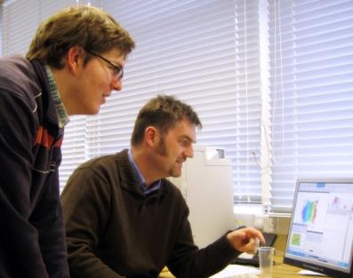
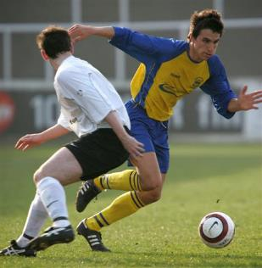
What is happening here?

Slide 3
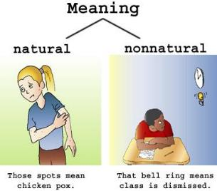
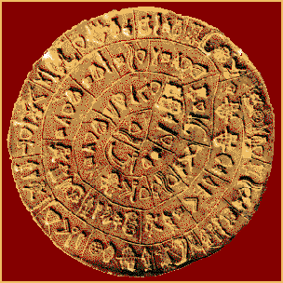
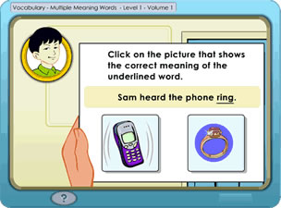
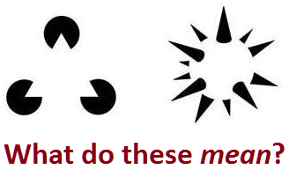
Where is Meaning?
Semanticity:
In everyday practice, we do not differentiate between types of meaning
Memory:
This is the Phaistos Disk. We know it has meaning but we don’t know what it is – we have lost the key
Socialisation:
Finding meaning in language is easy – because speaker and listener
co-operate in making meaning
Computation:
We find meaning everywhere - even in things that are not there
Semiosis:
Magritte reminded us that a picture is not the object, but it still “means” the object

Slide 4
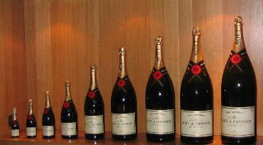
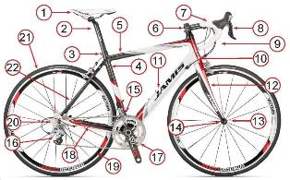
What is Meaning?
Meaning is arbitrary
Meaning is scaleable
Meaning is salient
Meaning is interrelational

Slide 5
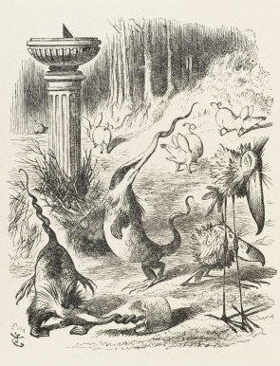
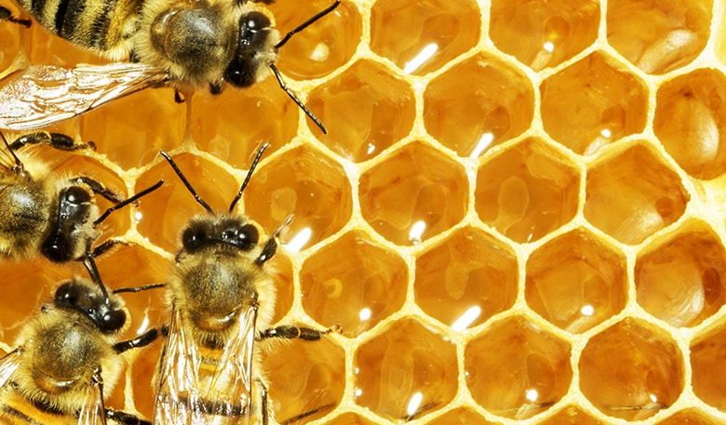
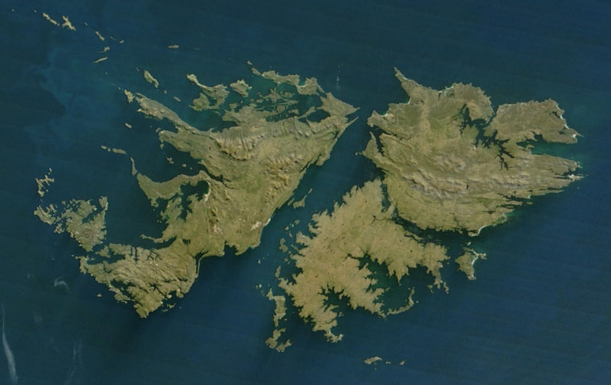
Negotiation toward Meaning
Agreement
Enforcement
Creativity
Naming
Falkland Islands
Falkland Islands
Islas Malvinas
Transformation

Slide 6
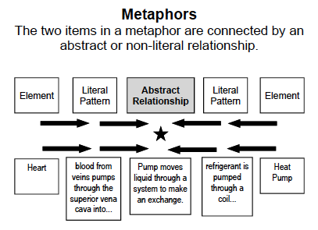
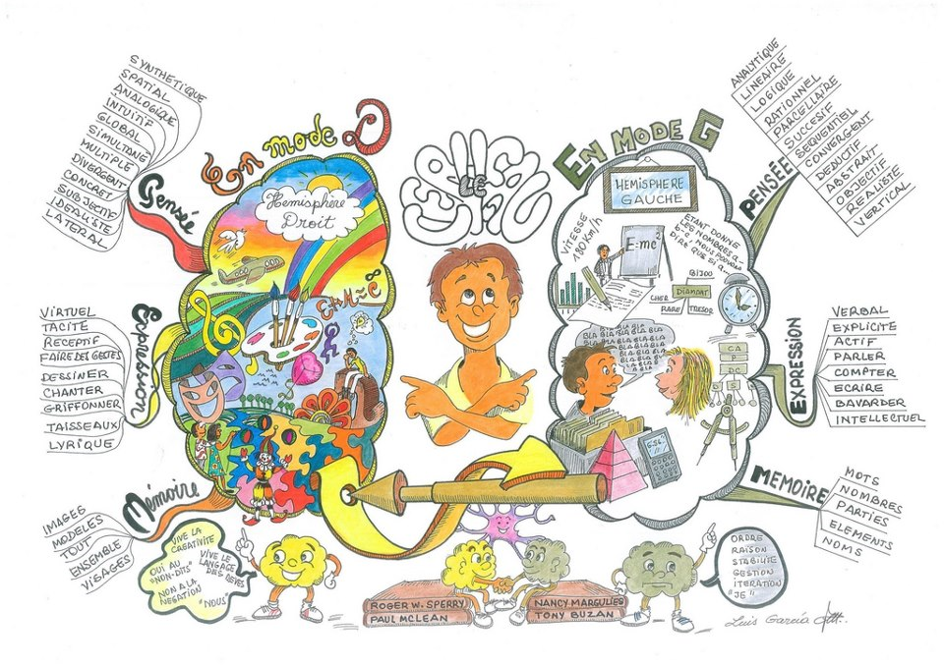
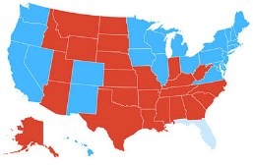
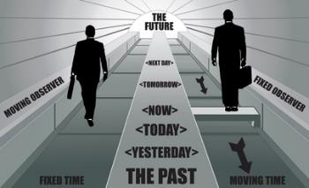
Metaphor
Metaphors make meanings
Metaphors present reality
in new ways
Metaphors are not just about verbal language
Metaphors make abstracts concrete

Slide 7
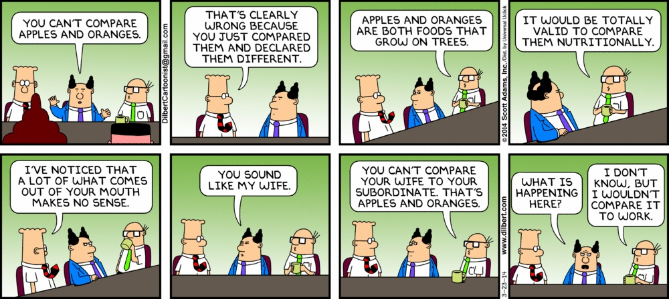
And finally ...

