Slide 1
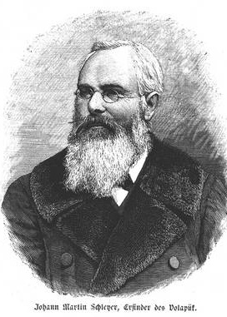
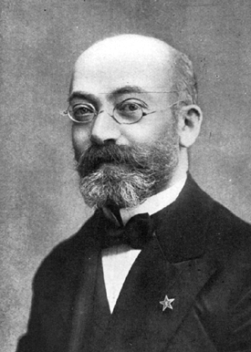
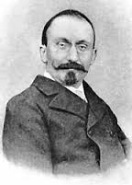
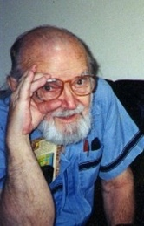
5SSEL026 – Language Construction Lecture 7 Artificial Languages 1
Johann Martin Schleyer
Volapük
Ludwik L. Zamenhof
Esperanto
Louis Couturat
Ido
James Cooke Brown
Loglan
Bob LeChevalier
Lojban

Slide 2
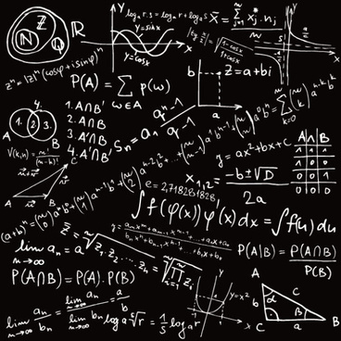
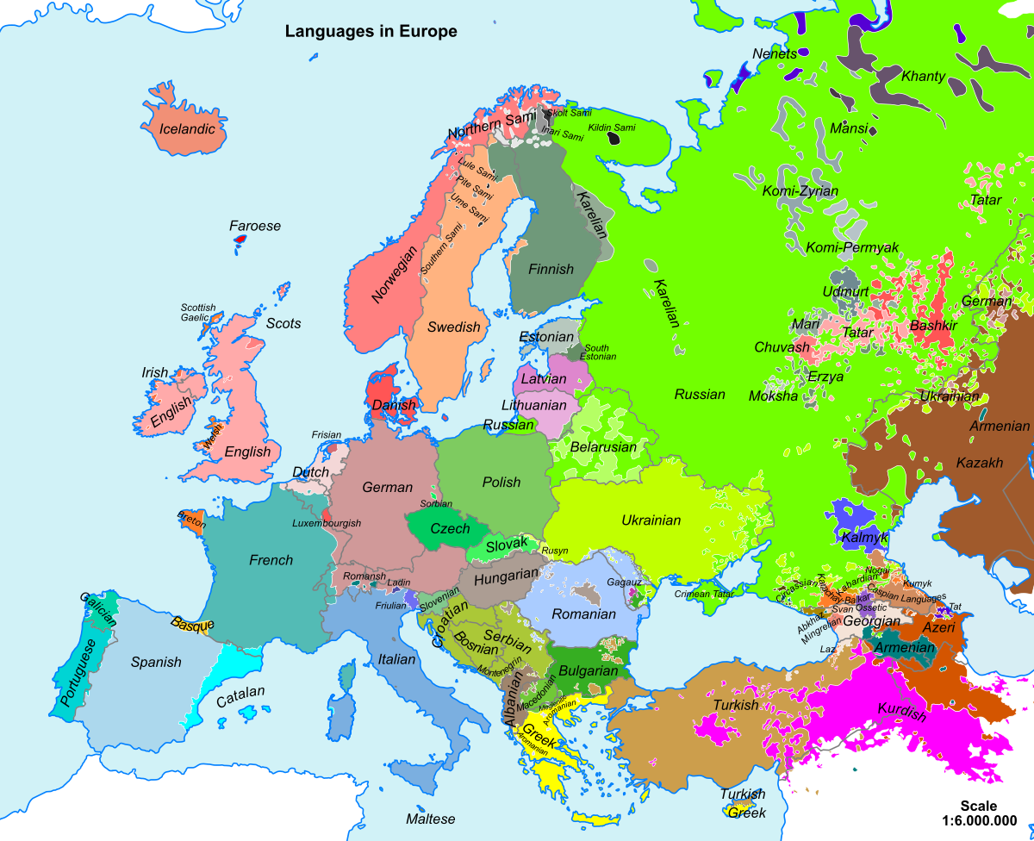
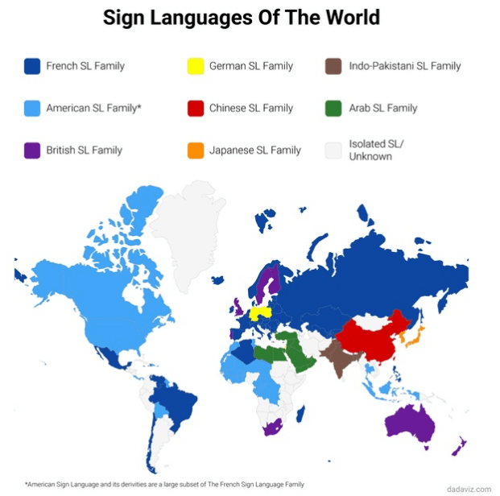
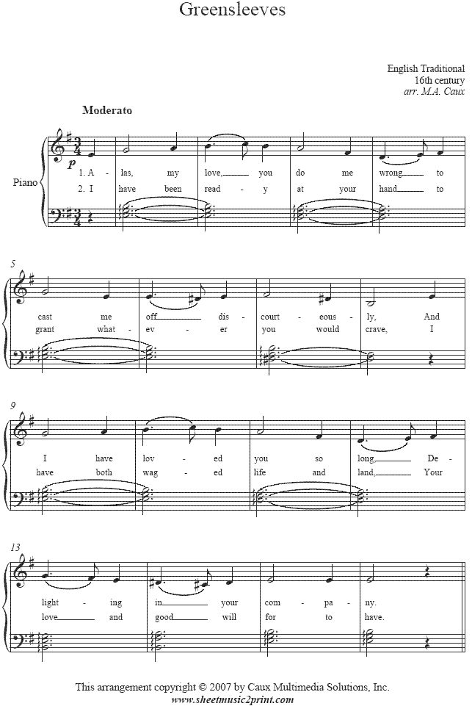
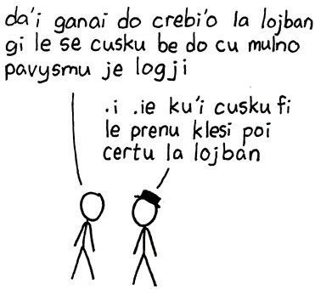
Why Artificial Languages (1)?

Slide 3
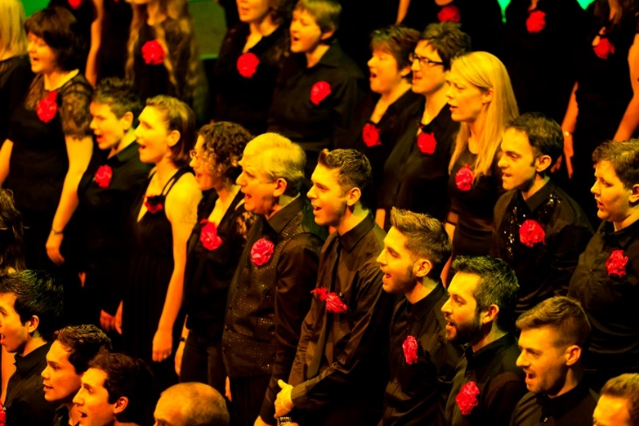
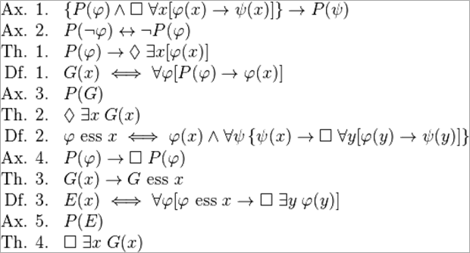
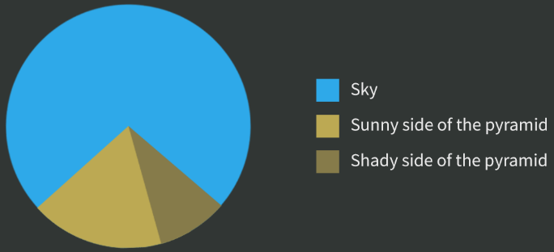
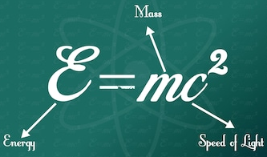
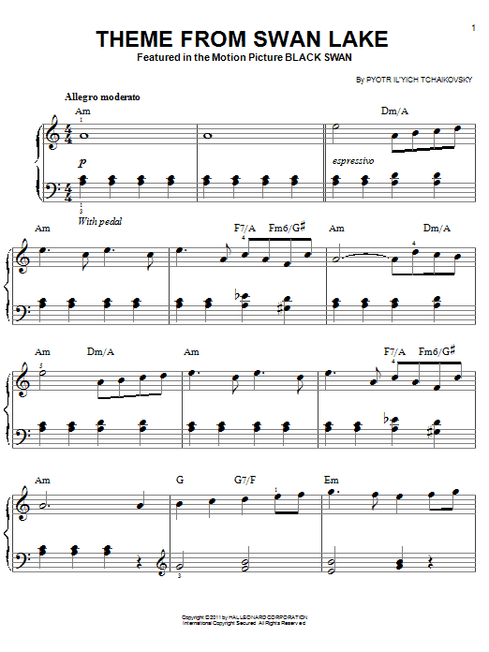
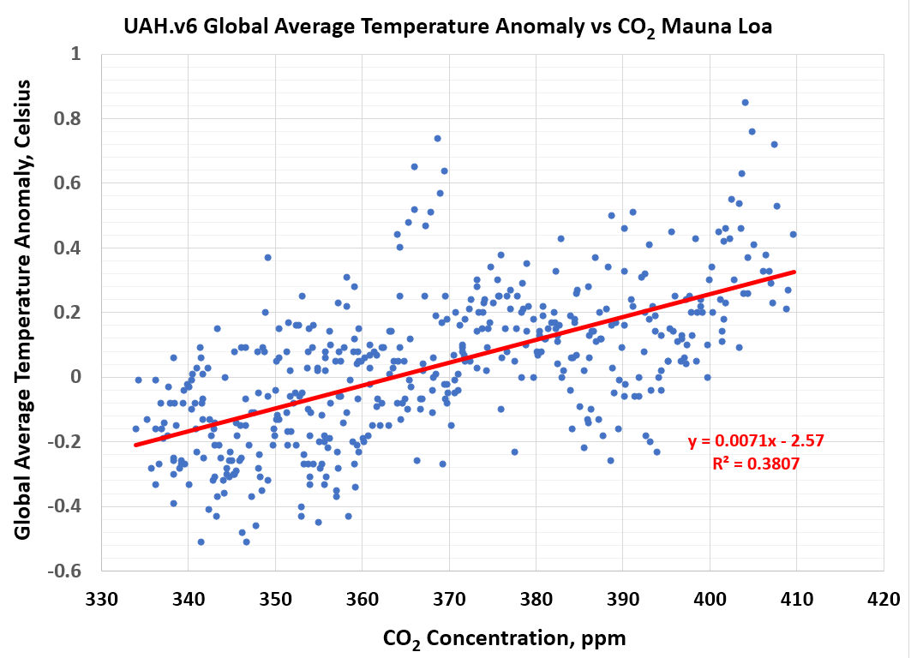
More Effective Codes
Gödel’s ontological proof that God exists
Which film?

Slide 4
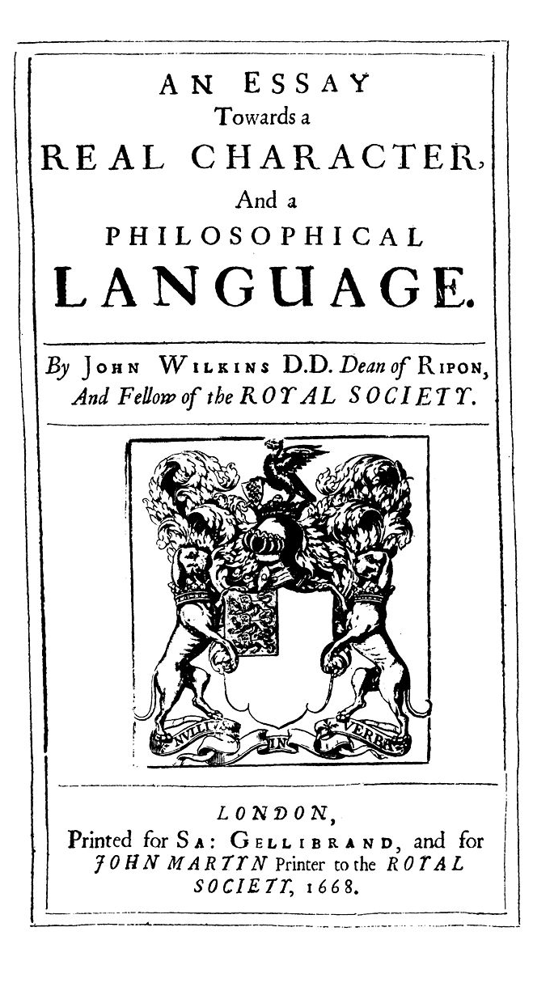
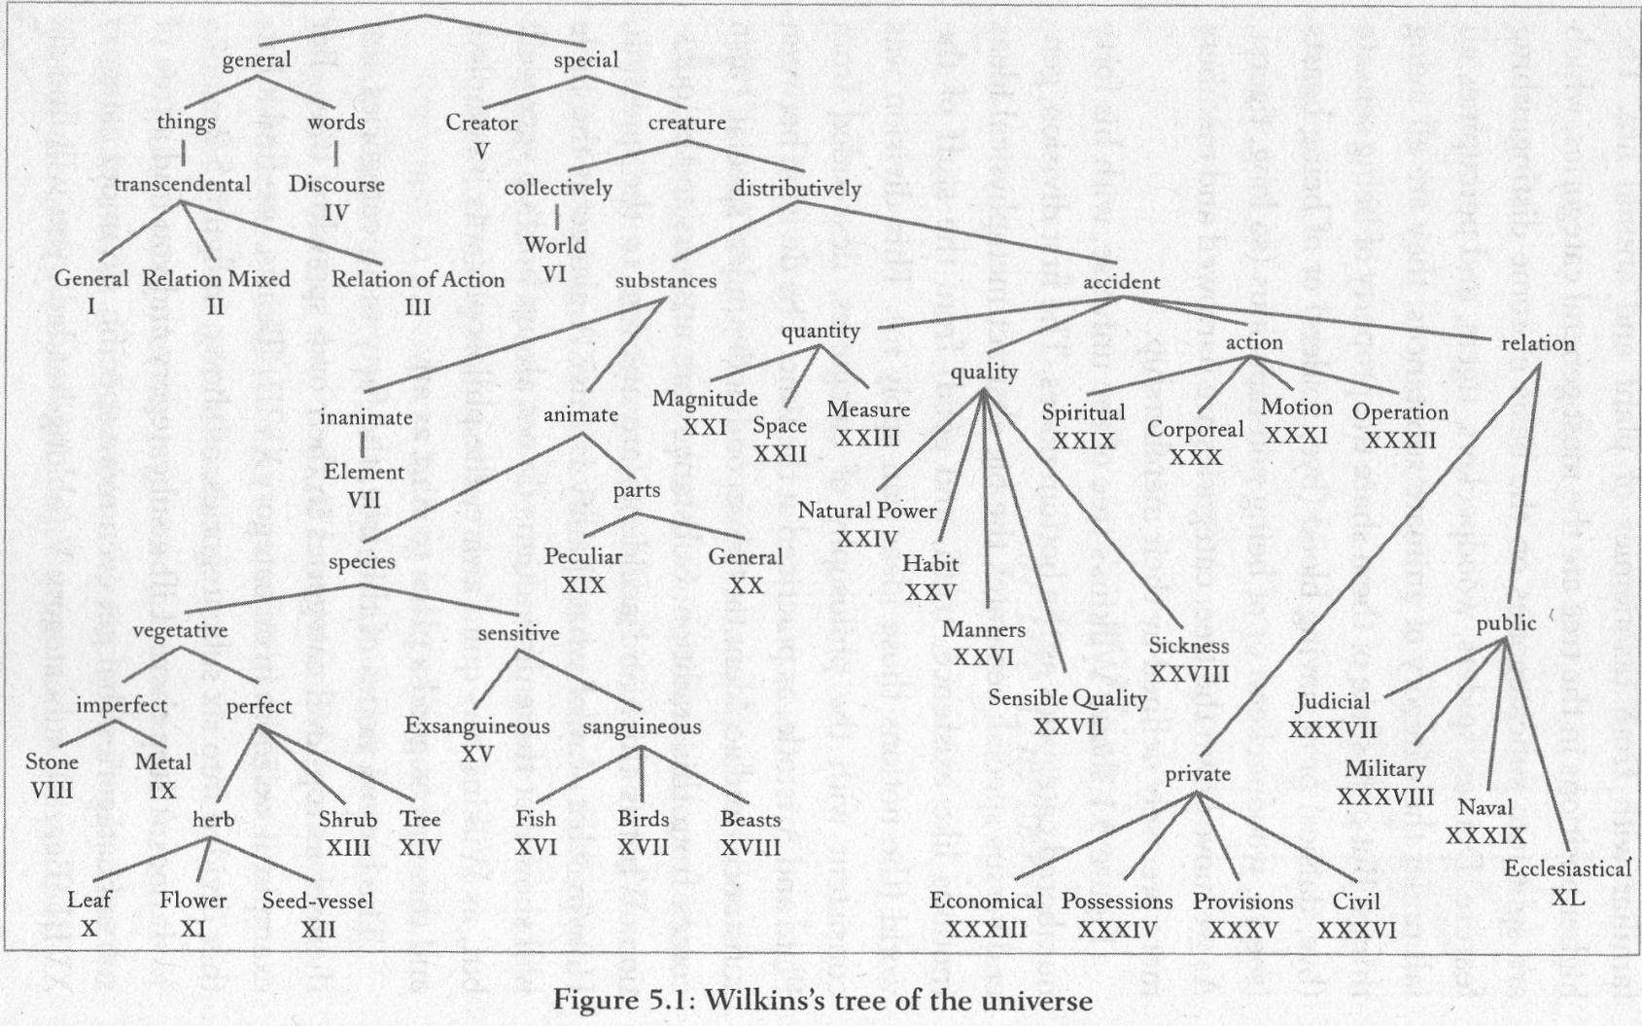
The Search for a New Lingua Franca
https://books.google.co.uk/books?id=BCCtZjBtiEYC&printsec=frontcover&source=gbs_ge_summary_r&cad=0#v=onepage&q&f=false

Slide 5
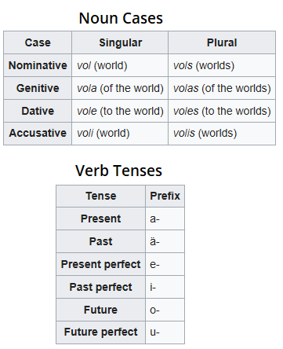
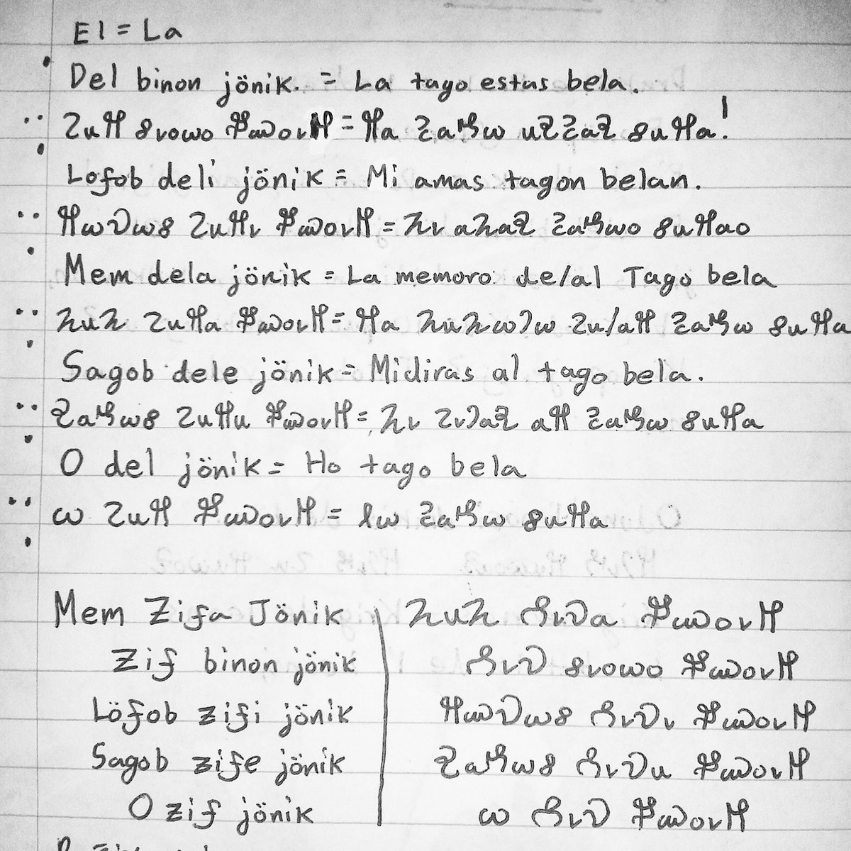
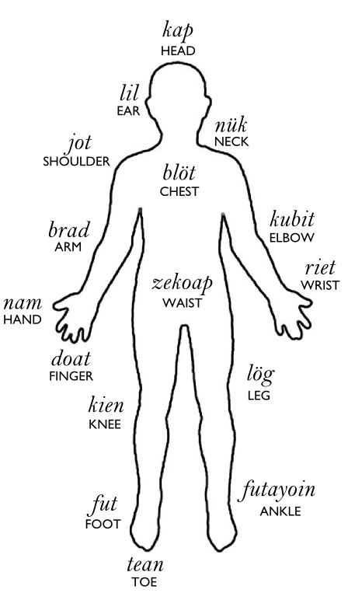
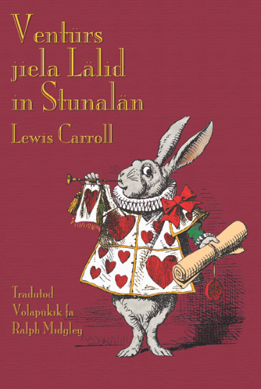
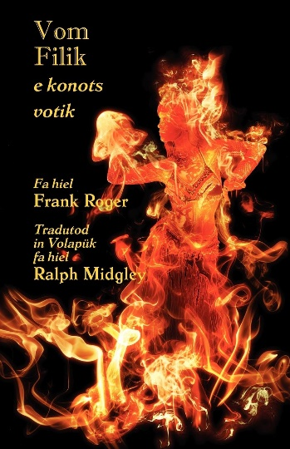
Volapük

Slide 6
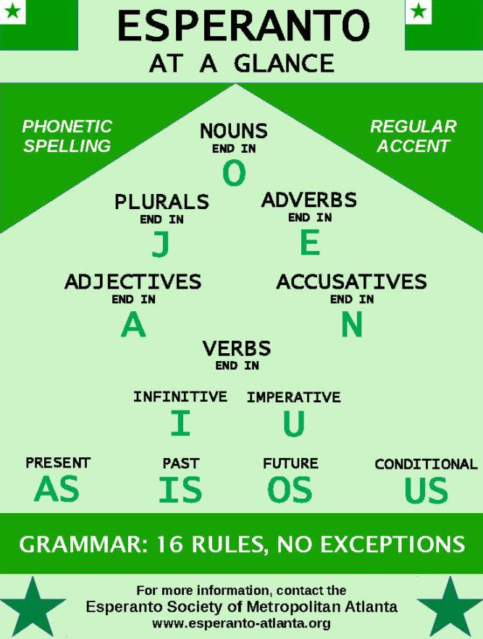
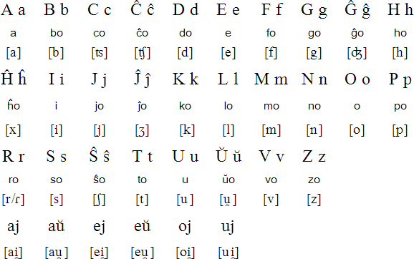
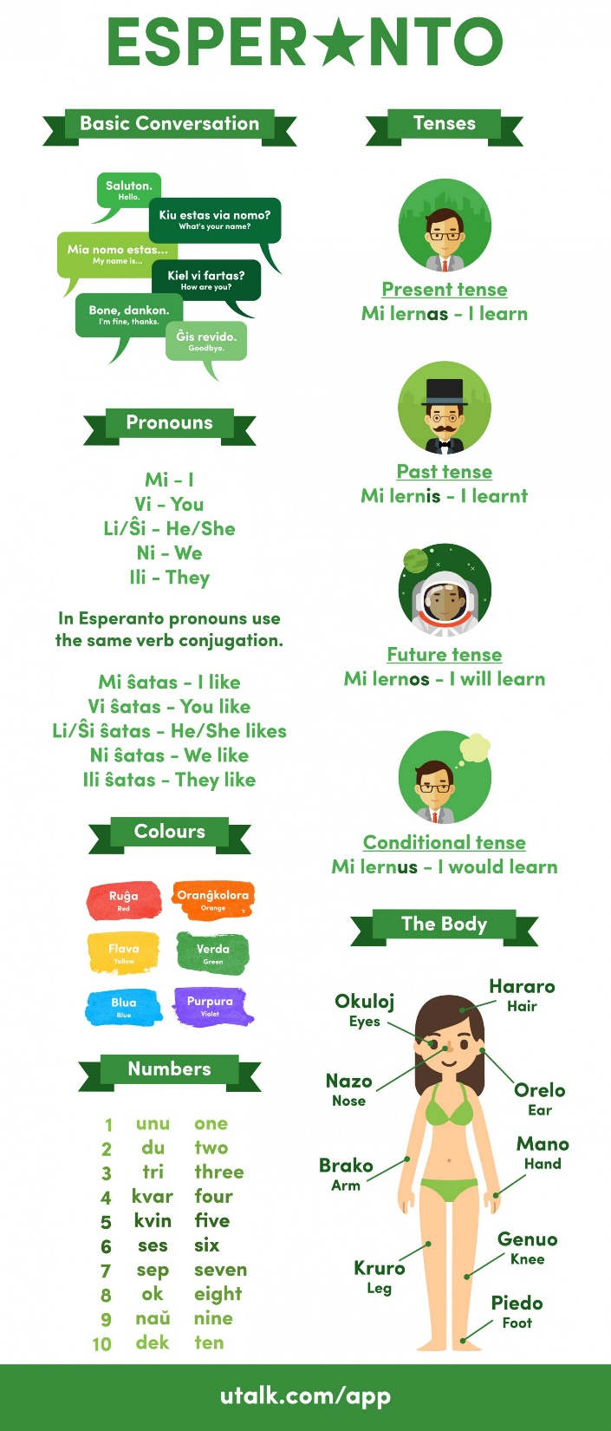
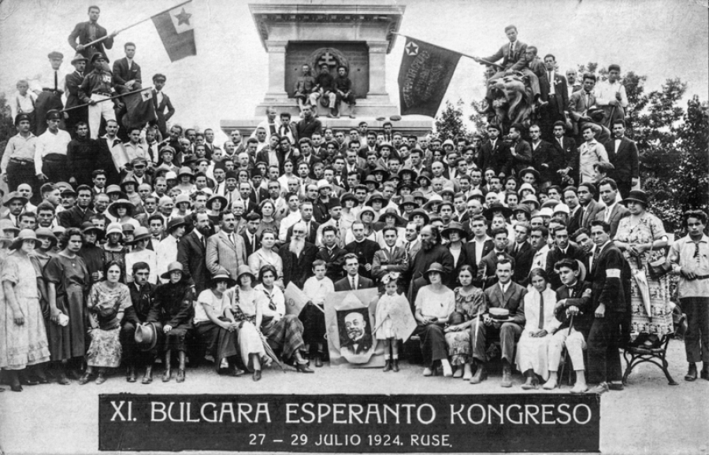
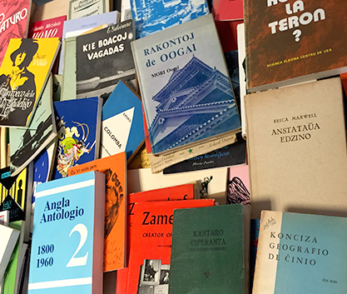
Esperanto

Slide 7
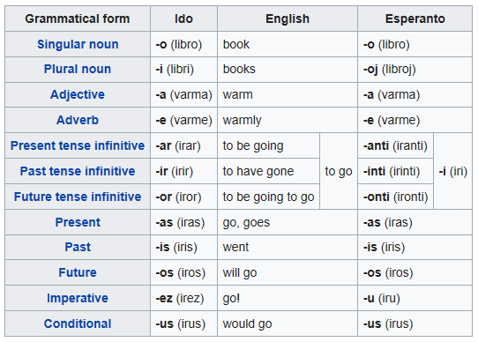
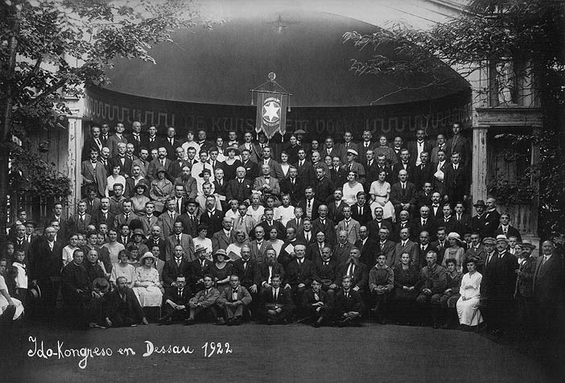
Ido

Slide 8
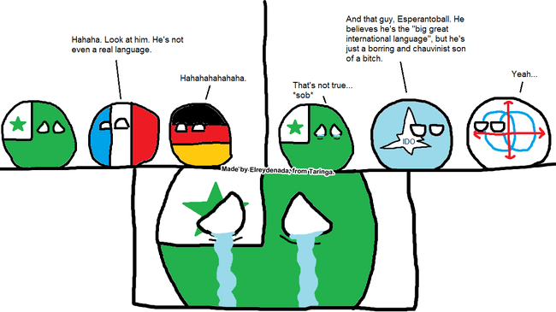
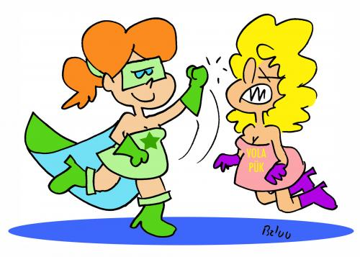
Neutrality

Slide 9
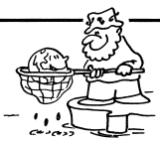
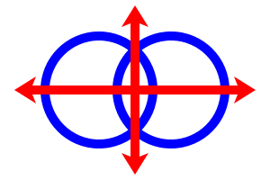
A More Logical Language
The Lord’s Prayer in Loglan
Hoi Memio Farfu, ji vi le skatyhaa gu,
Eo ga nu sentydju ga letu namci.
I eo letu nu bragai fa fadkaa.
I eo lotu nu furmoi ga nu durzo vi la Ter, ciuvi le skatyhaa.
I donsu mio na levi denli lemio rardei breba.
I tsenordri mio lopo mio dasysru gu,
ciu lepo mio tsenordri raba ji dasysru mio.
I glida mio no nepo nu zavdazmao,
Ibuo fremao mio lopo muerzavkao,
Imoi tu ponsu le nu bragai,
e lopu porli, e lopu graflo gu rana,
I eo tio dzabi.
Our Father, who art in heaven,
Hallowed be thy Name.
Thy kingdom come.
Thy will be done, On earth as it is in heaven.
Give us this day our daily bread.
And forgive us our trespasses,
As we forgive those who trespass against us.
And lead us not into temptation,
But deliver us from evil.
For thine is the kingdom,
and the power, and the glory,
for ever and ever. Amen.
Which shows that you can take the illogicality out of the language, but you can’t take the language out of the illogicality.
lojban Creation Poem
.i di'e se tcita lu banzgu li'u .itu’e simsa puzuki falenu la kamtei co'u vlipa co finti lo cnino .ije la kambau ca'o sincydzu setai le lijgri
bele tilju carce poi litru le pavyganra dargu .i simsa falenu puse cusku fa roda .eji'a
leka vrucau .i loi bangu di'i canci .i le norbau po'o cu mivzenba vau .uusai .i cerni nu gusni . . .
Once it seemed that Durationness had lost the power of procreation. Language crept along in a line-group like a one-width road full of heavy trucks. It seemed like everything had finished being expressed, even noiselessness. The amount of nation-languages was decreasing, & only semi-language thrived. Morning-light & the smell of a mountain forest.
. . .

Slide 10
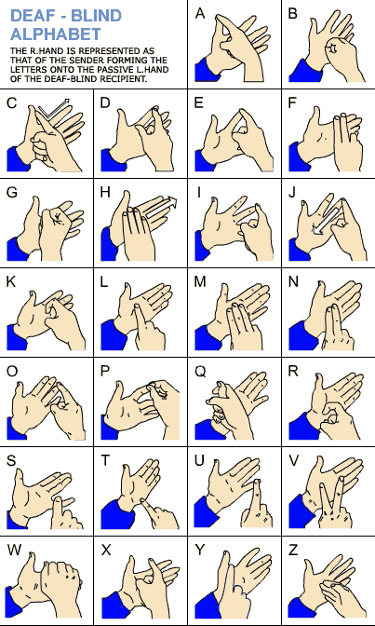
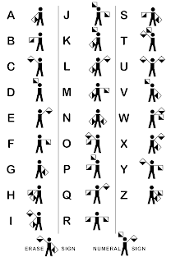
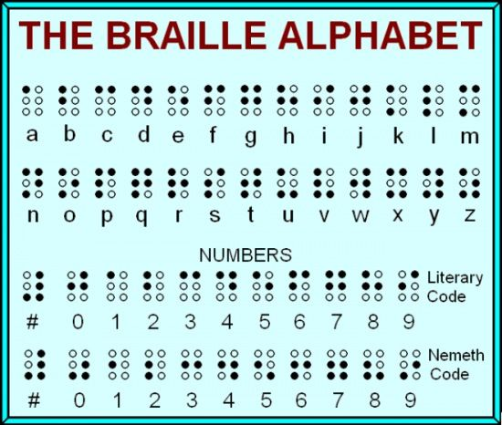
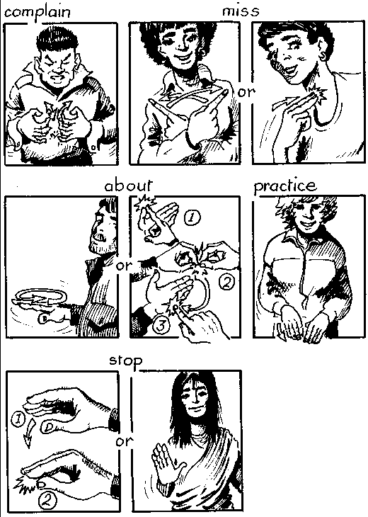
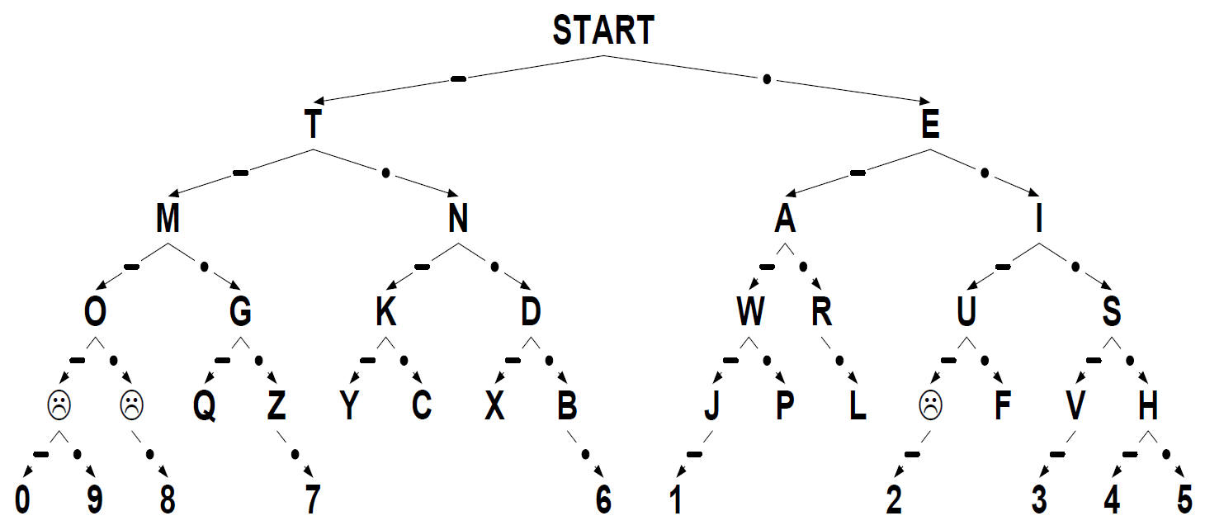
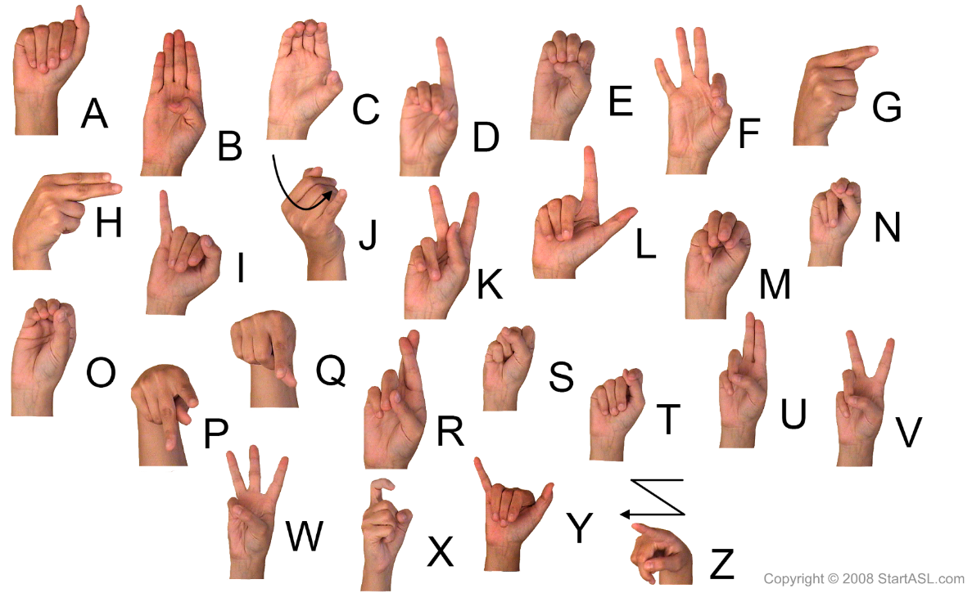
Languages by Other Means
Semaphore
Morse code⇨
BSL
ASL

Slide 11
And finally ...

