Slide 1
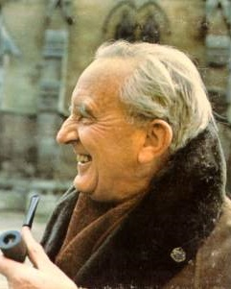
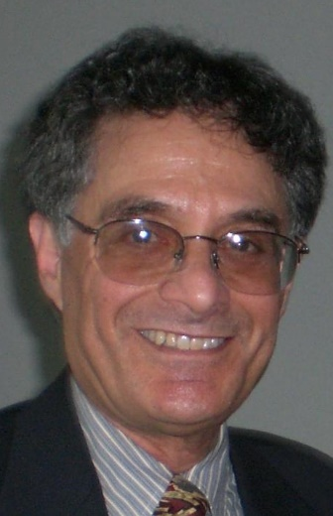
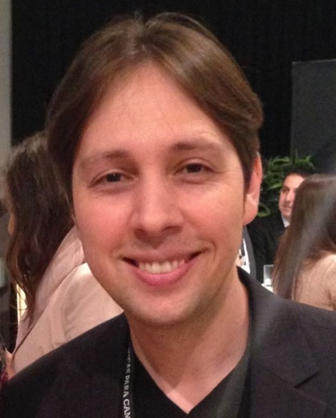
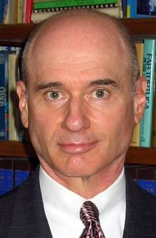
5SSEL026 – Language Construction Lecture 8 Artificial Languages 2
J. R. R. Tolkien
Quenya
Sindarin
Dwarvish
Orcish
Numenorean
. . .
Marc Okrand
Klingon
Atlantean
David J. Peterson
Dothraki
Valyrian
Paul R. Frommer
Na’vi

Slide 2
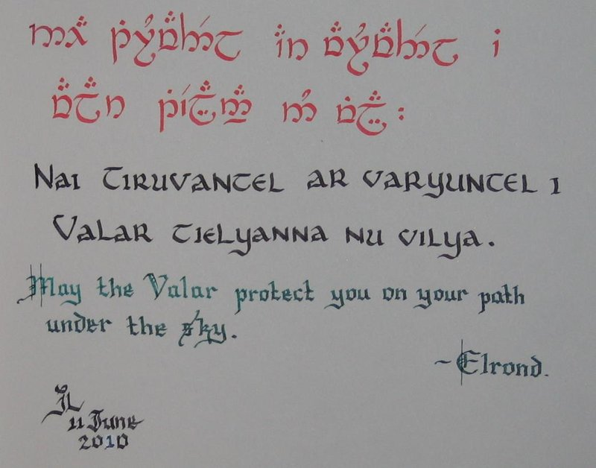
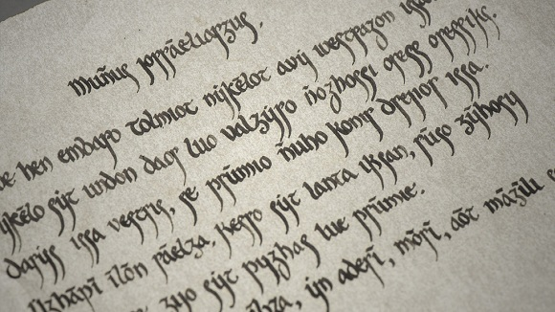
Why Artificial Languages (2)?
Voluntene Script
(Talisa’s letter, from Game of Thrones TV series)

Slide 3
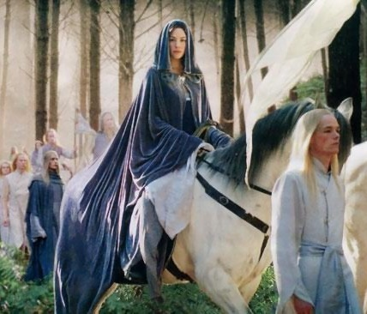
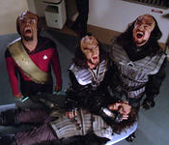
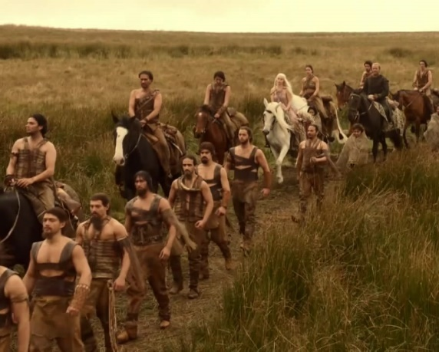
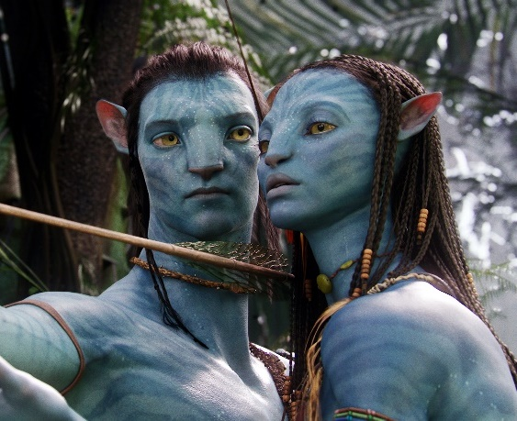
Fictional Languages
Ai laurië lantar lassi súrinen
Yéni únótimë vë rámar aldaron!
Ah! like gold fall the leaves in the wind,
long years numberless as the wings of trees!
DaH mojaq-mey-vam DI-vuS-nIS-be’ ’e’ vI-Har
I believe that we do not need to limit these suffixes now.
Nevakhi vekha ha maan:
Rekke, m'aresakea norethi fitte.
There is a place for him:
There, with the short-haired cowards.
Oel ngati kameie
I see you
Fìtrr lu sìltsana trr
Today is a good day

Slide 4
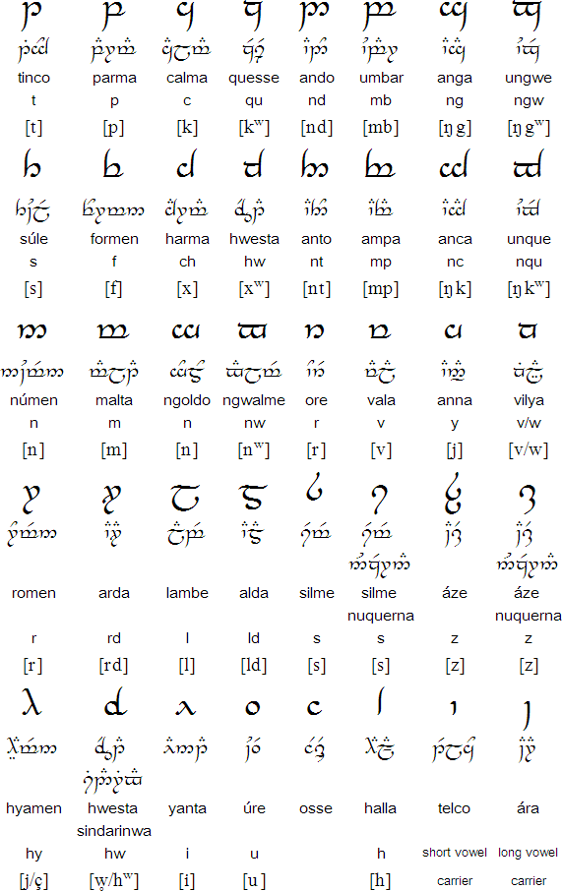
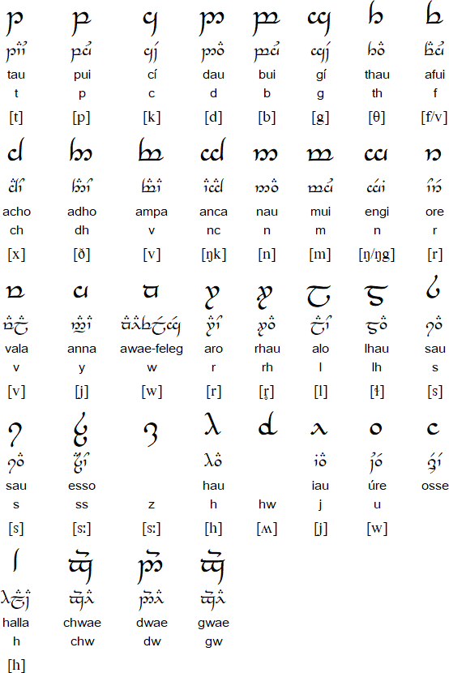
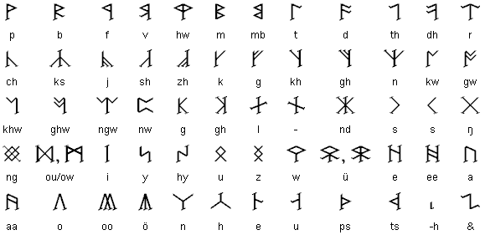
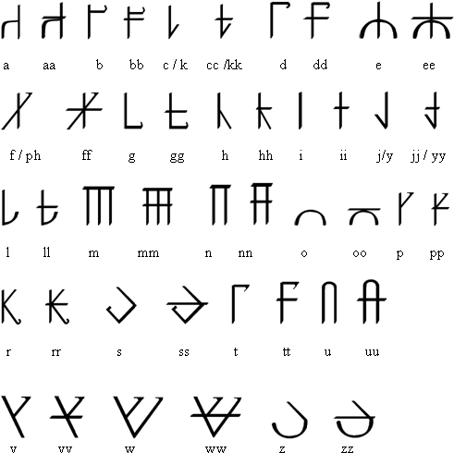
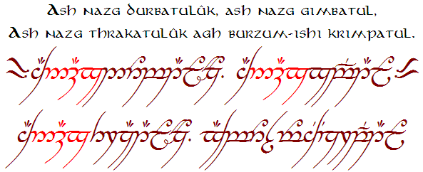
J.R.R. Tolkien
Khuzdul alphabet & script
Quenya alphabet & script
Sindarin alphabet & script
(The Tengwar)
Black speech
(no script, it uses adapted Tengwar letters)
Adunaroth (Númenórean) alphabet & script

Slide 5
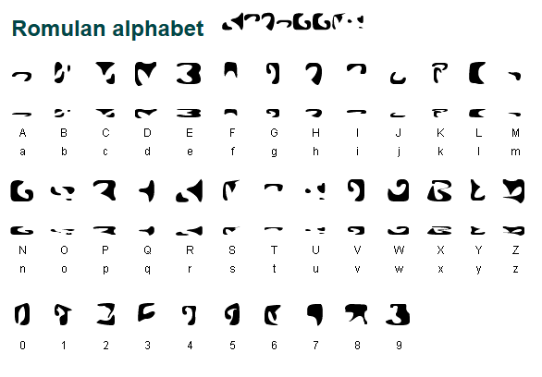
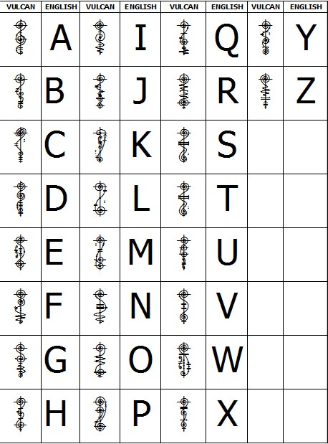
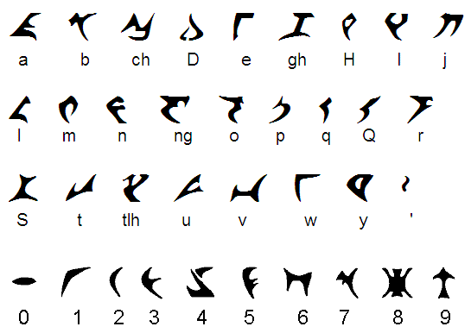
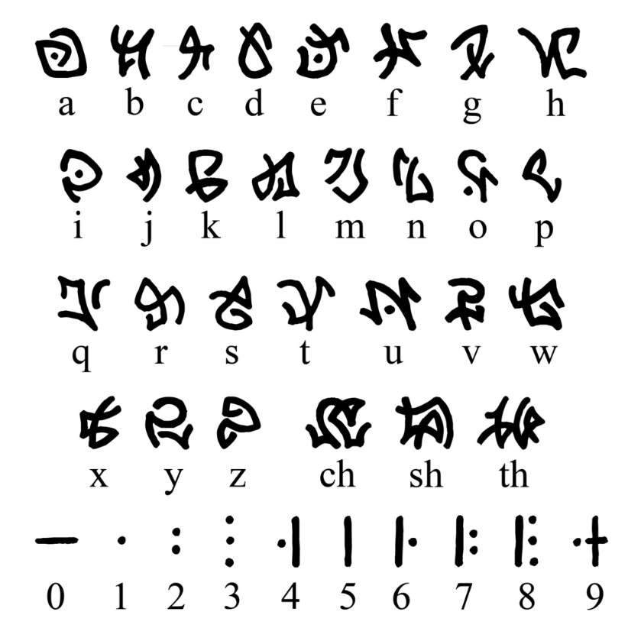
Marc Okrand
Golic Vulcan
alphabet
and script
Romulan alphabet and Rihannsu script
Atlantean alphabet and script
Klingon alphabet and KLI pIqaD script
(note the lack of a “k” sound)

Slide 6
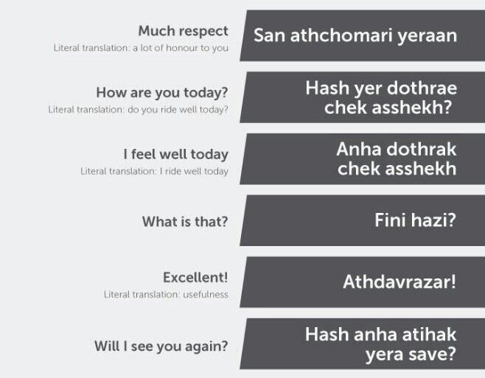
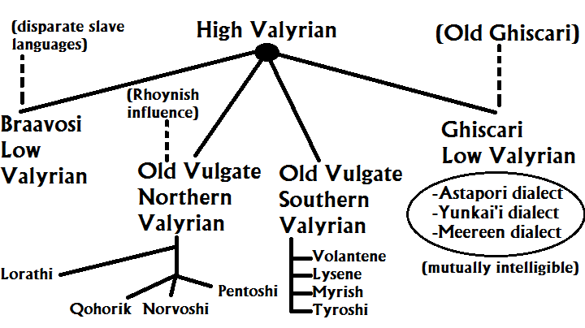
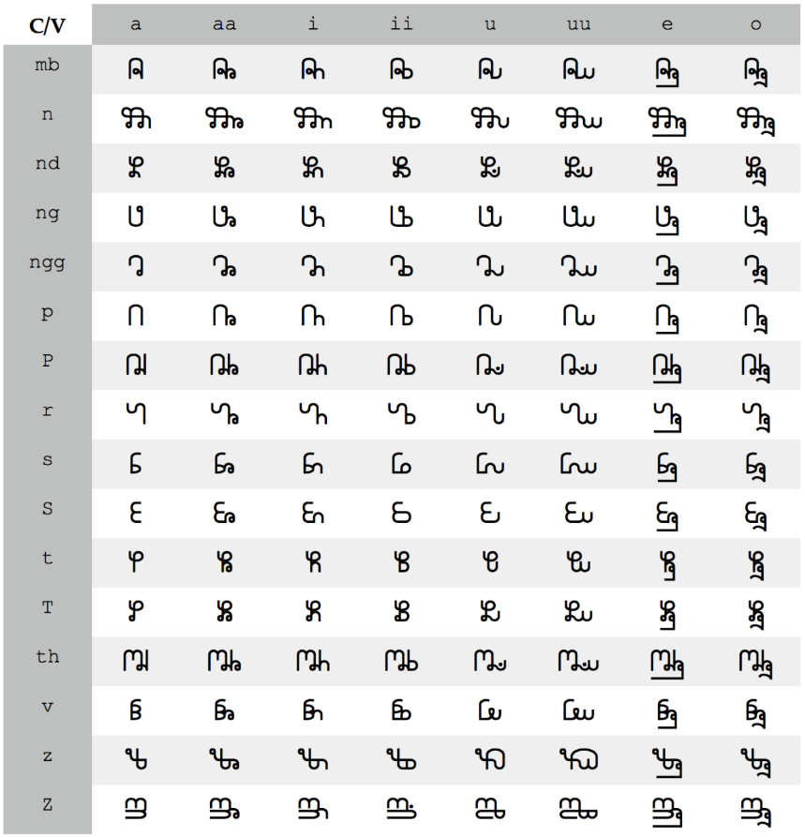
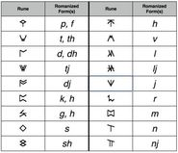
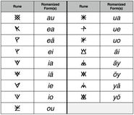
David J. Peterson
Dothraki
(no script)
Valyrian family of languages (no special script)
Castithan syllabic glyphs
Shiväisith alphabet and script
(from Thor: The Dark World)

Slide 7
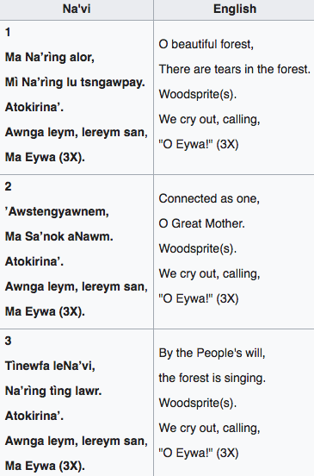
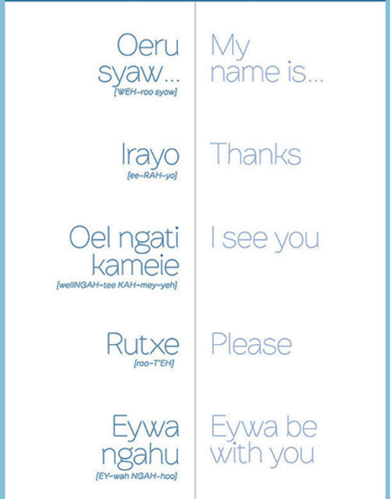
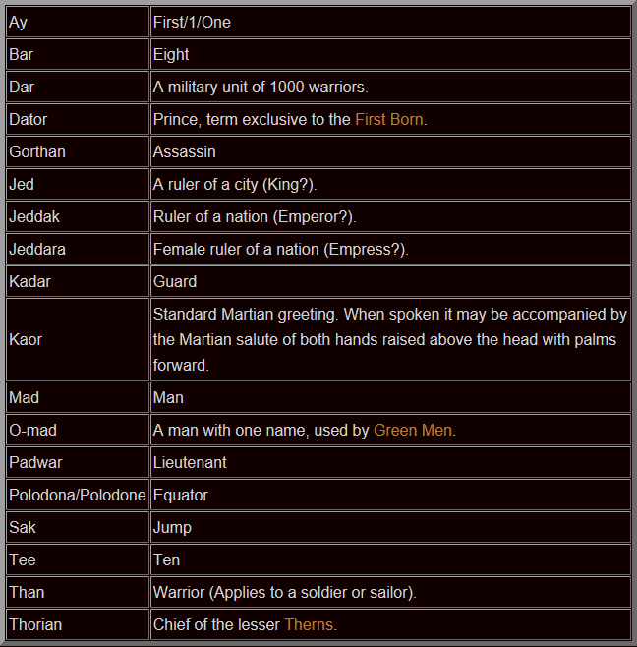
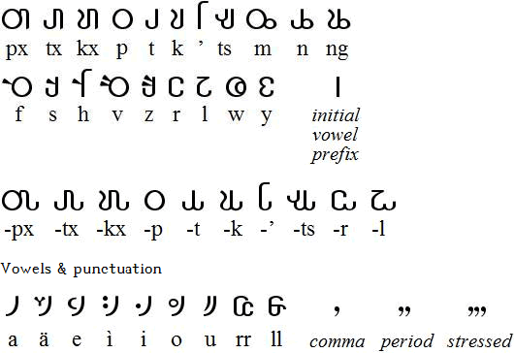
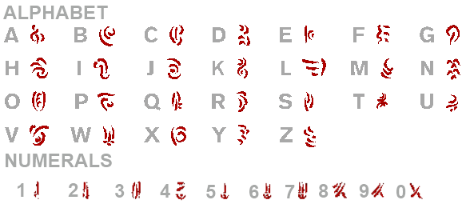
Paul R. Frommer
Barsoomian words created by
Edgar Rice Burroughs
Na’vi alphabet and script,
some words and a poem
Frommer’s Barsoomian script

Slide 8
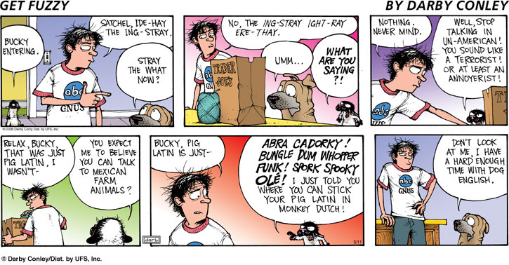
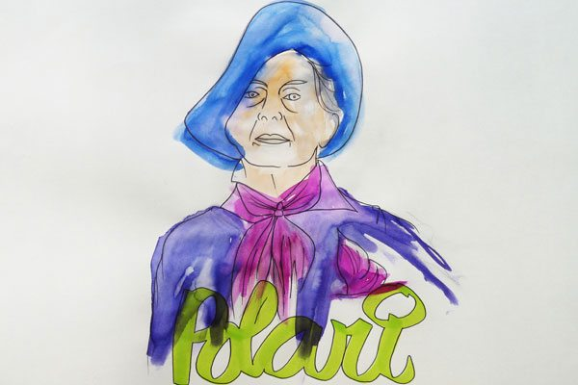
Secret Languages
The Secret Language of Casualty
FLK: Funny Looking Kid
GOK: God Only Knows
HANDBAG POSITIVE: Confused elderly woman lying on the bed but still clutching her handbag
LOBNH: Lights On But Nobody Home
NFN: Normal For Norfolk
PFO: Drunk, Fell Over
PRATTFO: Patient Reassured And Told To Go Away
TBP: Total Bloody Pain
TEETH: Tried Everything Else, Try Homoeopathy
UBI: Unexplained Beer Injury
Illustration by Lewis Mirrett

Slide 9
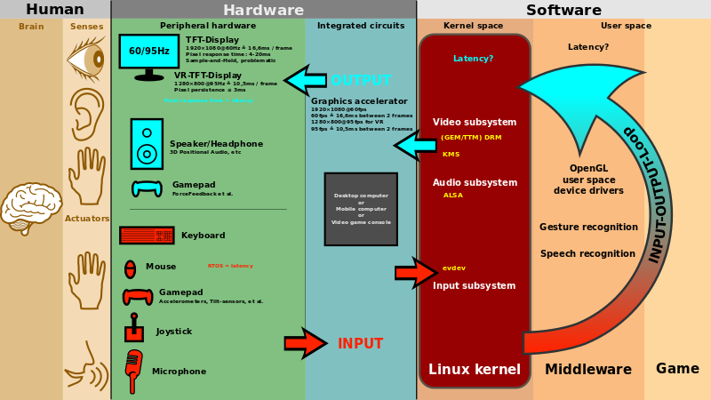
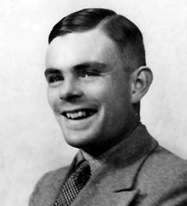
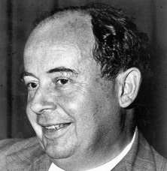
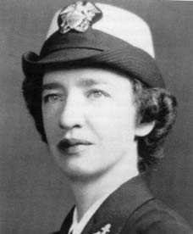
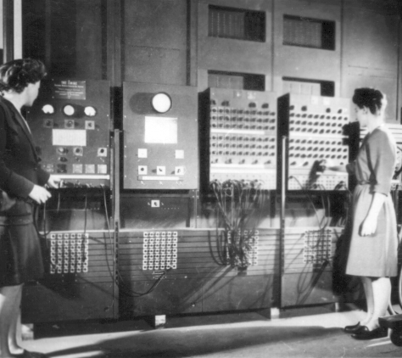
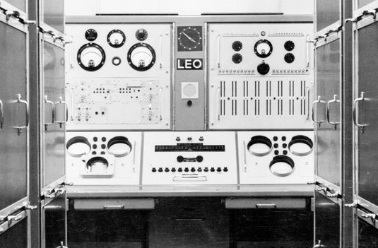
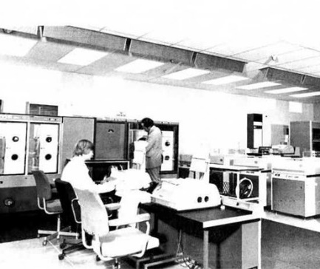
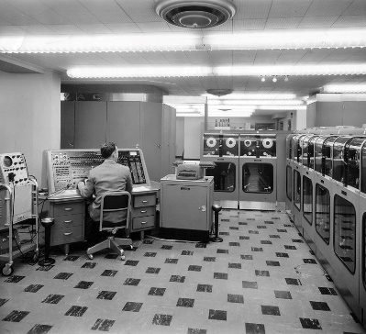
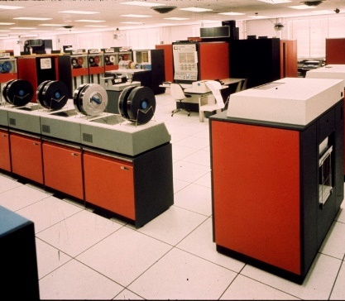
Working with Machines

Slide 10
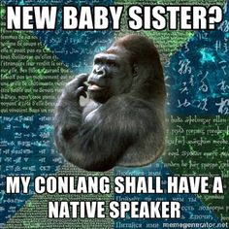
Making Languages for Fun

Slide 11
And finally ...

