Slide 1
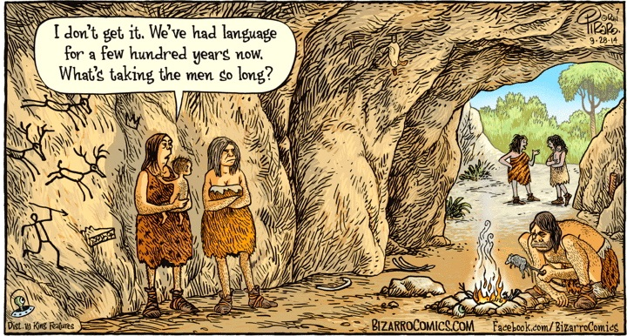
Personification Across Disciplines 2018 Durham University, September 17 – 19
Things
Do Things to
Things
Social calculus, agentive grammar
and the beginnings of language
Martin Edwardes
BSc MA PhD, FRAI
martin.edwardes@kcl.ac.uk

Slide 2
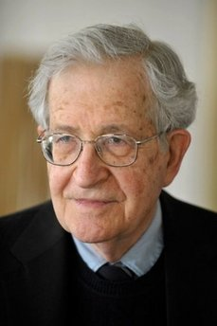
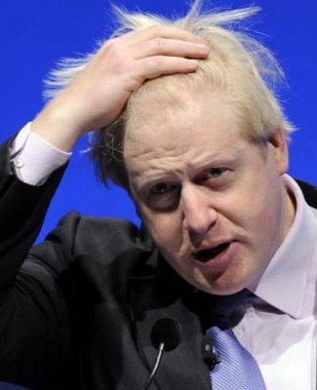
Personification Across Disciplines 2018 Social calculus, agentive grammar and the beginnings of language
What is Language for?
99% of use of language never even gets expressed – it’s internal.
we adhere to the view that the primary function of language is communication.
Well … er … no … yes, quite so … er … fwah … er … what was the question again?
Noam Chomsky
Michael Arbib

Slide 3
Personification Across Disciplines 2018 Social calculus, agentive grammar and the beginnings of language
Language Origins: Comparing Isms
 | Generativist Theory | Social Communicative Approach to Language
What | Language is a monolithic cognitive system which is independent of all other cognitive and communicative systems. Its communicative use is incidental. | Language is a communicative tool which is segmented, differentiated and hierarchical, and which can be recursive. It is the product of a series of evolutionary events in cognition, communication and socialisation.
How | As a single genetic mutation which gave early humans the capacity for recursive cognition (Chomsky’s MERGE). Once evolved, it was so useful that language-users quickly replaced non-language-users in the population. | As a series of genetic changes, each of which met a particular cognitive or communicative need. PLUS As a response to an increasingly sophisticated socialisation and enculturation.
Why | The mutation was random, so there is no reason why. | Because evolutionary pressures favoured co-operative and communicative traits in the population.
When | As a single event between 150kya and 40kya. | As a continuing process between 1mya and today.
Where | Unknown. | Initially Africa.
Who | Later Homo sapiens. | H.heidelbergensis likely first to use protolanguage, so it was genetically available to descendent species, and possibly culturally available to co-existing species.

Slide 4
Personification Across Disciplines 2018 Social calculus, agentive grammar and the beginnings of language
The Complexity of Social Calculus
Relationships
to track: 21
F
A
[SELF]
E
B
D
C

Slide 5
Personification Across Disciplines 2018 Social calculus, agentive grammar and the beginnings of language
Social Calculus: RELATIONSHIP-A
Personal relationships
to track: 6
Interpersonal relationships to track: 0
There is no conscious attention to the [SELF] by the self.
SO …
All social calculus can be handled by subliminal cognition.
F
A
Relationship --
Relationship -
[SELF]
E
Relationship +
Relationship ++
B
Relationship --
Relationship ++
D
C

Slide 6
Personification Across Disciplines 2018 Social calculus, agentive grammar and the beginnings of language
Social Calculus: A-RELATIONSHIP-B
Personal relationships
to track: 6
Interpersonal relationships to track: 15
There is no conscious attention to the [SELF] by the self.
BUT …
A-Relationship-B social calculus requires conscious attention to others, and an Objective Theory of Mind.
F
A
Relationship -
Relationship --
Relationship +?
Relationship ++
[SELF]
Observes …
E
Relationship +
Relationship ++
B
Relationship --
Relationship ++
D
C

Slide 7
Personification Across Disciplines 2018 Social calculus, agentive grammar and the beginnings of language
Social Calculus: A-RELATIONSHIP-B Shared
Gemma
[SELF]
Shares …
Beth
Alf
Beth
Relationship +
Relationship ++
Relationship ++
The self has a working RELATIONSHIP-A with Beth
Gemma shares an A-RELATIONSHIP-B model with me of the relationship between Alf and Beth
BUT… I am Alf
SO… To incorporate Gemma’s model into my social calculus I need a third-person model of myself
AND… I need to be aware of the intimate relationship between my model of me and my [SELF]
AND… What does Gemma’s model tell me about my relationship with Beth?

Slide 8
Personification Across Disciplines 2018 Social calculus, agentive grammar and the beginnings of language
The Seven Selves Modelling Hypothesis (SSMH)
Social selves
The self others believe me to be
Episodic selves
The self as modelled in individual past events
Self-model
The self I believe me to be
Actual self
Unknowable
Cultural self
The self I should be
Projected self
The self I want others
to believe me to be
Narrative self
The remembered self,
the self with history

Slide 9
Personification Across Disciplines 2018 Social calculus, agentive grammar and the beginnings of language
Route to Self-Modelling & Language
Relationship-A Social arithmetic
Large social groups
Extrinsic signalling system
Joint Enterprise
Large brains
Extrinsic communication system
A-Relationship-B Social calculus
Shared social calculus
Self-modelling
Intrinsic communication system - LANGUAGE

Slide 10
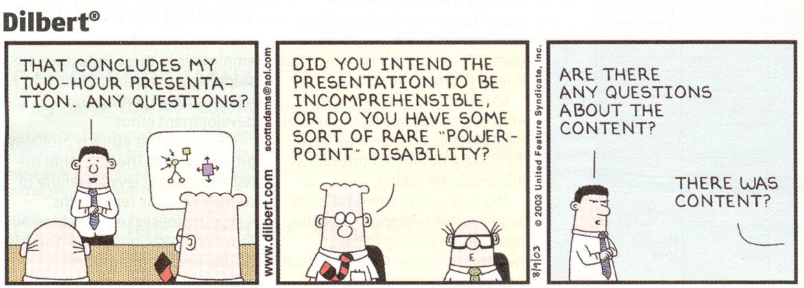
Personification Across Disciplines 2018 Durham University, September 17 – 19
Things Do Things to Things:
Social calculus, agentive grammar
and the beginnings of language
Any Questions, Comments, Expressions of disbelief?
Martin Edwardes
BSc MA PhD, FRAI
martin.edwardes@kcl.ac.uk

