Slide 1
6SSEL045 – Language Origins Lecture 10 Self-Awareness and Language

Slide 2
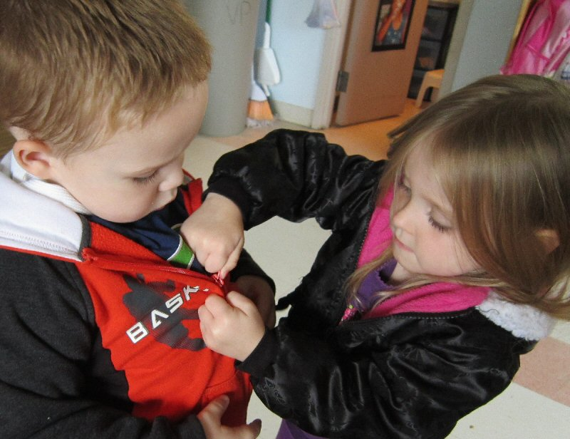
Sharing of Models: Shared Intentionality
He wants to do up his coat
I want to do up my coat
He can’t do up his coat
I can’t do up my coat
I can do up his coat
She wants to do up my coat
Let me do up your coat
OK
… and, most importantly,
She does up his coat

Slide 3
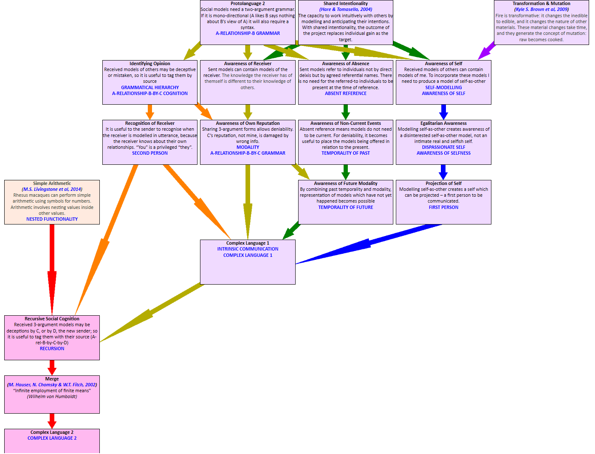
Language from Gossip to Discourse
Recursion
Opinion
Reputation
Ethereality
Selfness

Slide 4
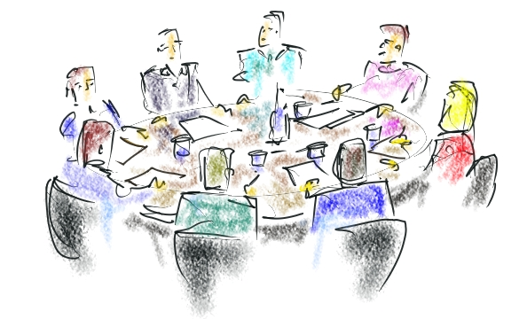
(1) Protolanguage 2 – Revisited
The social group [A-relationship-B]
Social duties
[A-governs-B]
Social Activities
[A-does-B]
Social Roles
[A-is-B]
Making & changing
[A-makes-B]
Establishing Complex Society

Slide 5
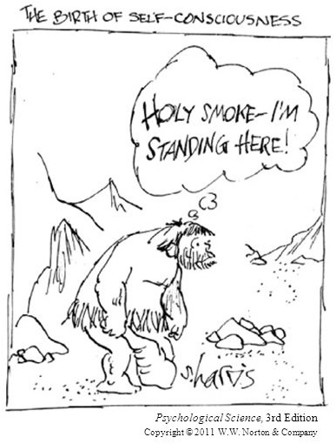
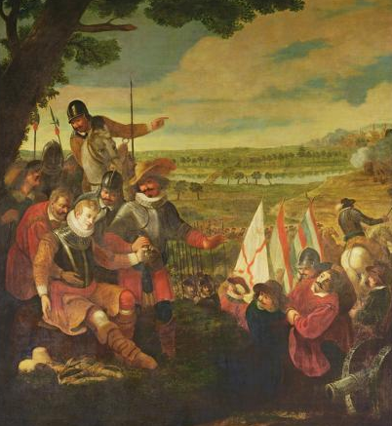
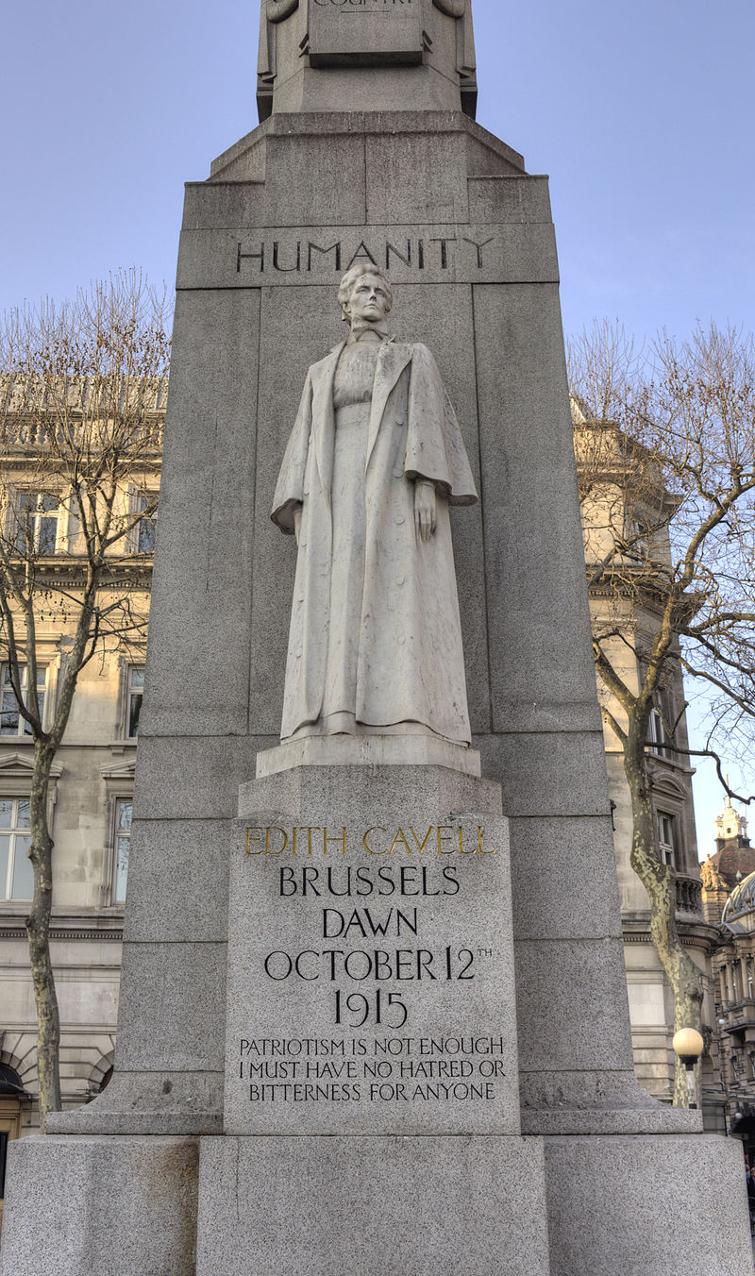
(2) Self as Object

Slide 6
(2) Self as Image
Social selves
The self others believe me to be
Episodic selves
The self as modelled in individual past events
Self-model
The self I believe me to be
Actual self
Unknowable
Cultural self
The self I should be
Projected self
The self I want others
to believe me to be
Narrative self
The remembered self,
the self with history
The image I try to project (the Projected self) is informed by:
the images of my self that I receive from others (the Social selves),
my own model of who I am (the Self-model),
and the self that others wish me to be (the Cultural self).
However, there is a feedback loop we ignore at our peril: the Projected self feeds back into our Self-model via the Social selves offered to me.

Slide 7
(2) Self as Image: How not to do it
Little Donny Jonny Trump Does Twitter
I used to be, George, the fair-haired boy — you know, when I was a contributor. I know more about contributions than anybody - Nov 2015
I know more about renewables than any human being on Earth - April 2016
Actually, throughout my life, my two greatest assets have been mental stability and being, like, really smart. Crooked Hillary Clinton also played these cards very hard and, as everyone knows, went down in flames. I went from VERY successful businessman, to top T.V. Star to President of the United States (on my first try). I think that would qualify as not smart, but genius....and a very stable genius at that! - Jan 2018
Helena_Torry@realDonaldTrump
Do you ever post criticism of your actions or do you see yourself as too perfect & that you have no faults?
realDonaldTrump@Helena_Torry
I consider myself too perfect and have no faults.
The Malevolent Satsuma, Twitter, Jan 2014
… ont pû tromper quelques hommes, ou les tromper tous dans certains lieux & en certains tems, mais non pas tous les hommes, dans tous les lieux & dans tous les siécles.
Jacques Abbadie, Traité de la Vérité de la Religion Chrétienne, 1684
One can fool some people, or fool all people in some places and times, but one cannot fool all people in all places and ages.

Slide 8
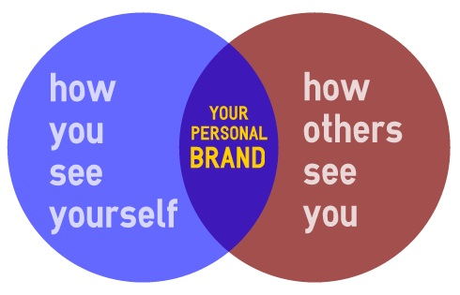
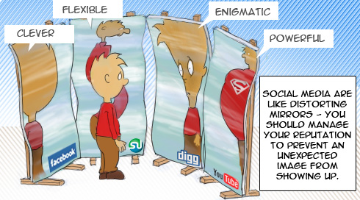
(3) Opinion and Opinion-makers
The way to gain a good reputation is to endeavor to be what you desire to appear. Socrates
The greater the difficulty the more glory in surmounting it. Skillful pilots gain their reputation from storms and tempests. Epictetus
Reputation is an idle and most false imposition; oft got without merit, and lost without deserving.
William Shakespeare
Kindly words do not enter so deeply into men as a reputation for kindness. Mencius
It is generally much more shameful to lose a good reputation than never to have acquired it. Pliny the Elder
M.I.T. has a reputation for turning out Dilberts. They may be brilliant in what they do, but no one can understand what they say. Steven Pinker

Slide 9
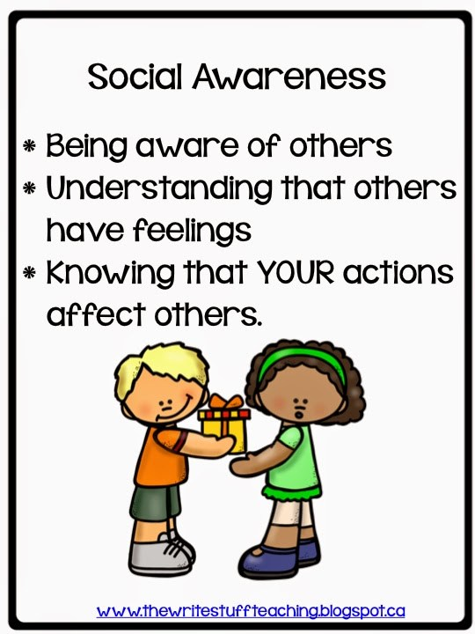
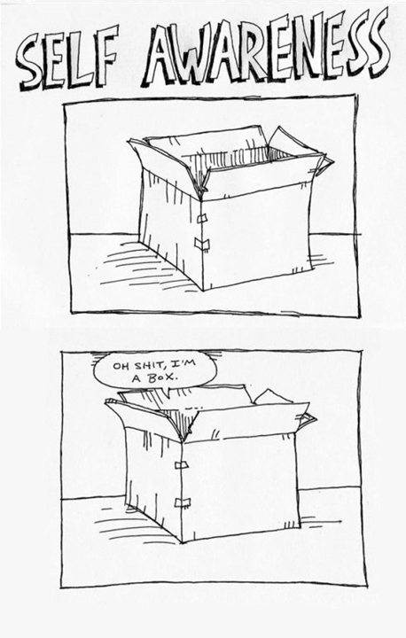
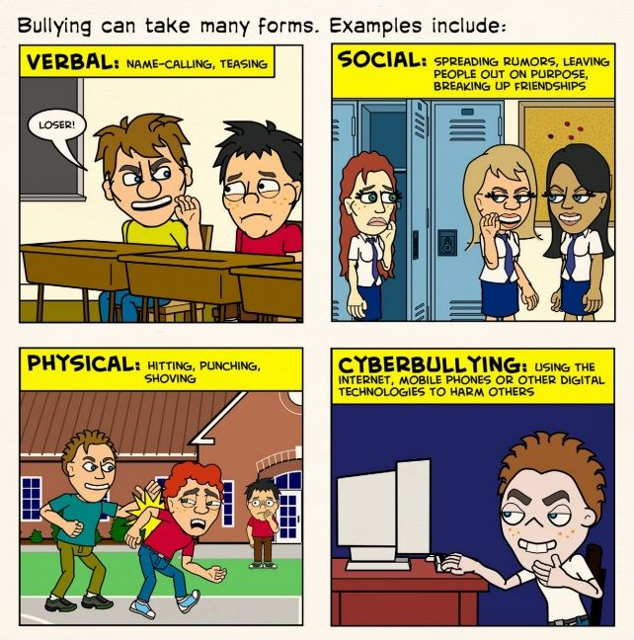
(3) Other-awareness and Self-awareness

Slide 10
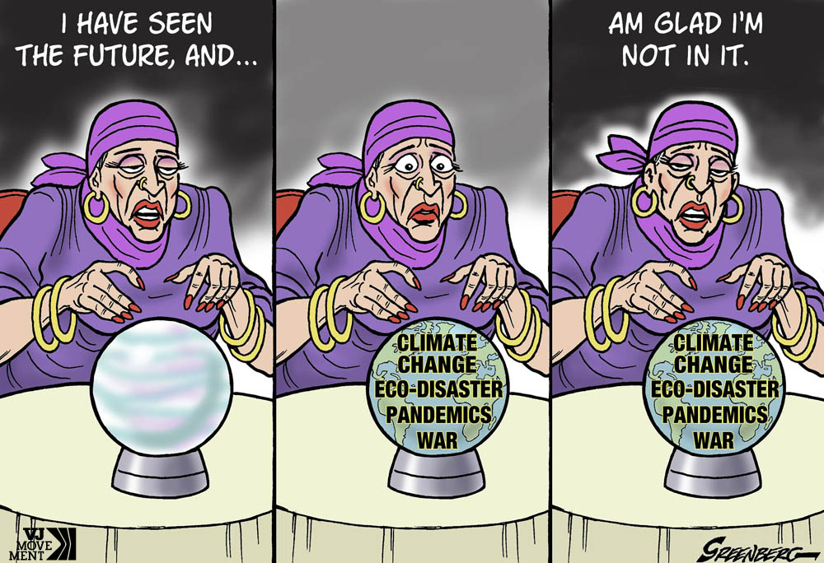
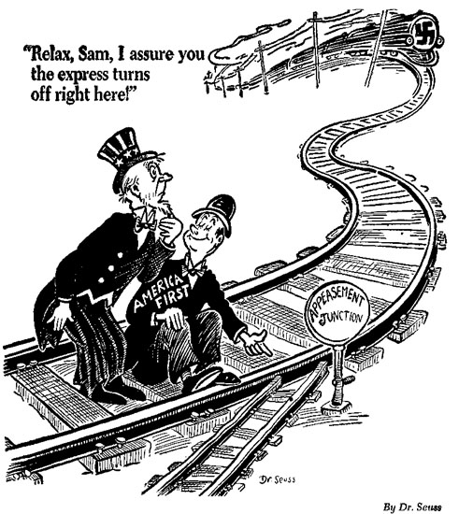
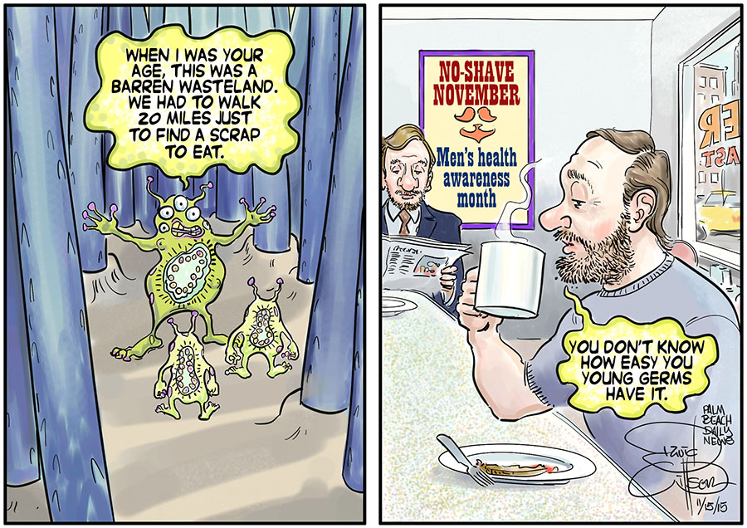
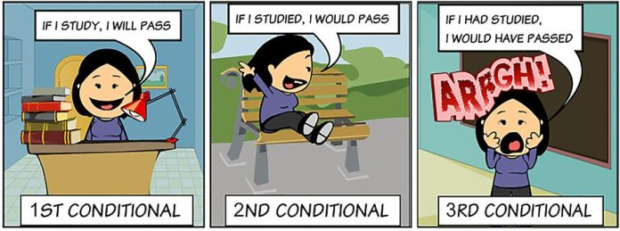
(4) Out of Sight Not Out of Mind
Things we cannot see but know are there, and can discuss
Unicorns
The
future
The
past
And crap logic
Irony
Modality

Slide 11
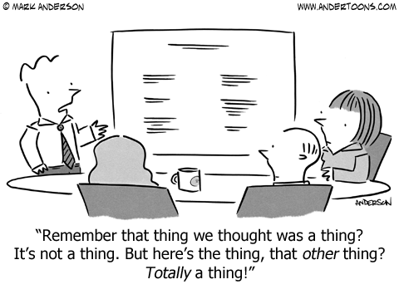
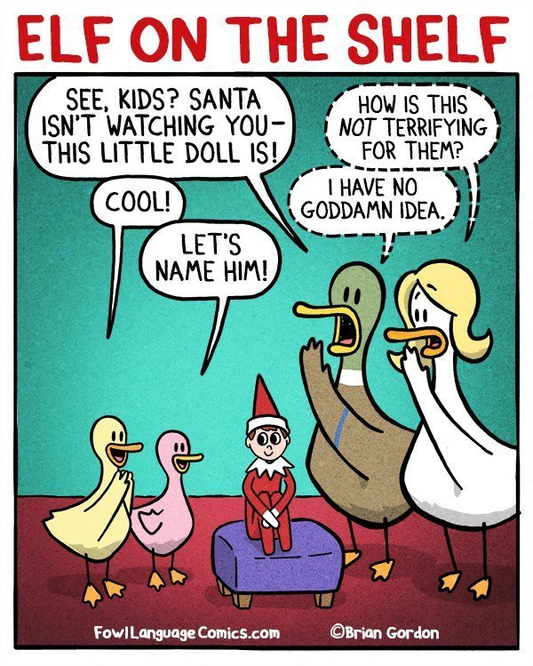
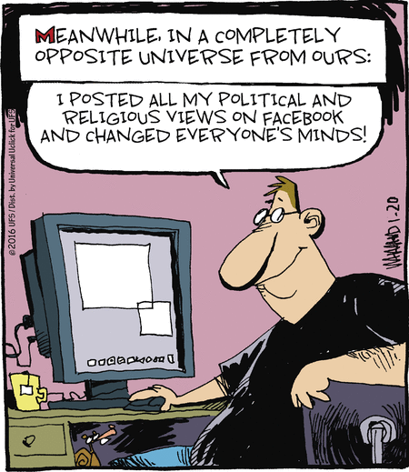
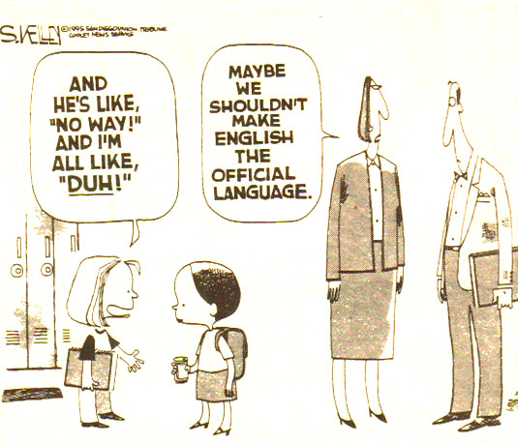
(5) Establishing a Dialogue

Slide 12
(6) Hierarchy, Iteration, Recursion and MERGE
This is the maiden, all forlorn,
Who milked the cow with the crumpled horn,
That tossed the dog,
That chased the cat,
That caught the rat,
That ate the malt,
That lay in the house
That Jack built.
I know who he is
I know
Who he is
I
know
who
he
is
ITERATION
[A who [action 1] B] + [[[[that] [action n] Cn]] x 5] + [that Jack built]
HIERARCHY
Del said that [x]
S=[C[B[A]]]
Gemma thinks that [y]
Alf likes Beth
RECURSION
This is a construct (subject-verb-object)
which contains an SVO as its object,
which contains an SVO as its object
MERGE
[Alf likes Beth] = A [NP+VP[V+NP]
[Gemma thinks that y] = B [NP+VP[V+NP]
[Del said that x] = C [NP+VP[V+NP]

Slide 13
(6) The difference between Iteration and Recursion
PROBLEM: There is a set of boxes, one of them contains a key you want.
Each box contains one item; that item can be a key, another box, or something else.
Grab a box
Grab a box
look at item
in box
look at item
in box
Item =key?
Y
You’re done
Item =key?
Y
You’re done
N
N
Item =box?
Y
Add new box to set of boxes
Item =box?
Y
Discard old box, look at new box
N
N
Discard old box
Discard old box
ITERATIVE SOLUTION: Reduce the boxes-in-boxes problem to a pile-of-boxes problem
RECURSIVE SOLUTION: Reduce the boxes-in-boxes problem to a next-box problem

Slide 14
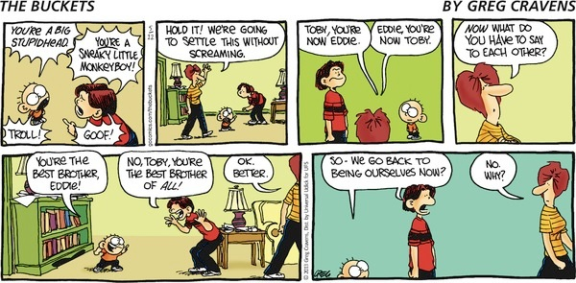
And finally ...

