Slide 1
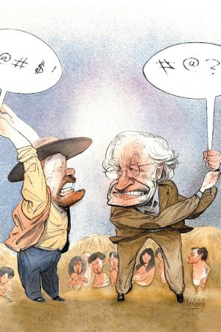
6SSEL045 – Language Origins Lecture 1 What Is Language?

Slide 2
What is language?
“I personally believe we developed language because of our deep inner need to complain.”
― Jane Wagner
“Language is my whore, my mistress, my wife, my pen-friend, my check-out girl. Language is a complimentary moist lemon-scented cleansing square or handy freshen-up wipette. Language is the breath of God, the dew on a fresh apple, it's the soft rain of dust that falls into a shaft of morning sun when you pull from an old bookshelf a forgotten volume of erotic diaries.”
― Stephen Fry
“The limits of my language means the limits of my world.”
― Ludwig Wittgenstein
“Language is the source of misunderstandings.”
― Antoine de Saint-Exupéry
“Using words to talk of words is like using a pencil to draw a picture of itself, on itself. Impossible. Confusing. Frustrating ... but there are other ways to understanding.”
― Patrick Rothfuss
“For in spite of language, in spite of intelligence and intuition and sympathy, one can never really communicate anything to anybody.”
― Aldous Huxley
“All this twaddle, the existence of God, atheism, determinism, liberation, societies, death, etc., are pieces of a chess game called language, and they are amusing only if one does not preoccupy oneself with winning or losing this game of chess.”
― Marcel Duchamp
“Language is a virus from outer space”
― William S. Burroughs
“Anyone can speak Troll. All you have to do is point and grunt.”
― J.K. Rowling

Slide 3
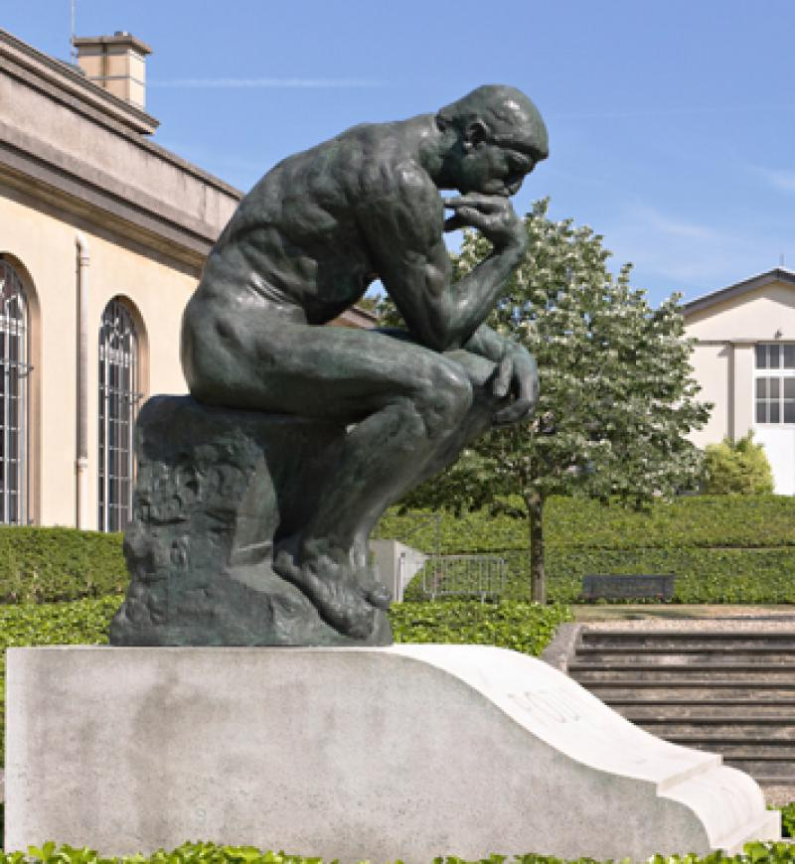
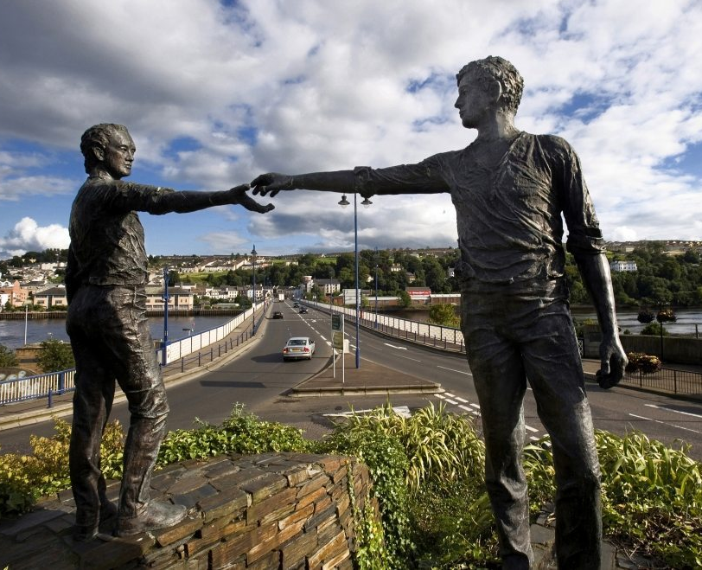
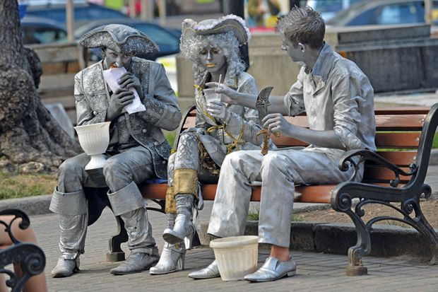
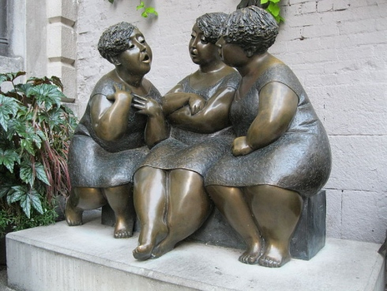
What is language for?
Thinking?
The Thinker, Auguste Rodin, Paris
Signalling?
The Smoke Signal,
Ellis Luis Burman,
Pioneer's Park, Lincoln, Nebraska
Social Instrument?
Hands across the Divide,
Maurice Harron, Derry, Island of Ireland
Communication?
Les Chuchoteuses,
Rose-Aimée Bélanger, Montréal, Canada
Socialisation?
Living statues on lunch break

Slide 4
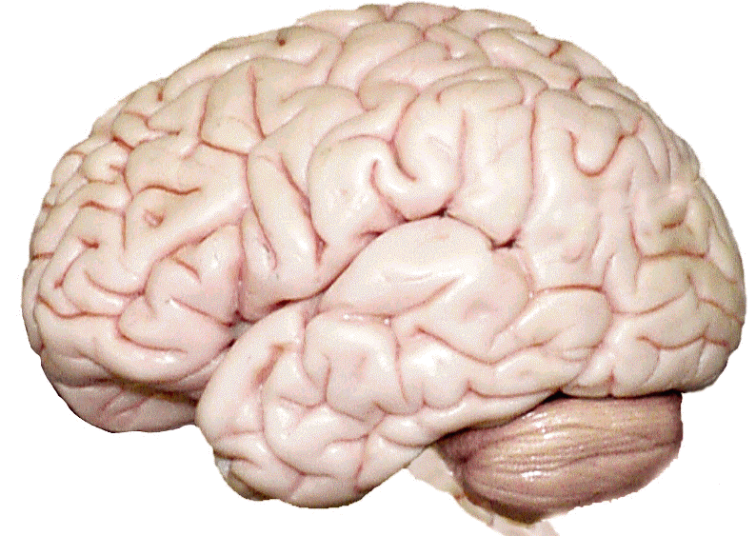
How does language work?
Signal
Motor Control Area
Intention
Message
Lexis
Semantics
Syntax
Grammar
Phonology
Motor Control Area
(Mirror Neurons)
Under-standing
Lexis
Semantics
Syntax
Grammar
A simplistic view of the features involved in language production and reception
Phonology

Slide 5
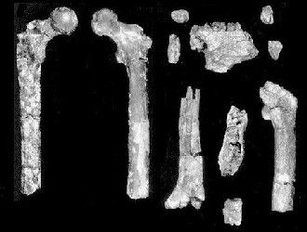
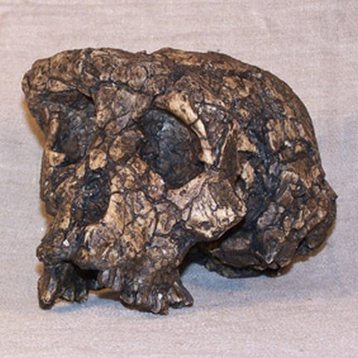
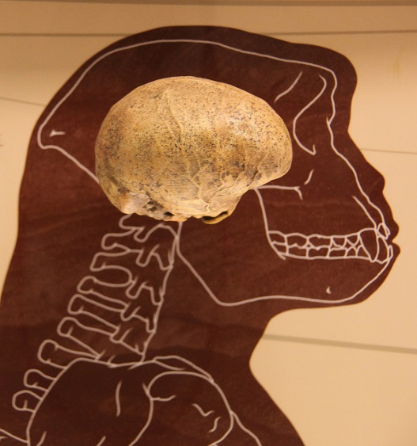
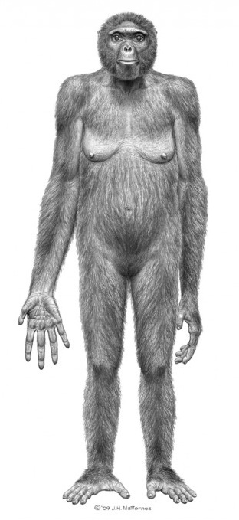
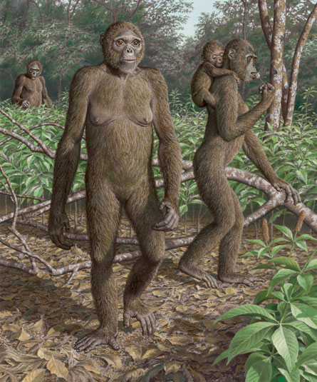
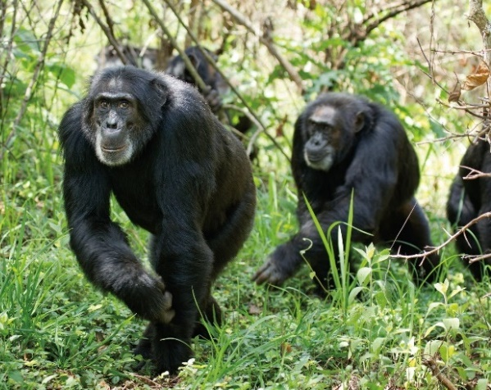
Ardi, the uncommon ancestor
Orrorin
tugenensis
Sahelanthropus tchadensis
Ardipithecus ramidus
Not

Slide 6
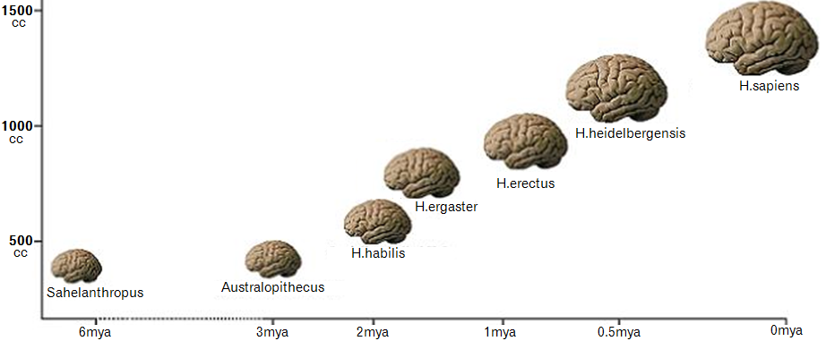
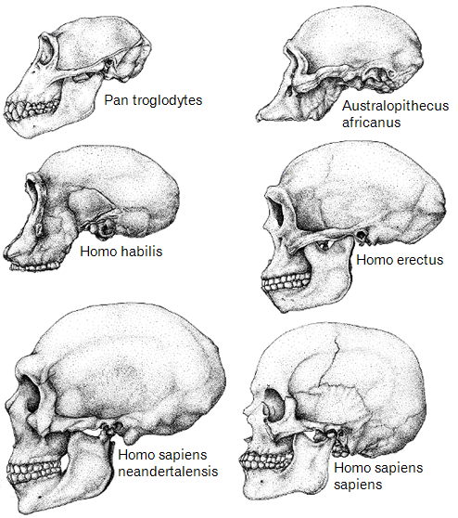
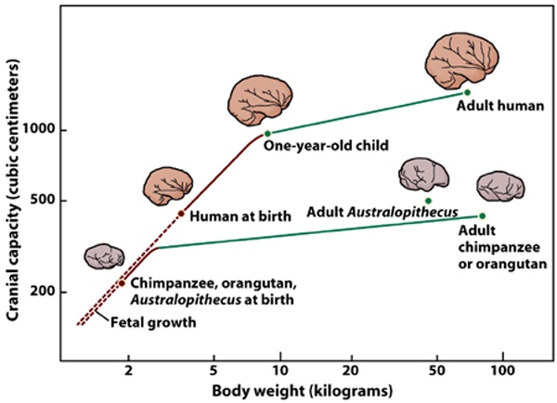
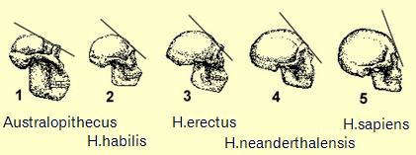
Building bigger brains

Slide 7
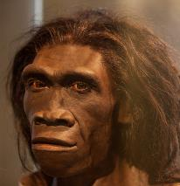
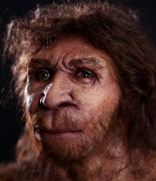
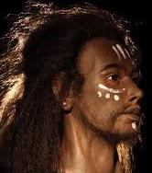
How old is language?
Homo naledi

Slide 8
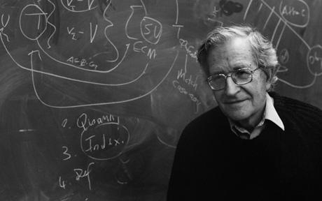
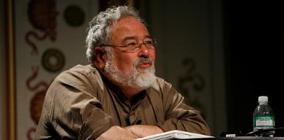
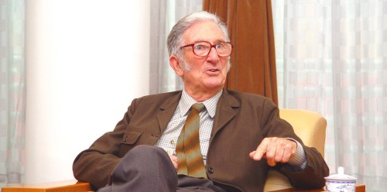
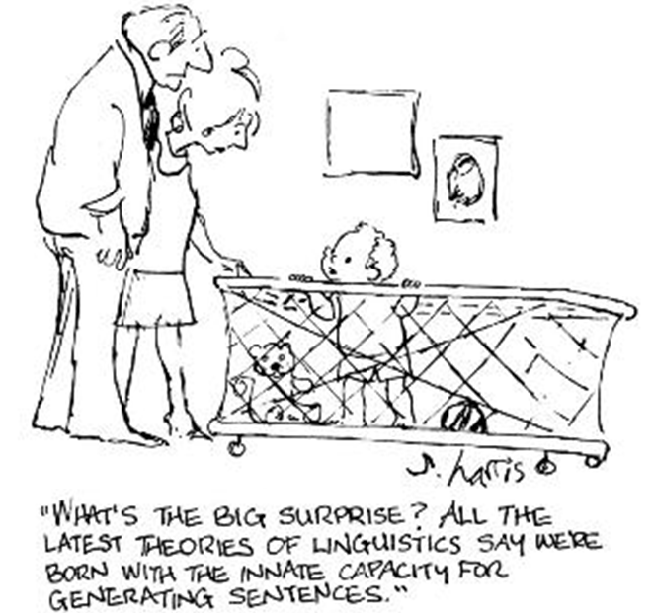
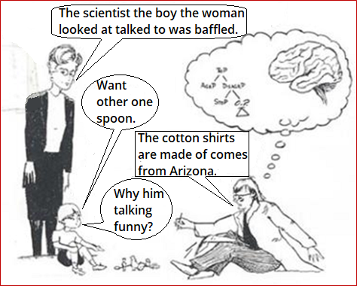
Three key –isms of linguistics
Most thought is unconscious. It doesn’t work by mathematical logic. You can’t reason directly about the world—because you can only conceptualise what your brain and body allow, and because ideas are structured using frames … all words are defined in terms of conceptual frames, not in terms of some putative objective, mind-free world.
George Lakoff
[On language:] First, it is transmitted physically, by sound waves travelling through the air; secondly, it is produced and received biologically, by the human brain and its associated organs of speech and hearing; thirdly it is exchanged socially, in contexts set up and defined by the social structure; and fourthly it is organized semiotically as a system of meanings. M.A.K. Halliday
In fact a very tiny part of language is externalized – what comes out of your mouth, or from your hands if you’re using sign. But even that part is often not used for communication in any independently meaningful sense of the term “communication”.
Noam Chomsky, 2012
You only think you’re barking at nothing. We’re all barking at something.

Slide 9
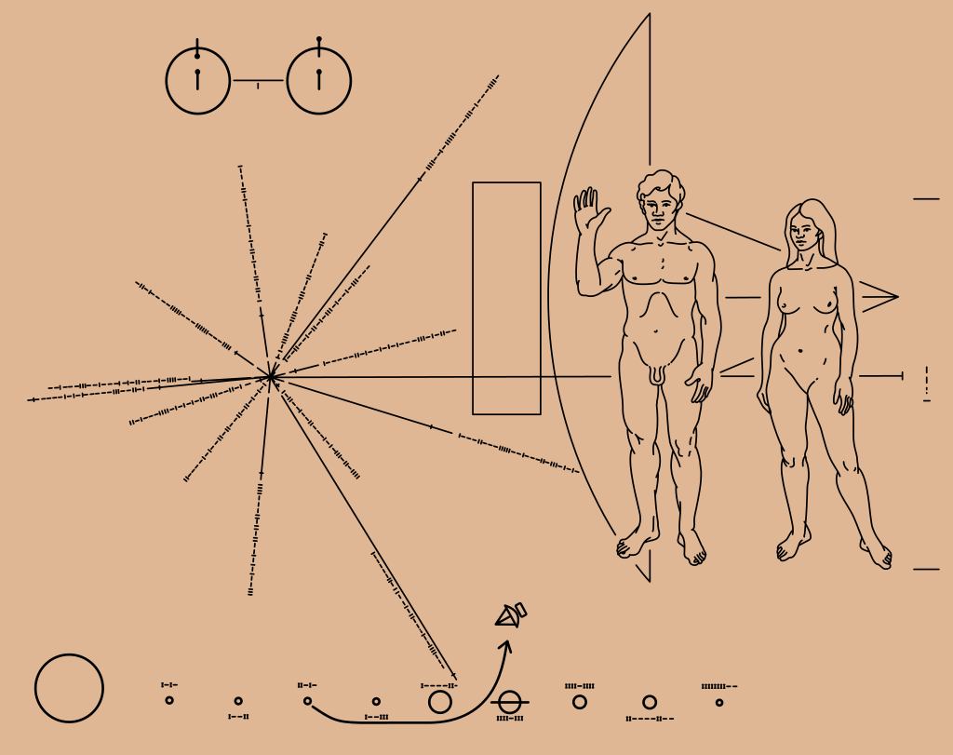
What is being human?
Hydrogen atom
The Pioneer spacecraft shape
Distances and directions to 14 local pulsars, with pulse sequences
This is what we have told aliens about us (a plaque on the Pioneer spacecraft)
The Happy Couple
Solar system

Slide 10
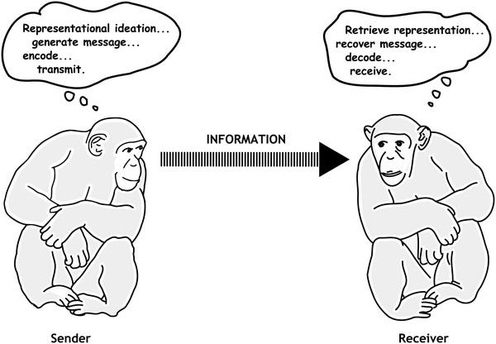
Is language uniquely human?
Human spoken language seems to be adventitious. The exploitation of organ systems with other functions for communication in humans is also indicative of the comparatively recent evolution of our linguistic abilities.
Carl Sagan
Just because brains have different shapes and are wrapped in different bodies, it does not mean they are incapable of doing similar things. The brain is primarily for interpreting and responding to sensation, and primates have the same senses as us.
The chimpanzee study was - well, it's still going on, and I think it's taught us perhaps more than anything else to be a little humble; that we are, indeed, unique primates, we humans, but we're simply not as different from the rest of the animal kingdom as we used to think.
Jane Goodall

Slide 11
How we got to language
http://martinedwardes.me.uk/eaorc/eaorc_languageroute.html

Slide 12
And finally ...

