Slide 1
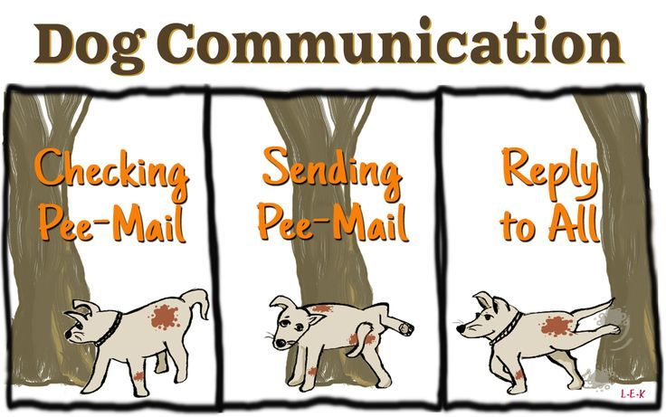
6SSEL045 – Language Origins
Lecture 2
Nonhuman Communication

Slide 2
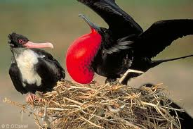
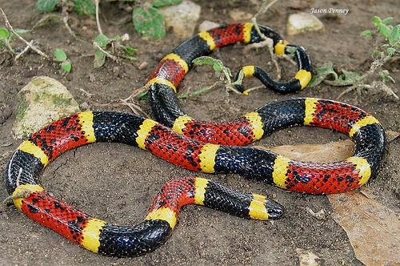

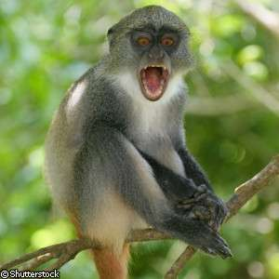
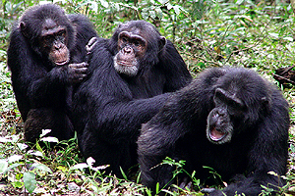
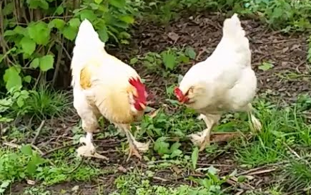
Why do nonhumans communicate?
Mating
Male Frigate bird displaying to female
Deterrence
Coral snake
Red in black OK for Jack;
Red in yellow kills a fellow.
Displaying emotion
American Grizzly bear
Warning
Vervet monkey giving leopard warning call
Building alliances
Chimpanzees grooming
Food calling
Roosters often call to the hens when they find good food

Slide 3

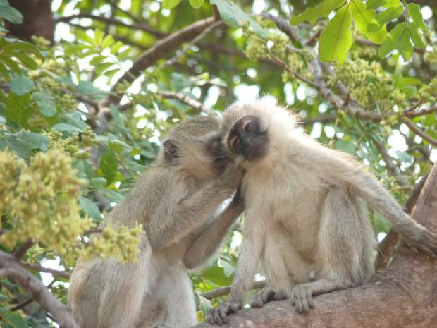
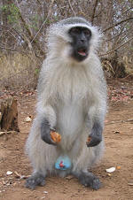
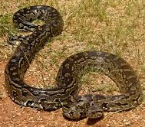
Language-like features of nonhuman signalling
Reactive
[Grunt]
Reliable
Systematic
Voluntary
[Chutter]
Reliable
Grooming is Voluntary
– but is it Reactive, Reliable and in the same System as warning calls?
Reactive
Reactivity, Reliability, Systematicity, Volition –
They are all here, just not all at the same time
Warning calls are Reactive, Reliable and Systematic
– but are they Voluntary?

Slide 4
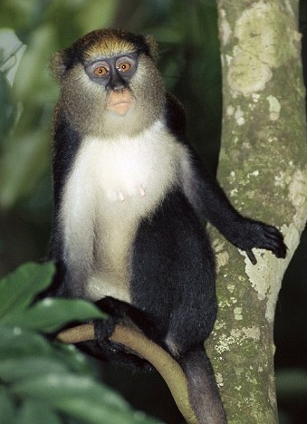

How do nonhumans mean?
Campbell’s Monkey (Cercopithecus campbelli) Eagle Warning Call
Get out of tree!
Eagle!
Hok!
Hok!
Sender meaning and receiver meaning
do not need to be
the same for signals
to work

Slide 5


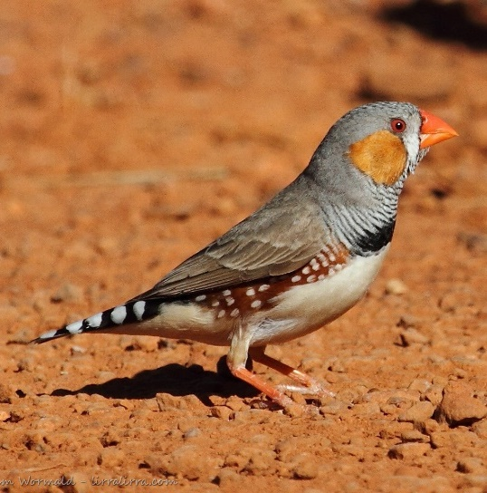
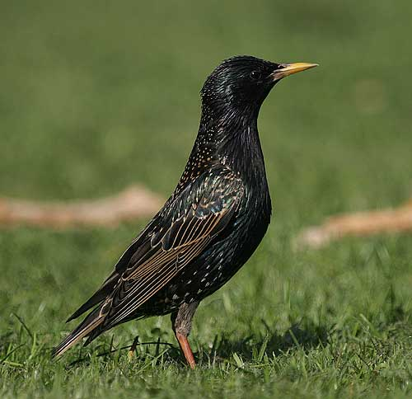

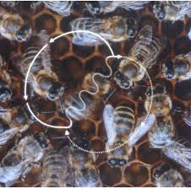
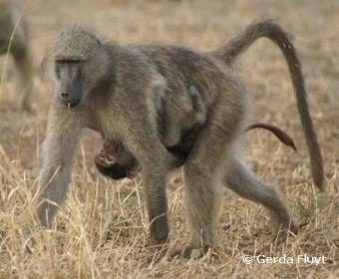


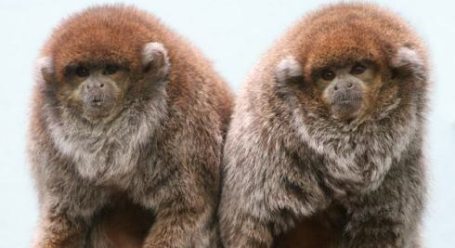
Do nonhumans use compositionality?
Segmentation
Differentiation
Hierarchy
Recursion
Segmentation
Differentiation
Hierarchy
Recursion

Slide 6
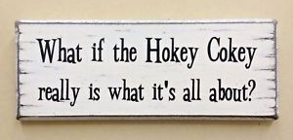
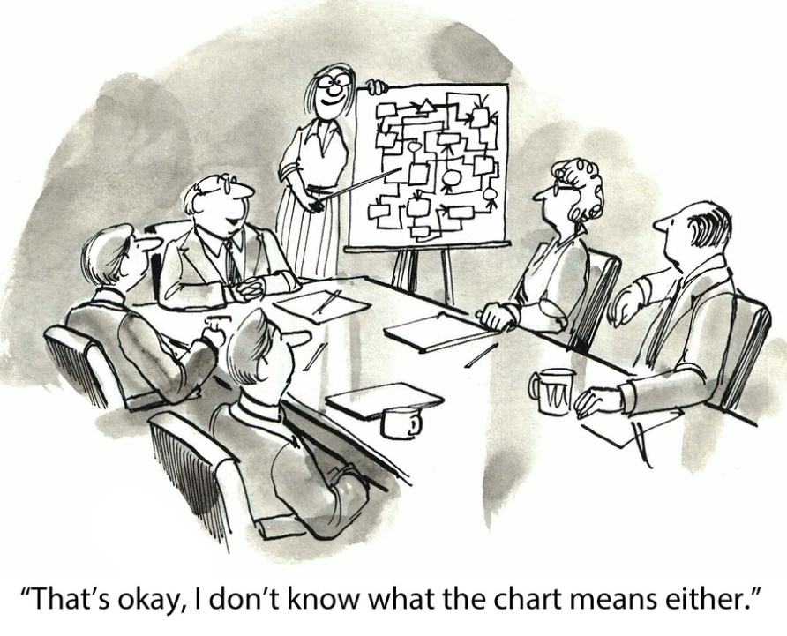

Nonhumans & signal complexity
In nonhumans …
Semantic Recursion …
Modality …
The boy the girl the man saw teased cried.
Limited
Seems to be
absent
Complex exchange &
Altruism …
Highly
Co-operative
Social System
Absent?
Mostly
absent

Slide 7
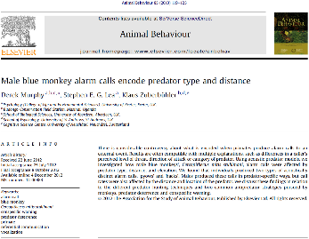
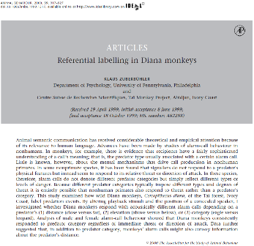
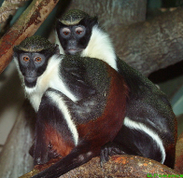
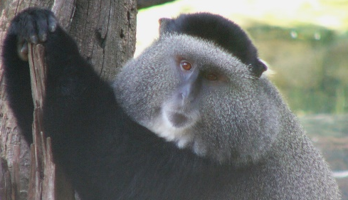
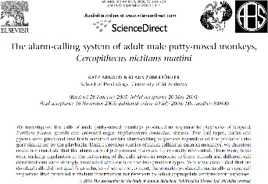
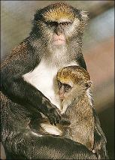
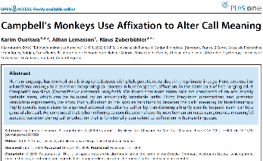

Wild monkey signalling

Slide 8
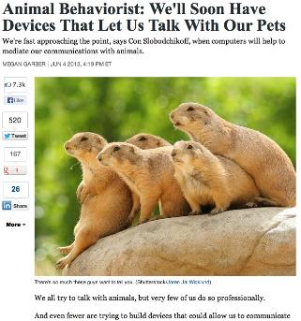
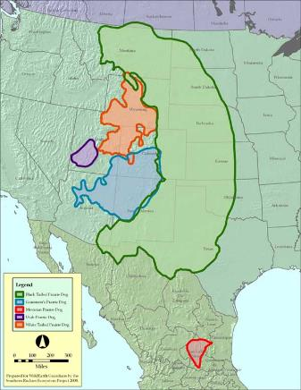
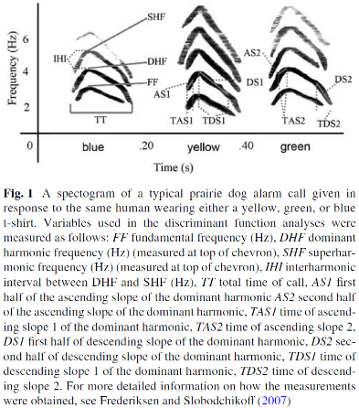

Prairie dogs
(Cynomys gunnisoni)

Slide 9
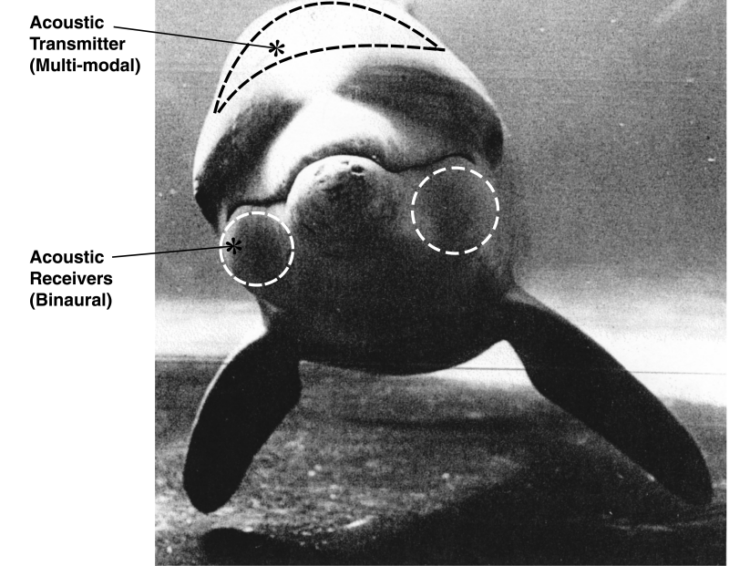
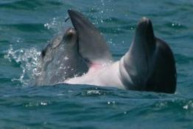
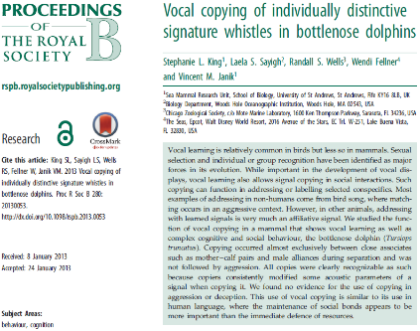
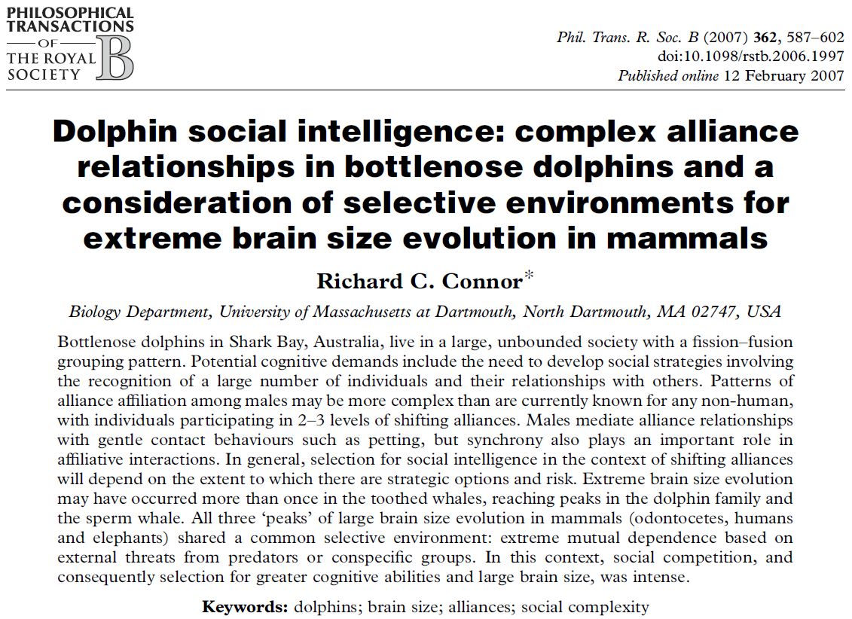
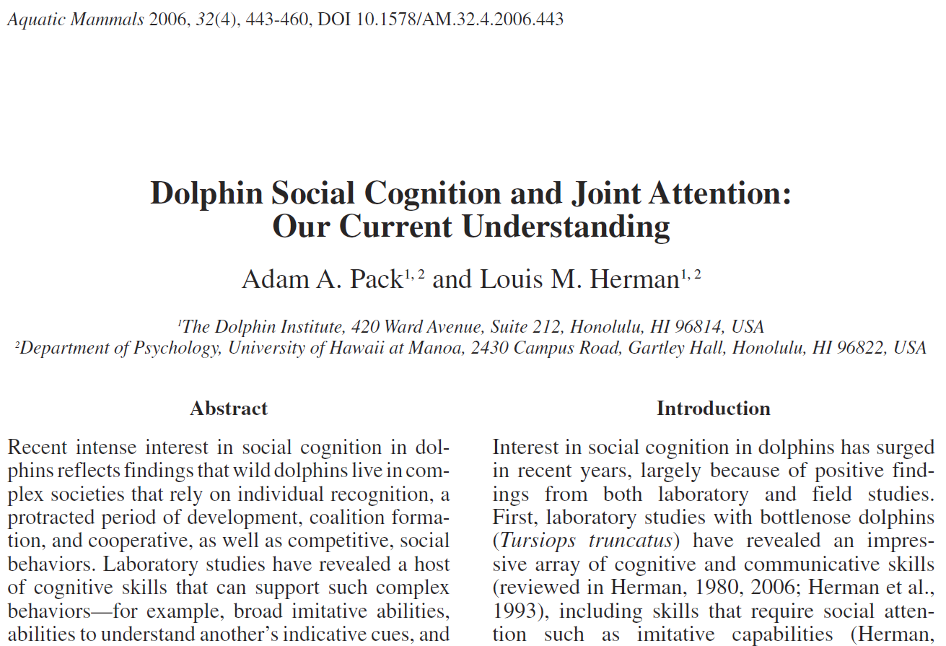
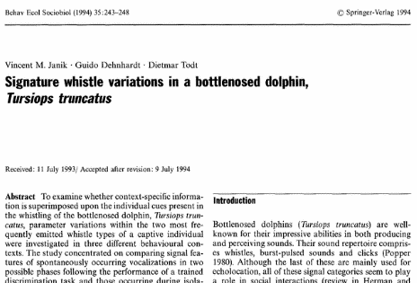
Dolphins

Slide 10
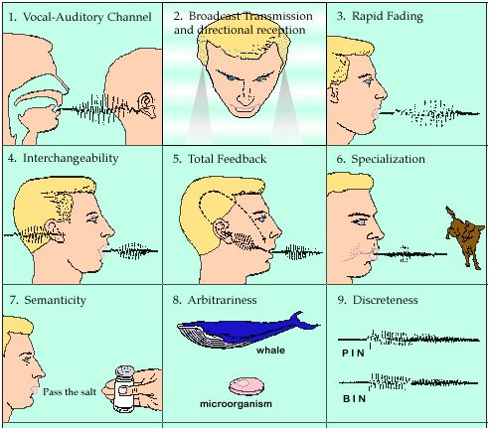
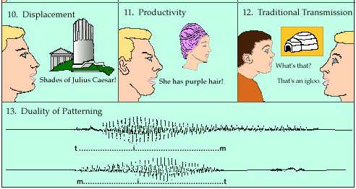
Humans and language
Charles Hockett’s design features of language, 1960
According to Hockett:
Only features 9 through 13 are exclusive to the hominoid clade.
Only features 10, 11 and 13 are exclusive to modern humans.
The other 8 features are common to all primates.
Features 9, 12 and 13 are now known to be present in nonhuman communication, leaving only 10 & 11 as exclusively human.
In 1963 Hockett added Deceit, Reflexivity and Learnability. We now know all three of these are present in nonhuman communication. Nonhumans using human language also seem able to master features 10 and 11.

Slide 11
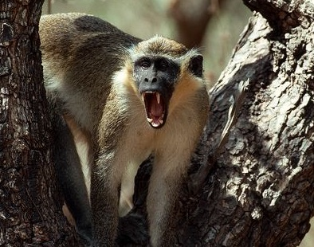
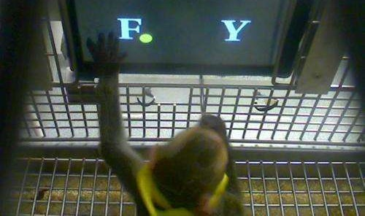
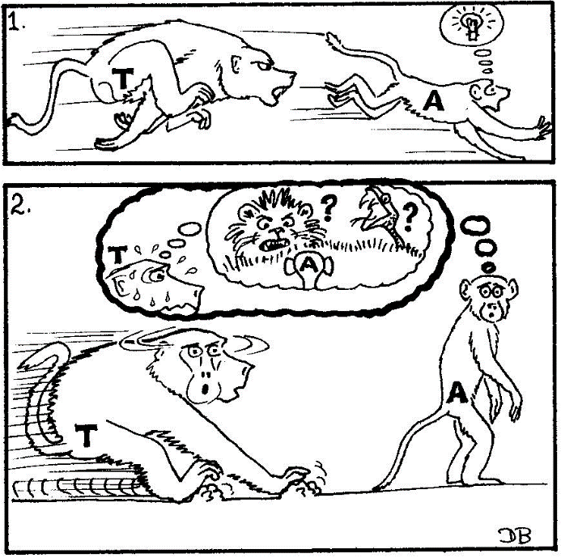

Where nonhuman meaning resembles human meaning
Deception
Calculation
Tool-making
http://video.nationalgeographic.com/video/news/chimps-pound-missions-vin?source=relatedvideo
https://www.youtube.com/watch?v=TtmLVP0HvDg
https://www.youtube.com/watch?v=Wex59IATah4

Slide 12
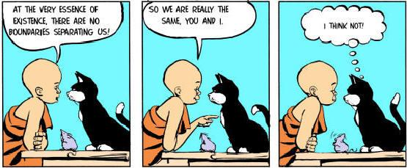
And finally ...

