Slide 1
2020 BA ELL Poster Competition
WHAT YOU DO
Create a dynamic and informative poster reflecting any area of linguistics
PRIZES
For each year group:
1st prize of £125
and
2nd prize of £75
Posters can be viewed on
Tuesday 11th February
12:30 to 1:30pm
in FWB 1.60
TO TAKE PART
send an email to l.sankaran@kcl.ac.uk before 5th February, giving:
The title of the poster
Name(s) of participant(s)
Type of poster (digital or printed)
Individual and group entries are welcome
If you produce a printed poster you will be reimbursed for your printing costs.
You can submit a poster even if you cannot attend the poster competition itself.

Slide 2
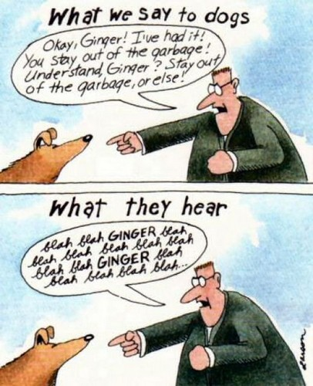
6SSEL045 – Language Origins Lecture 3 Nonhumans Using Human Language
Can they be as good at it as some humans?

Slide 3
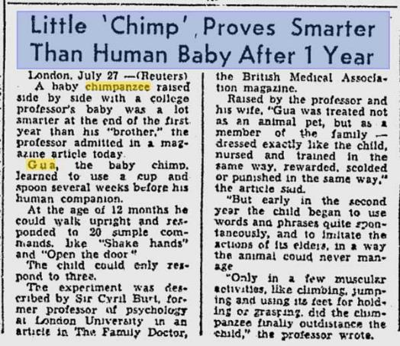
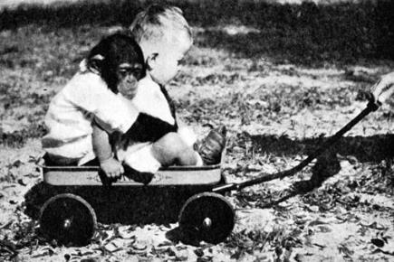
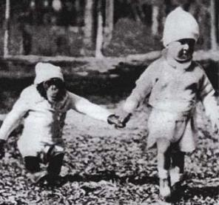
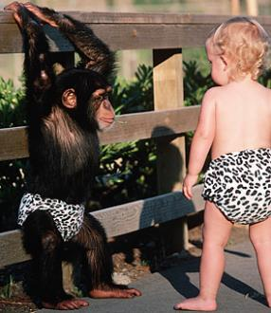
Gua (1930-1933)

Slide 4
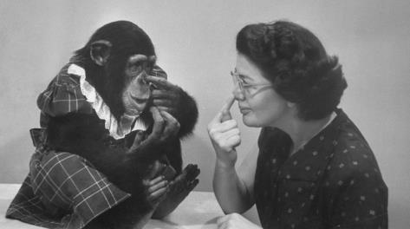
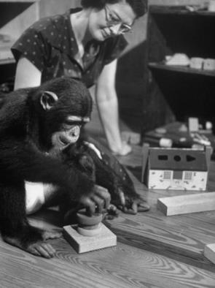
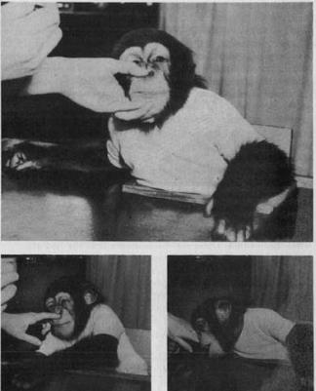
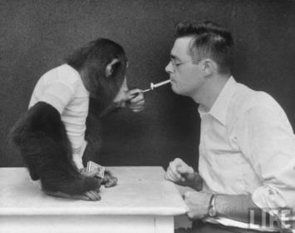
Viki (1947-1954)

Slide 5
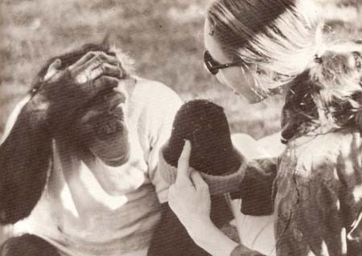
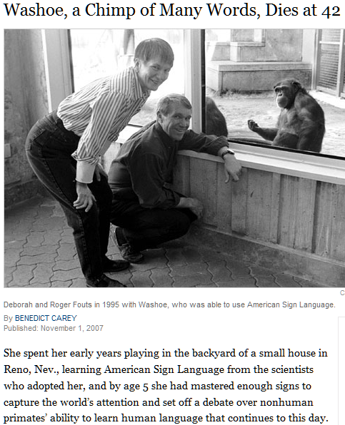
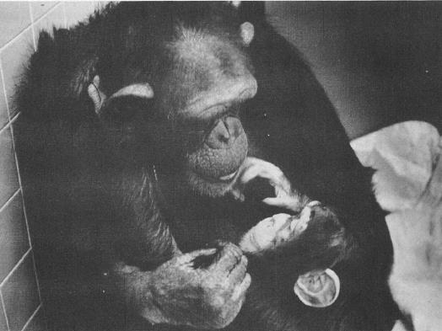
Washoe (1965-2007)

Slide 6
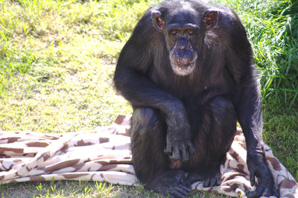
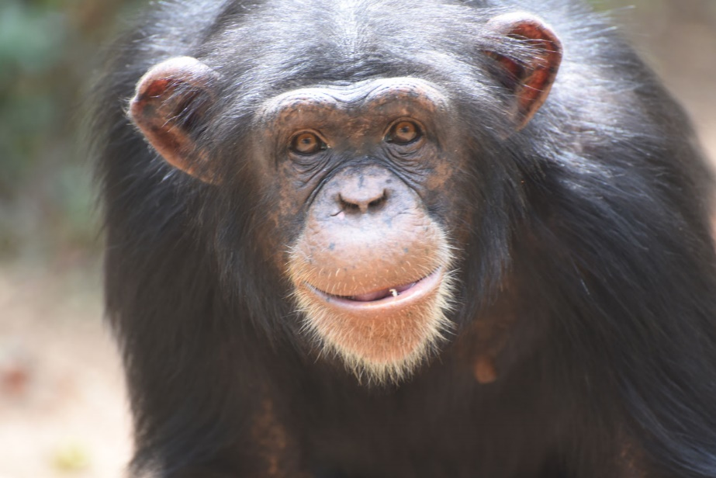
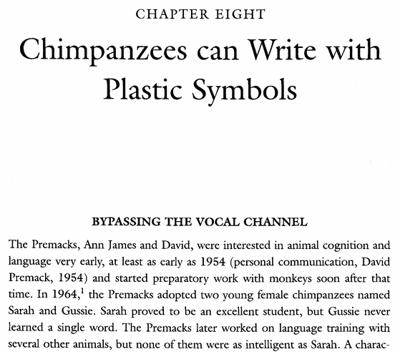
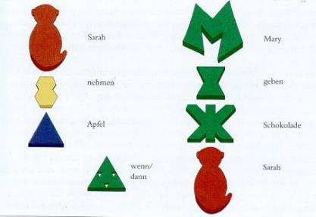
Sarah (1959-2019)
Sarah take apple when/then Mary give chocolate [to] Sarah

Slide 7
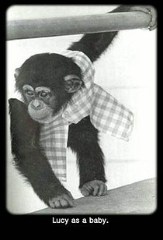
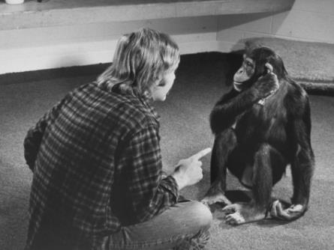
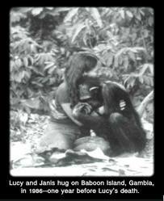
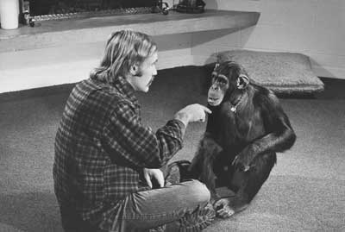
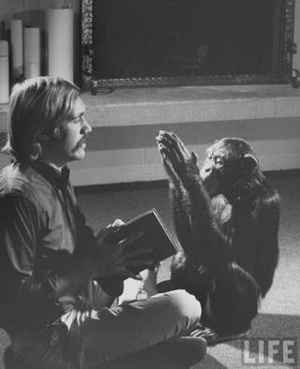
Lucy (1964-1988)
Lucy as baby
Lucy & Janis hug on Baboon Island, Gambia, in 1986 – one year before Lucy’s death

Slide 8
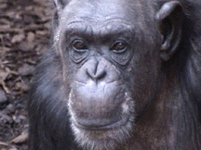
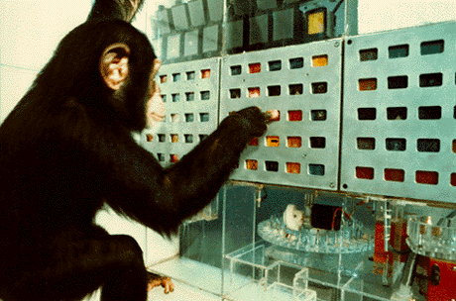
Lana (1970-2016)

Slide 9
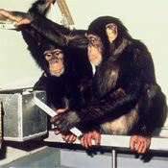
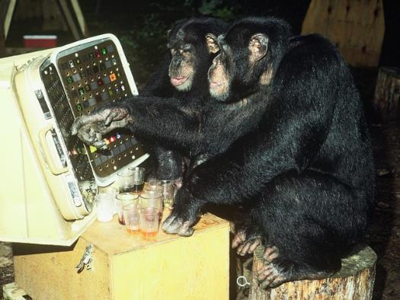
Sherman & Austin (1973-2018) (1974-1996)

Slide 10
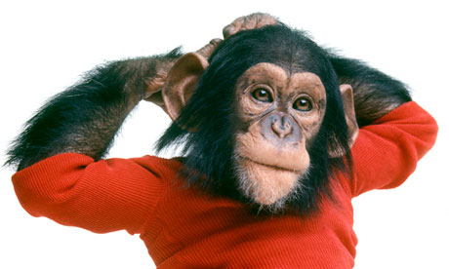
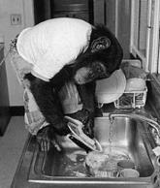
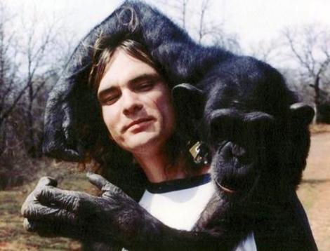
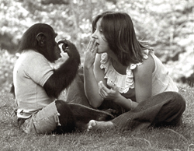
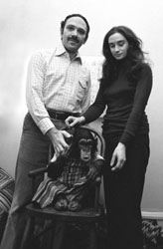
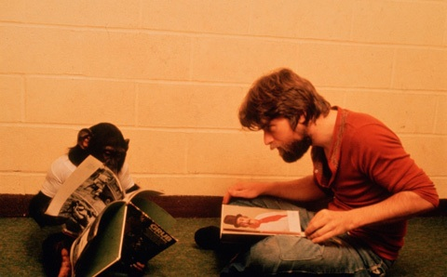
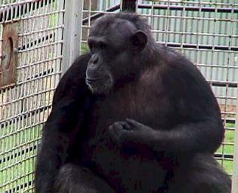
Nim Chimpsky (1973-2000)

Slide 11
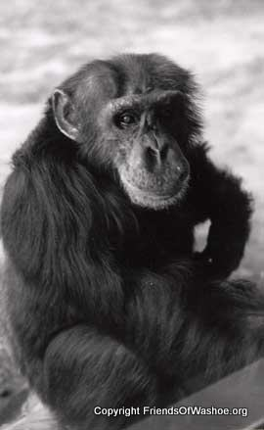
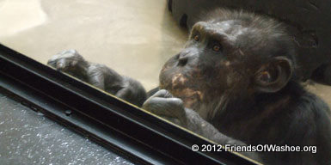
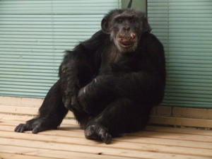
Loulis (1978-)

Slide 12
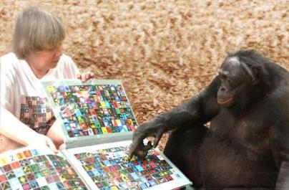
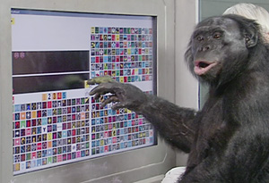
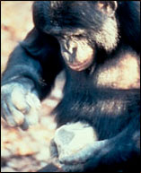
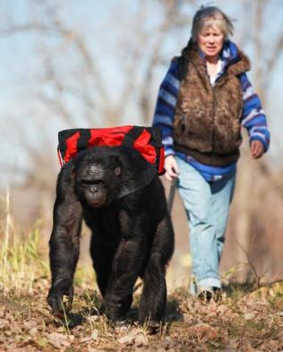
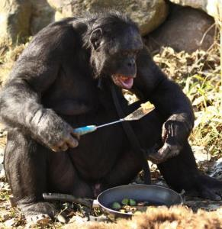
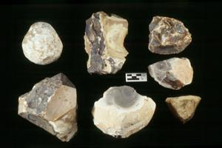
Kanzi (1980-)

Slide 13
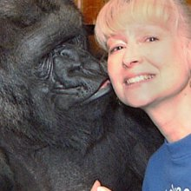
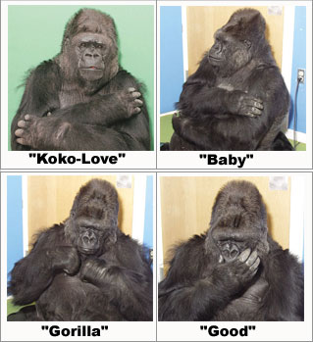
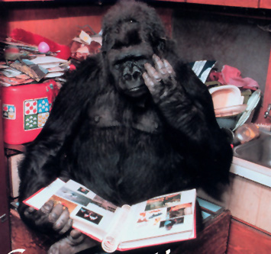
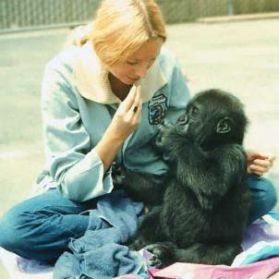
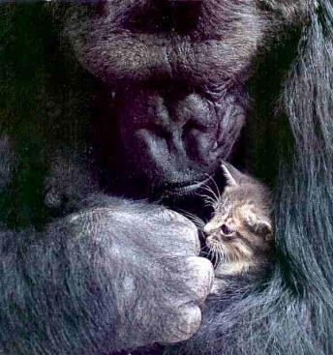
Koko (1971-2018)

Slide 14
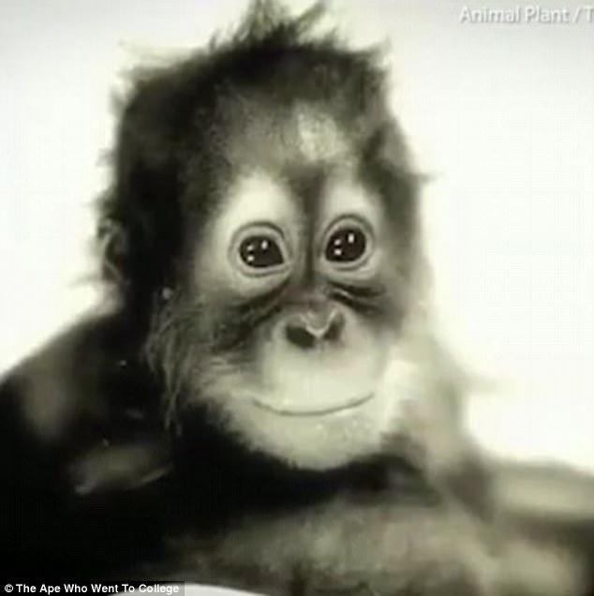
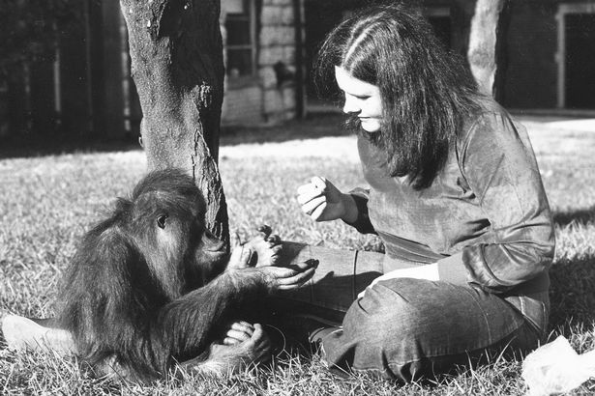
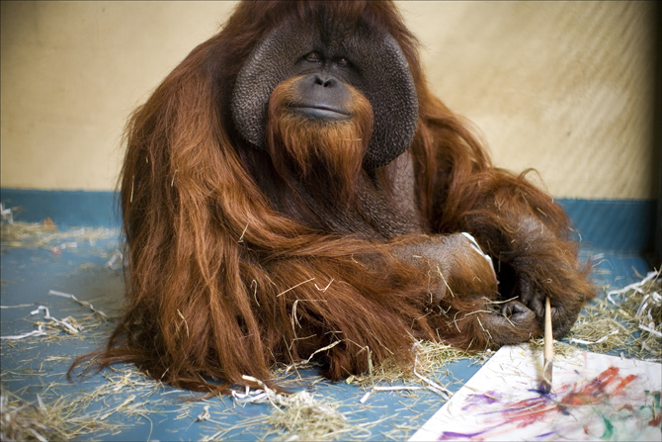
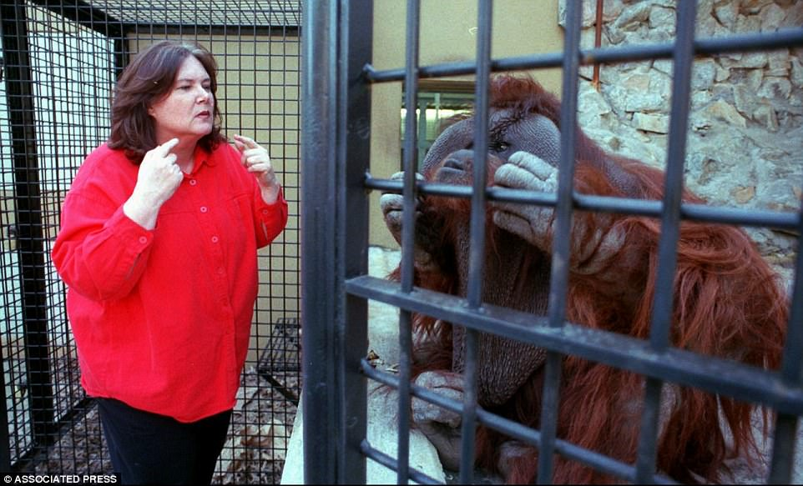
Chantek (1977-2017)

Slide 15
Alex (1976-2007)

Slide 16
Rico & Chaser (1994-2008) (2004-2019)

Slide 17
Dolphins
Jarvis Bastian
Buzz & Doris
Akeakamai & Louis Herman
Akeakamai & Phoenix

Slide 18
What does this tell us about language?
Is this the best we can do?
What would the human version of these diagrams look like?
Relaxed contentment
Curious alert
Dozy
Asleep

Slide 19
And finally ...

