Slide 1
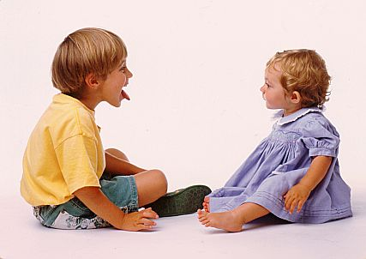
6SSEL045 – Language Origins Lecture 4 How Human Children Acquire Language

Slide 2
Linguistics problem 1:
Innate or Learned?
 | Nativist Approach to Explaining Language Acquisition | Social-Communicative Approach to Explaining Language Acquisition
Easy to explain | Language is mostly innate. Language is modular and specialised. | Language uses the same mechanisms as other cognition. Language evolved from existing communication systems. Language evolved to enable complex communication.
Hard to explain | How does language interface with other cognition? How did the specialist modules evolve? What evolutionary need did language satisfy? | How does a child differentiate language from other events? How do the language systems in the brain work together?
 | Nativist Approach to Language Origins | Social-Communicative Approach to Language Origins
What | Language is a monolithic cognitive system which is independent of all other cognitive and communicative systems. Its communicative use is incidental. | Language is a communicative tool which is segmented, differentiated and hierarchical, and which can be recursive. It is the product of a series of evolutionary events in cognition, communication and socialisation.
How | As a single genetic mutation gave early humans the capacity for recursive cognition (Chomsky’s MERGE). Once evolved, it was so useful that language-users quickly replaced non-language-users in the population. | As a series of genetic changes, each of which met a particular cognitive or communicative need. PLUS As a response to an increasingly sophisticated socialisation and enculturation.
Why | The mutation was random, so there is no reason why. | Because evolutionary pressures favoured co-operative and communicative traits in the population.
When | As a single event between 150kya and 40kya. | As a continuing process between 1mya(?) and today.
Where | Unknown. | Initially Africa.
Who | Later Homo sapiens. | H.heidelbergensis likely first to use protolanguage, so it was genetically available to descendent species, and possibly culturally available to co-existing species.

Slide 3
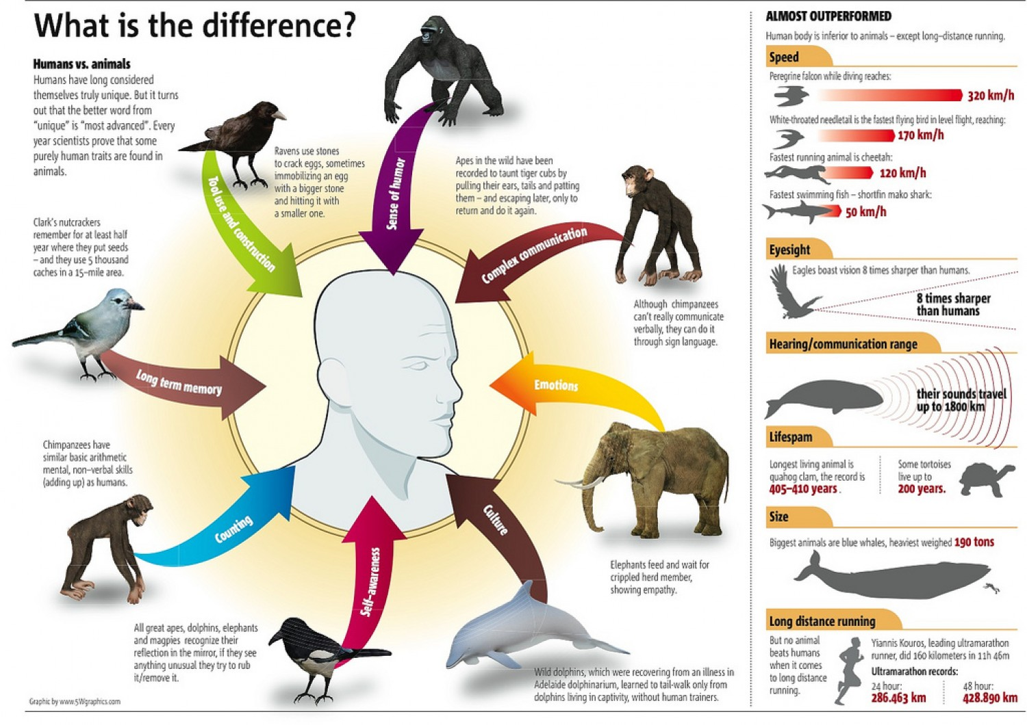
Linguistics problem 2:
Prefigured or Unique?

Slide 4
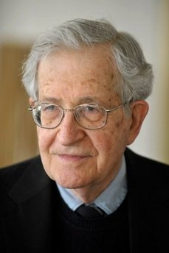
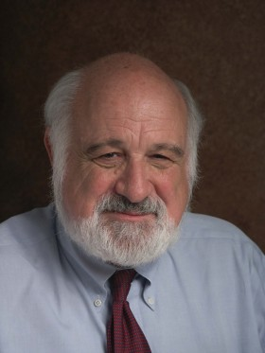
Linguistics problem 3:
Thinking or Communicating?
99% of use of language never even gets expressed – it’s internal.
we adhere to the view that the primary function of language is communication.
“The requirement not to be rude about judges applies only to judges in this country. It does not apply to judges in the EU, so let me be rude about them. Let me indulge in the floccinaucinihilipilification of EU judges”.
Noam Chomsky
Michael Arbib
Jacko Brie-Smogg

Slide 5
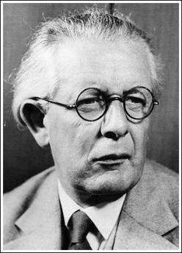
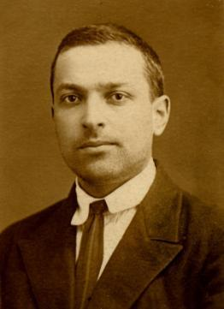
Two classic models of
language acquisition
Lev Vygotsky (1896-1934)
“Every function in the child’s cultural development appears twice: first, on the social level, and later, on the individual level; first, between people..., and then inside the child. This applies equally to voluntary attention, to logical memory, and to the formation of concepts. All the higher functions originate as actual relations between human individuals.”
Jean Piaget (1896-1980)
“We recall how, starting with purely practical and quasi-physiological groups, the child begins by elaborating subjective groups, then arrives at objective groups, and only then becomes capable of representative groups.”

Slide 6
Child language development
It may be as difficult to derive a grammar from hearing unconnected static sentences as it would be to derive the invariance of quantity and number from simply looking at liquids in containers and objects in space. The changes produced by pouring back and forth and by gathering together and spreading apart are the data that most strongly suggest the conservation of quantity and number. We suspect that the changes sentences undergo as they shuttle between persons in conversations are, similarly, the data that most clearly expose the underlying structure of language.
Roger Brown
A child's developing linguistic system can be represented in a systemic grammar as interrelated sets of options in meaning, together with their realisations.
Michael Halliday
Language learning is a dynamic process in which children continually redescribe their current language model, matching against the input while relying less and less on external support for their conclusions about grammar.
Kathy Hirsh-Pasek & Roberta Michnick Golinkoff
Children get their information about language from their caretakers and the adults around them. Infants are remarkably sensitive to statistical regularities they hear in language, in sound patterns, grammatical inflections on words, patterns for coining new words, and constructions in adult speech. They tend to pick up on the most frequent nouns, verbs and adjectives first, and then extend their range. In doing this, they depend on social interaction. They attend to what is in the joint focus of attention for adult and child, to what is physically and conversationally present, and hence to the language directed to them as addressees. Indeed, social interaction is essential to the process of acquisition.
Eve V Clark

Slide 7
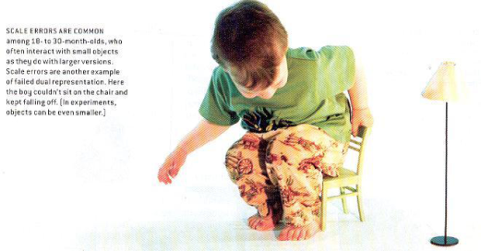
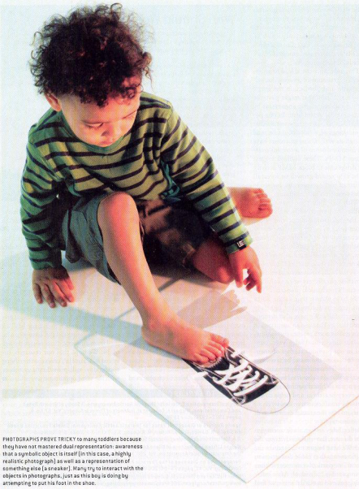
Infants don’t understand models

Slide 8
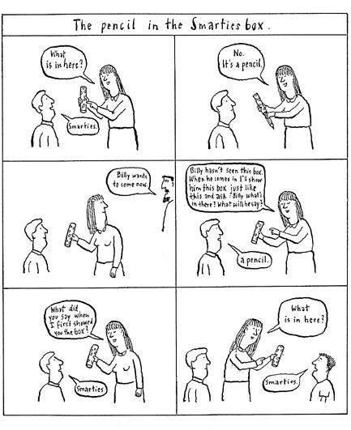
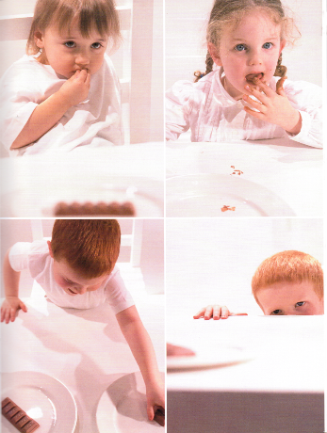
Chocolate and Smarties

Slide 9
Development through childhood
0-6 | 6-9 | 9-12 | 12-18 | 18-24 | 24-36 | 36-48 | >48 | Theorist
Sensorimotor stage |  |  |  |  | Preoperational stage |  |  | Piaget
Preverbal thought |  |  |  |  | Verbal thought |  |  | Vygotsky
Solitary play |  |  |  | Parallel play | Parallel play | Associative play | <72m: Co-operative play >72m: Intentional play | Kaye
Unaware of self | Acculturation in progress |  |  |  | Self aware |  |  | Kaye
Encounters with others treated by default as benign |  |  |  |  | Beginnings of negotiation: wheedling |  | Others have minds | Gopnik, Meltzoff, Kuhl
Learning about others | Learning expressions and behaviour |  | Others are agents | Others have agendas | Empathy | Taking control of self | Theory of Mind | Gopnik, Meltzoff, Kuhl
Generalised soundmaking |  | Language-specific babbling | Single words |  | Simple Grammar | Full language |  | Gopnik, Meltzoff Kuhl
Pre-language | One word utterances |  |  | Two word utterances |  | Full language |  | Brown
Accoustic packaging |  | Segmentation, linguistic mapping |  |  | Complex syntactic analysis | Full language |  | Hirsh-Pasek, Golinkoff
 |  | Instrumental, Obligatory, Intentional, Personal functions | Imaginative function | Heuristic Function |  | Informative function? |  | Halliday
Language learning |  |  |  |  | Learning through language |  | Learning about language | Halliday
Vocabulary up to 500 words |  |  |  |  | Vocabulary increasing by 1,000-3,500 words p.a. |  |  | Clark

Slide 10
And finally …

