Slide 1
You will receive a personalized link to the survey on 13th February
for every survey done, KCL will donate £1 to Centrepoint, a homeless youth charity
You can pick up a KCL class of 2019-20 tote bag from WBW 1/1 (just show email confirmation of having completed the survey!)
It only takes 10 minutes!
Assessments
Supervision
More can be done to improve aspects of feedback and assessment
Deadlines for 2nd/3rd year coursework spread out/varied deadlines introduced
Tutorials are now timetabled at the start of the year for all students on the programme. Year 3 students now have one timetabled tutorial per semester
A new grading form focusing on ‘strengths’ and ‘areas for improvement’ was introduced on KEATs to improve marking consistency

Slide 2
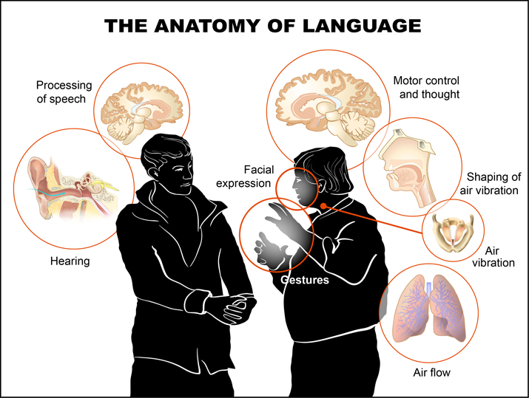
6SSEL045 – Language Origins Lecture 5 Sound and Gesture
5
1
2
3
4

Slide 3
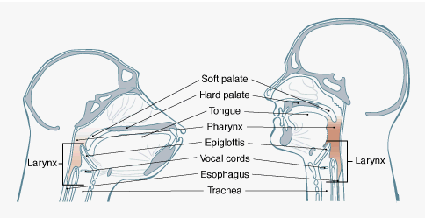
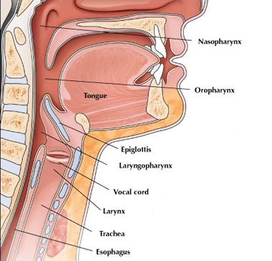
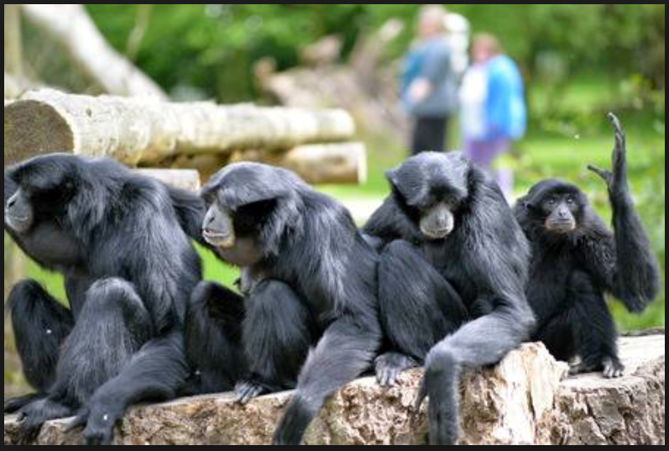
The Vocal Tract
Later Homo
Pan-Homo Common Ancestor
Australo-
pithecus
Bipedality
Early
Homo
Chest Cavity, Lungs, Airflow
Simiang gibbons
(Symphalangus syndactylus)
– the singing gibbons

Slide 4
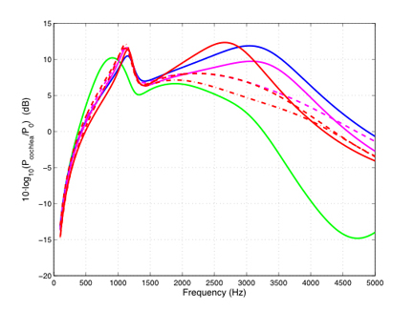
The Auditory System
Homo sapiens
vocal loudness
Pan troglodytes
vocal loudness
About Hearing:
The curved lines show the effectiveness of hearing at different frequencies.
The line height indicates how much sound gets through the auditory channel.
Chimp (Pan troglodytes) hearing gets worse at higher frequencies.
The top hearing frequency for both humans and chimps is about 20,000 Hz.
Homo sapiens
Homo heidelbergensis
Pan troglodytes
About Vocalisation:
Although base vocal frequency ranges are low (human 85-400, chimpanzee 200-500), formant frequencies give them higher-pitched overtones.
Maximum human voice loudness is about 90db (off this chart).
Maximum chimpanzee voice loudness is about 100db (off the chart).
The human voice gets softer as pitch rises, the chimp voice gets louder.
See:
J. Braga et al. (2015).
Disproportionate Cochlear Length in Genus Homo
Shows a High Phylogenetic Signal during Apes’
Hearing Evolution. In PLoS ONE 10:6, e0127780.

Slide 5
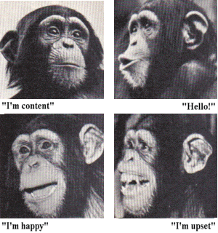
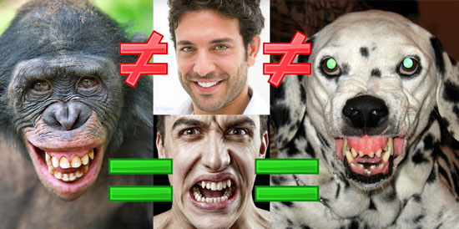
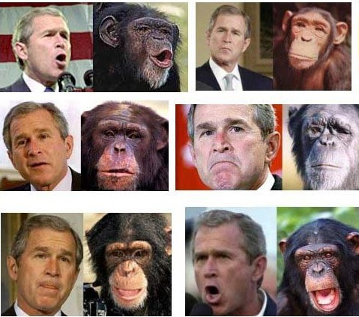
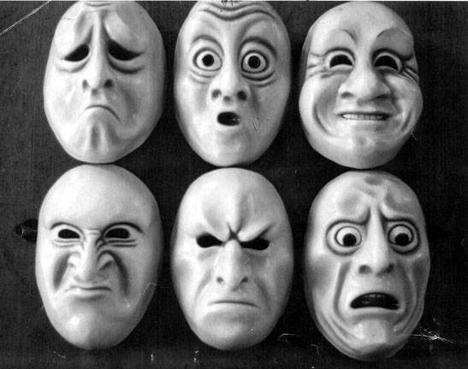
Facial Expression

Slide 6
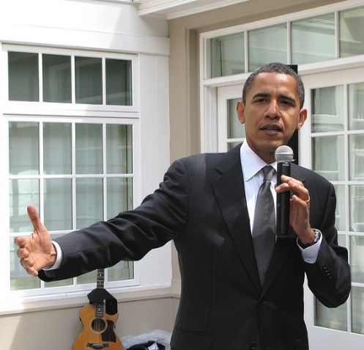
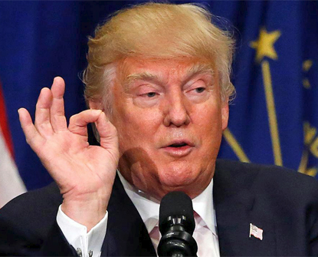
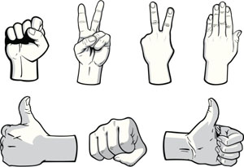
Complex Gesture

Slide 7
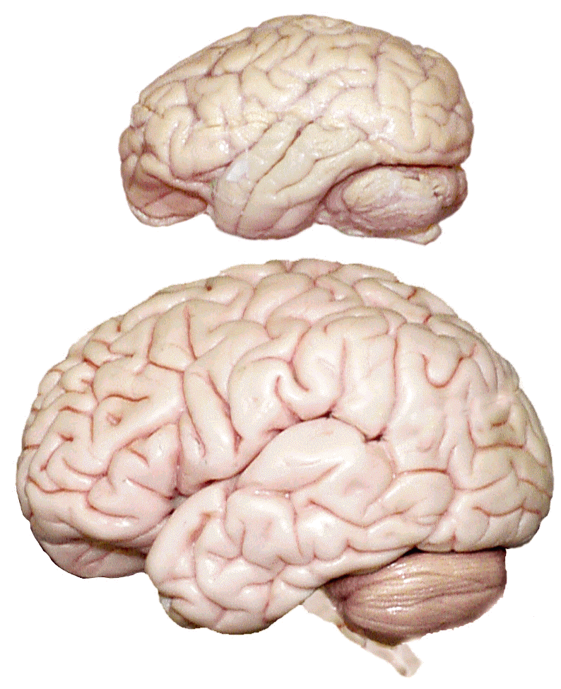
Language in the Brain
Chimpanzee brain
Lips & mouth motor cortex
Hand motor cortex
Fronto-polar cortex
Supra-marginal gyrus
Broca’s area
Angular gyrus
Auditory cortex
Wernicke’s area
Orbitofrontal cortex
[Inferior frontal gyrus]
Exner’s area??
Human brain

Slide 8
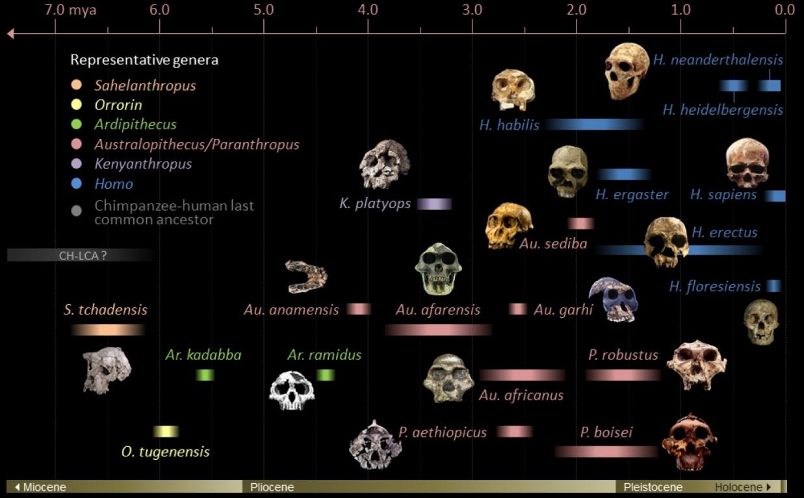
What Happened When?
Lips, Cheeks, etc.;
Facial Expression;
Complex Gesture
Functional Bipedality
Chest, Air flow, etc.
Tongue & Larynx;
Auditory system
RECENT BRAIN SIZES
H.heidelbergensis
≈ 1300cc
Neanderthal
≈ 1600cc
Pleistocene H.sapiens
≈ 1500cc
Holocene H.sapiens
≈ 1350cc
Brain size ≈700cc
Recent Brain sizes ≈1400cc
Brain size ≈900cc
Brain size ≈475cc
Homo naledi
Brain size ≈350cc

Slide 9
Was human language originally gestural?
The main sources of current evidence are: (1) Signed languages invented by deaf communities share with speech the essential characteristics of language, including such properties as reference, generativity, grammar, and prosody; (2) Great apes in captivity are much better able to learn intentional communication systems based on manual gestures than to acquire speech; (3) The manual gestures of chimpanzees in the wild are more flexible and context-independent than their vocalizations; (4) The mirror system in the primate brain provides a natural platform for the evolution of language; it represents manual gestures and some nonvocal oral movements, but not vocalizations.
Michael C. Corballis, 2010, p2.
How are gestures recognized as meaningful in these ways? As was already suggested, they are forms of action that—although schematized, abbreviated, and often conventionalized—tend to be recognized as derived from forms of practical action … In my view, this suggests that gestures can best be understood as forms of action derived from how one uses one’s hands to show or change the shape or form of things … It seems they are understood exactly as actions of this sort, and that, once a person is able to perform the action, he or she can arrive at its aim, providing a clue to the concept (or class of concept) that the gesture is used to conjure up.
Adam Kendon, 2017, p168.
Over a century of ape language research has yielded strong evidence in support of the importance of gesture in language evolution and revealed that apes can learn many aspects of language previously thought to be uniquely human when reared in language-enriched environments from infancy … Early interactive routines, and opportunities to share attention more generally, may be central to the symbolic development of apes, as they are for human children.
Kristen Gillespie-Lynch et al, 2014, p7.
The human language-ready brain rests on evolutionary innovations that extend far back in the primate line, including possessing a mirror system for dexterous manipulation, and then to complex imitation, pantomime, protosign and the extension of protosign and protospeech. However, language – as distinct from protolanguage – is unique to humans – as distinct from protohumans – and reflects a rich history of human inventions of tools for increasingly subtle communication.
Michael Arbib, 2008, p18.

Slide 10
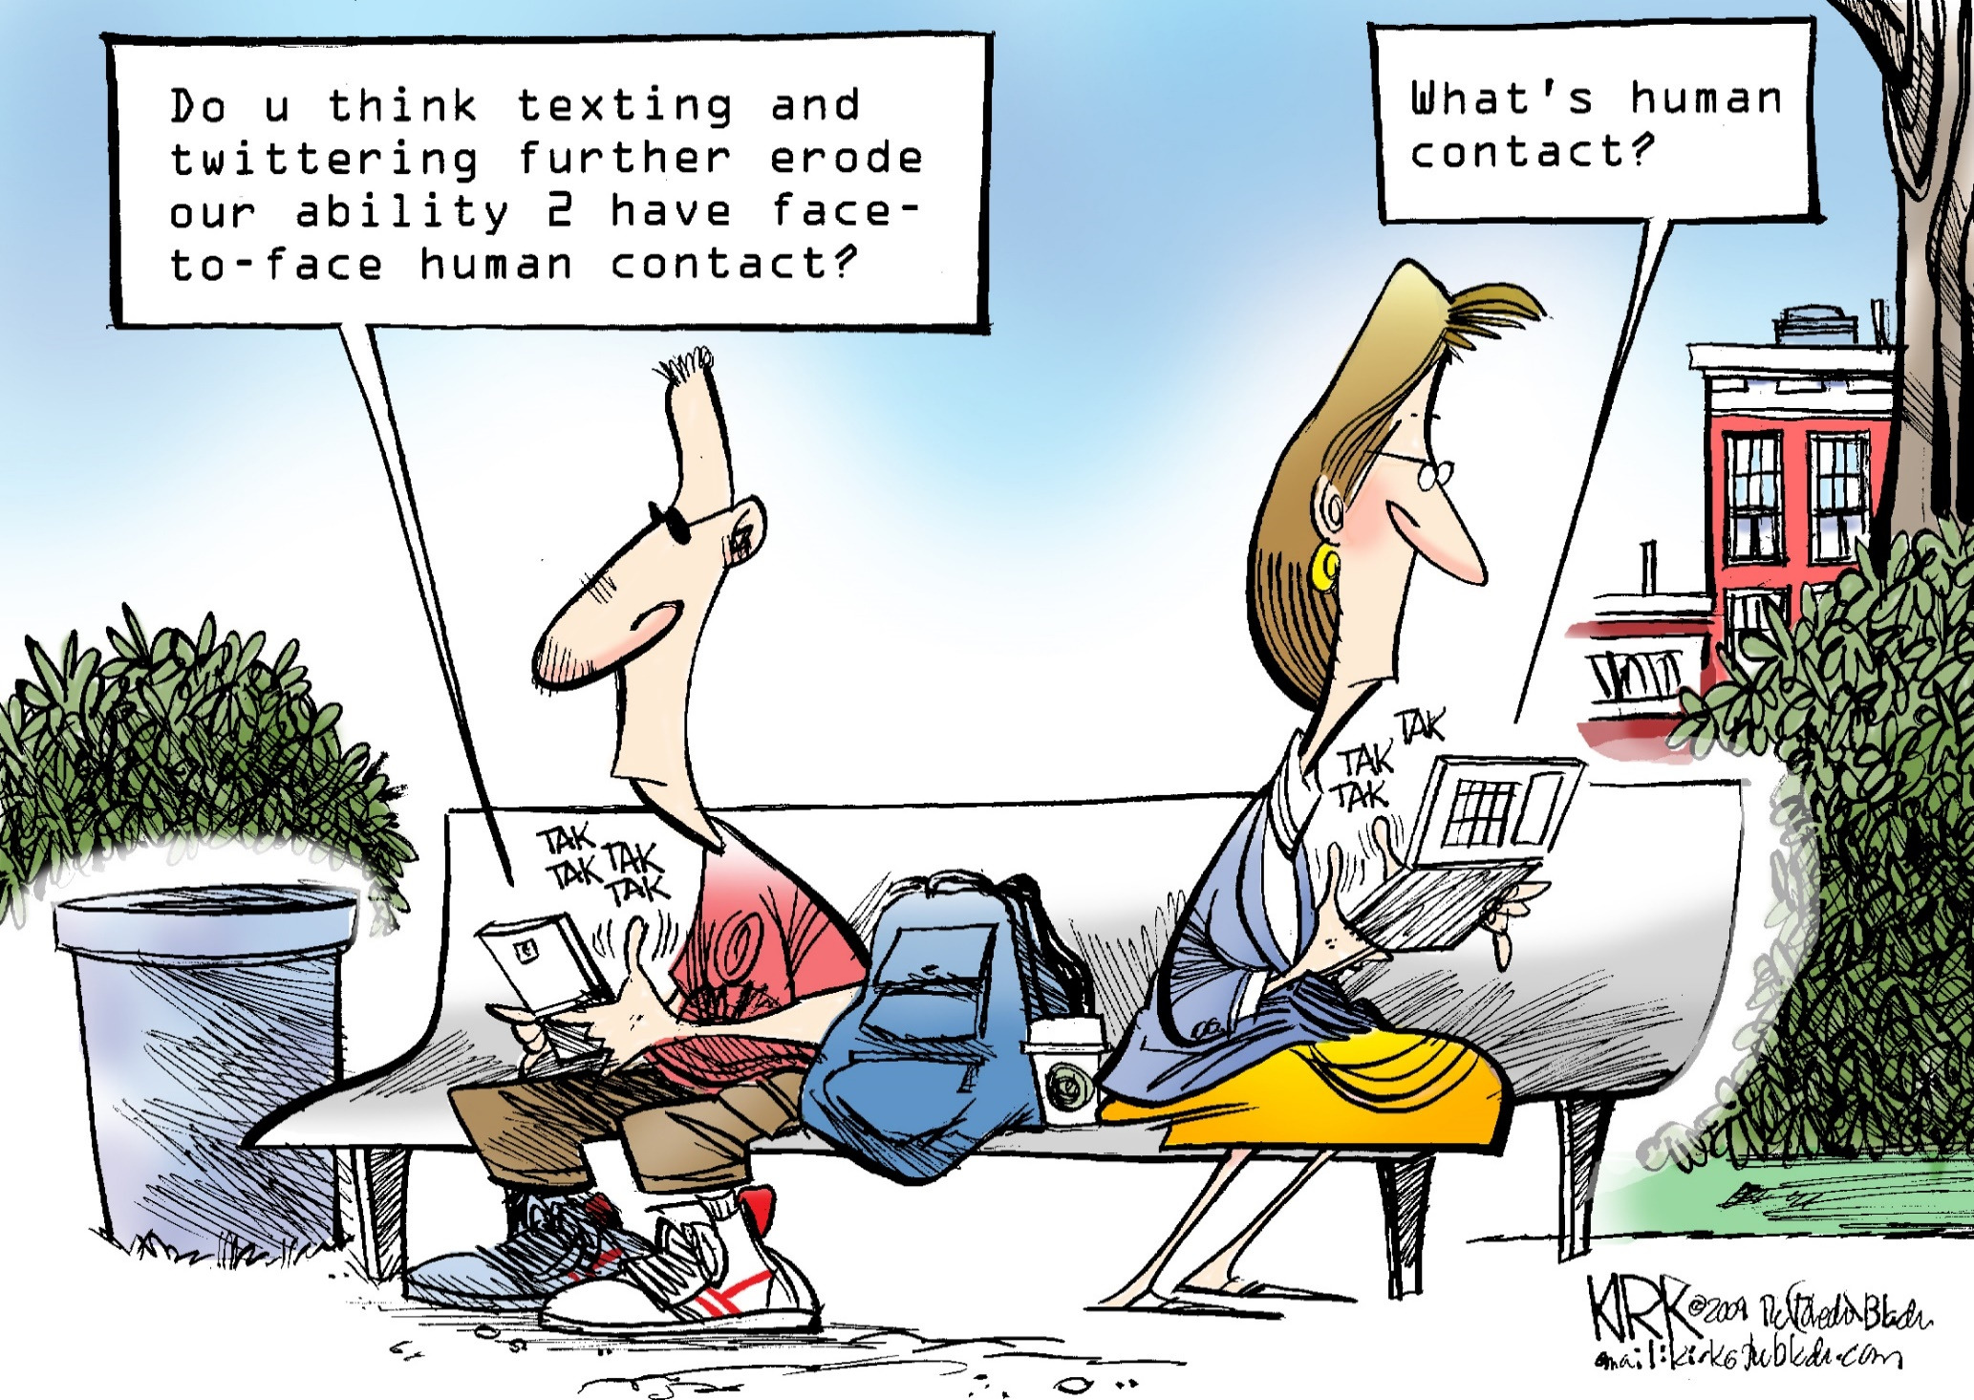
And finally …

