Slide 1
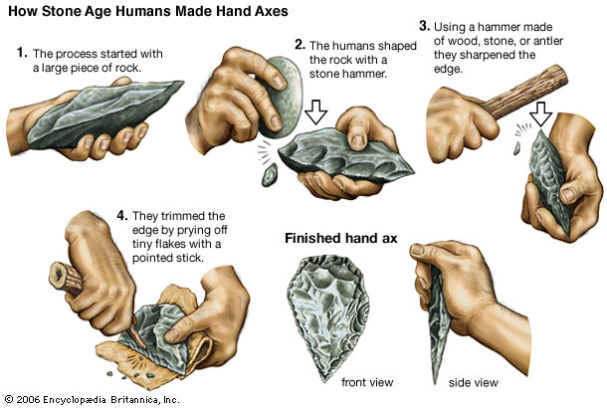
6SSEL045 – Language Origins Lecture 6 Tools and Cognitive Complexity

Slide 2
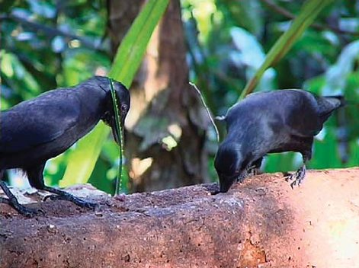
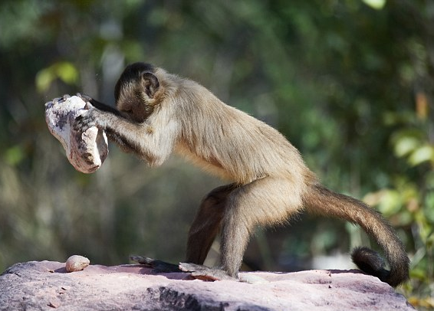
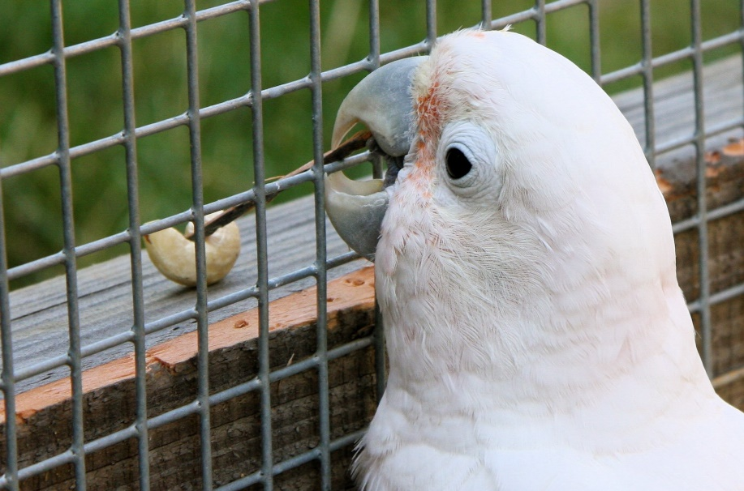
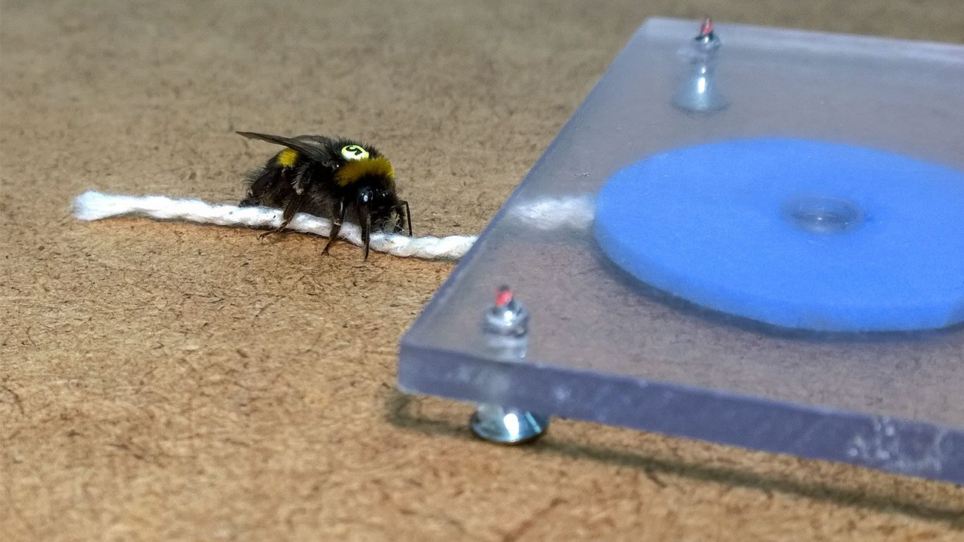
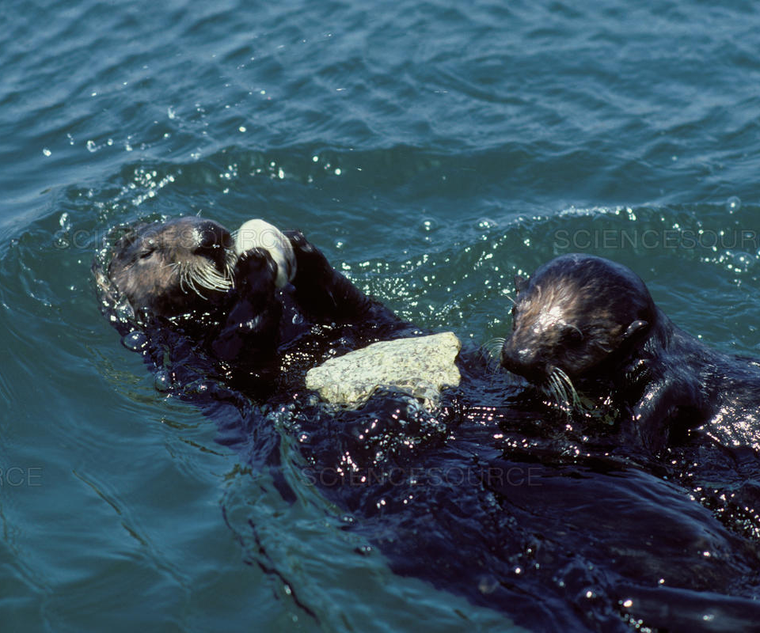
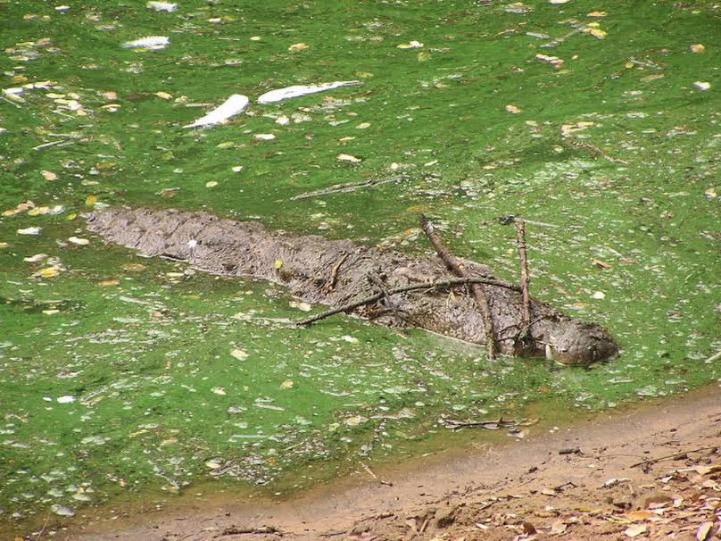
Nonhuman Tool Use
New Caledonian crows grub-fishing using a pandanus leaf (L) & a stick (R)
Capuchin monkey cracking a nut
Figaro (Goffin’s cockatoo)
retrieving a cashew
Bumble bee pulling a string
to get a nectar reward
Sea otter cracking clam
Crocodile using sticks and mud
to look like a log

Slide 3
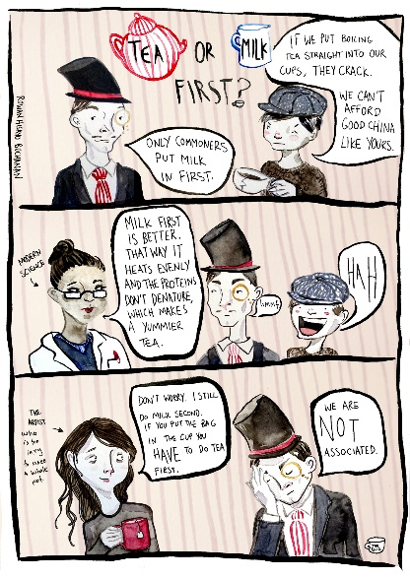
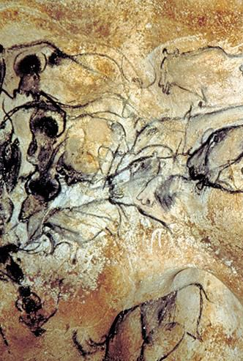
Tool Use and Language
Physical Environment
=
Instrumental
extensions
Correct
usage
Correct
sequencing
Nested
iteration
Object ⇨
process
Negotiation toward meaning
Social Environment
falls
in
mainly
on
plain
rain
Spain
The
the
This is the cat
That killed the rat
That ate the malt
That lay in the house
That Jack built
Word
⇩
Sentence
⇩
Dialogue
⇩
Conversation
⇩
Relationship

Slide 4
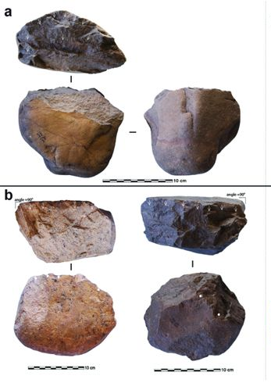
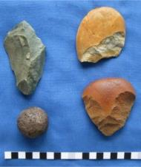
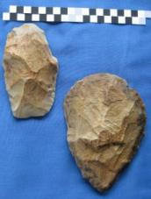
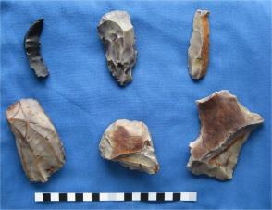
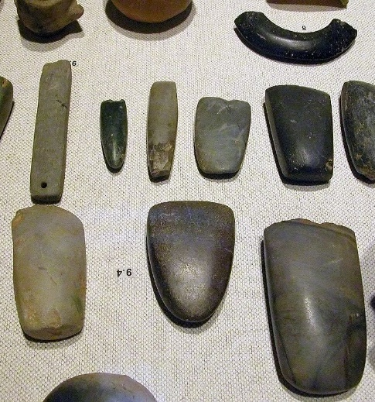
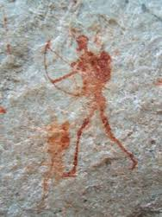
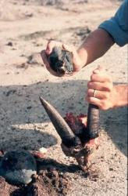
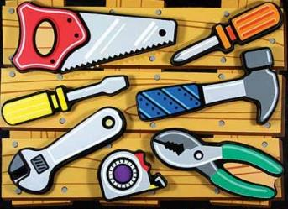
Tool-making
Lomekwian
3.3mya
Oldowan
2.6mya
Acheulean
1.7mya
Levallois-Mousterian
300kya
Mesolithic/Neolithic
20kya
Mesolithic/Neolithic tool complexity
20kya
Modern tool complexity
7kya(?) to Now

Slide 5
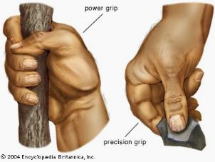
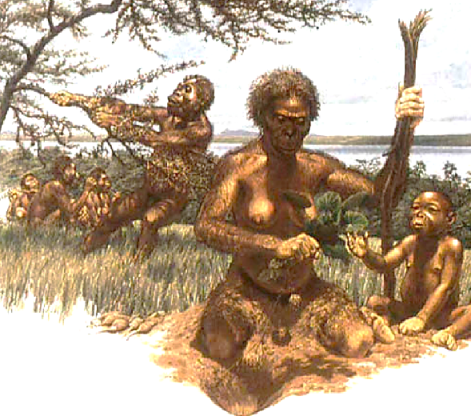
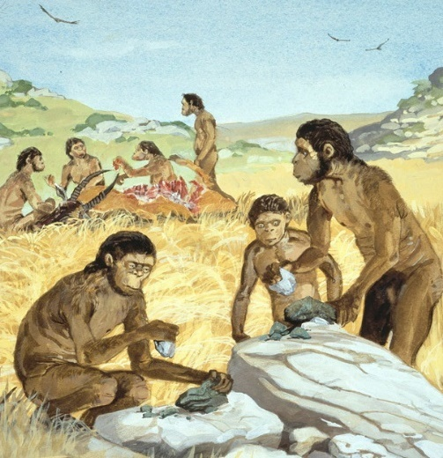
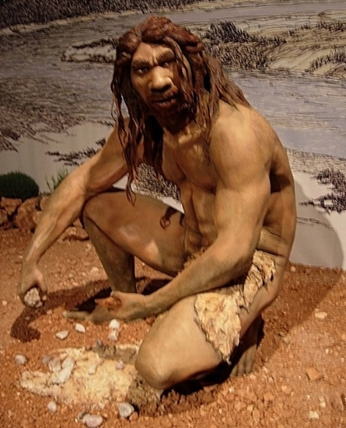
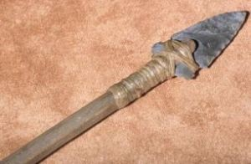
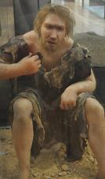
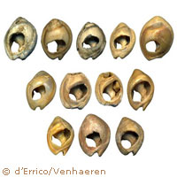
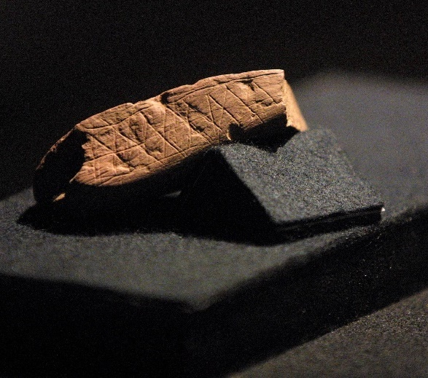
Advanced Tool-making
Tool-making grips
Australopithecus
Homo habilis
Homo heidelbergensis
Multi-material tools
Clothes
Jewellery
Art ?

Slide 6
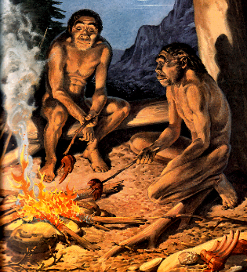
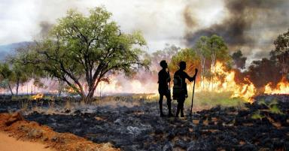
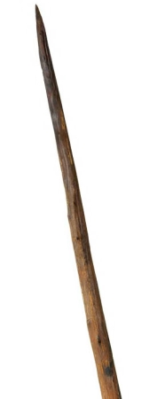
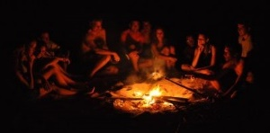
Fire and Cooking
Landscape management
Cooking
Tool Hardening
Socialisation

Slide 7
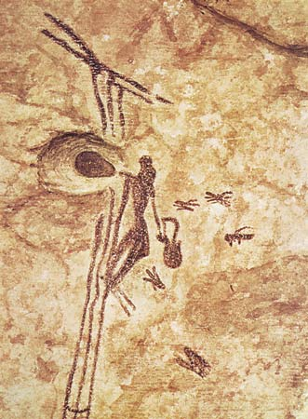
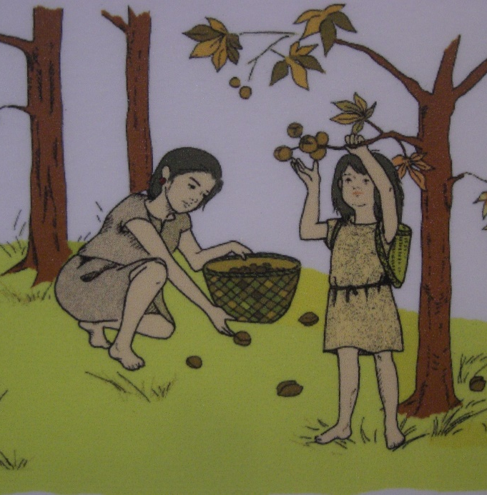
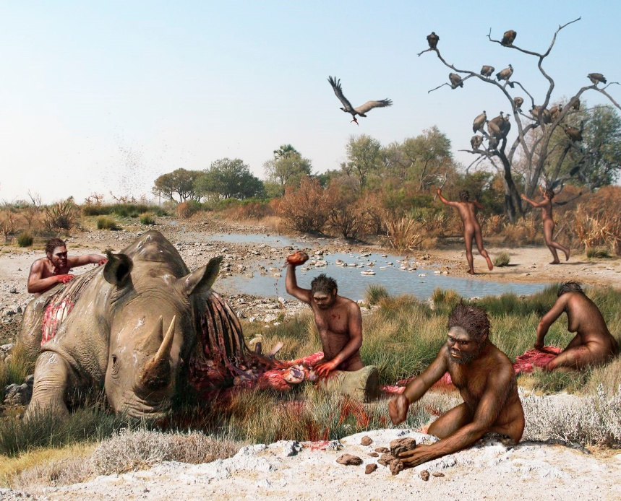
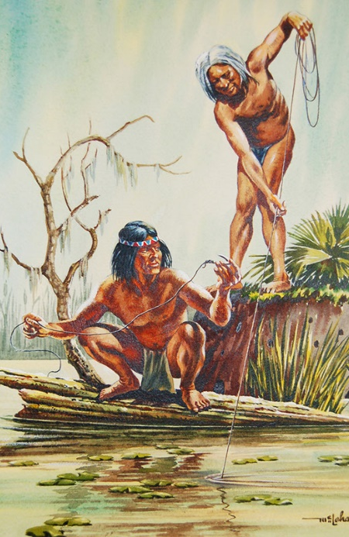
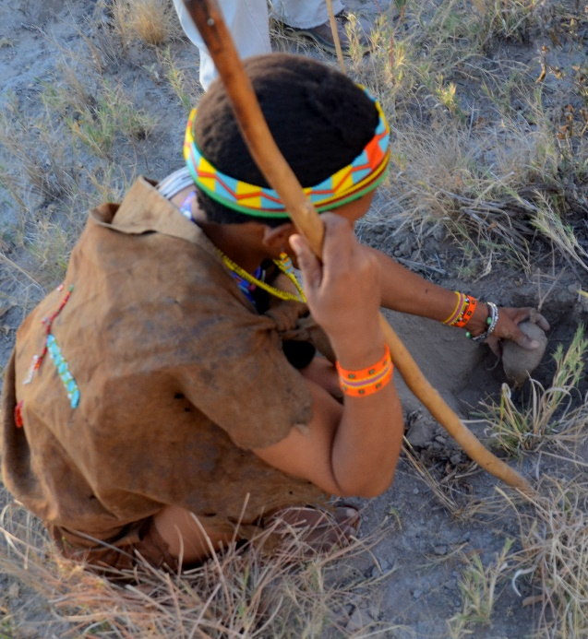
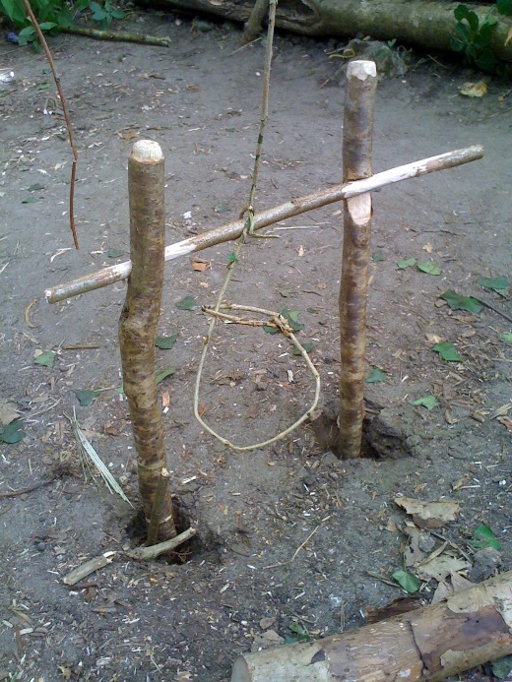
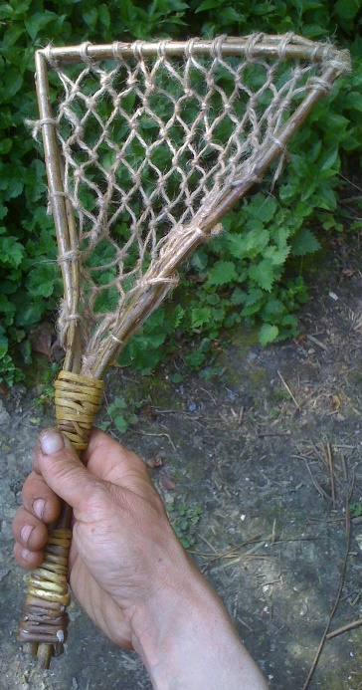
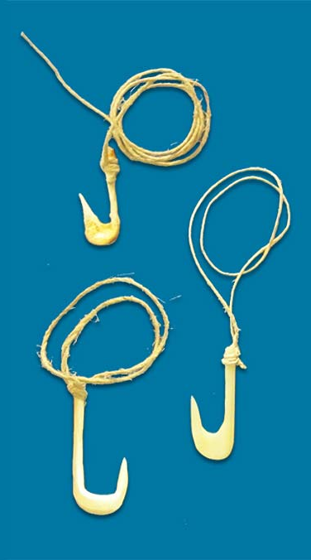
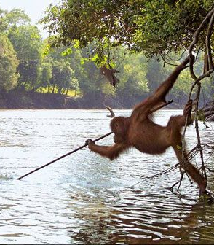
What about Gathering?
Honey-gathering
Other types of gathering –
Plant, fruit, nut, insect, etc.
Scavenging
Line fishing
Digging stick
Snare trap
Net
Fishing hooks
Fishing spear

Slide 8
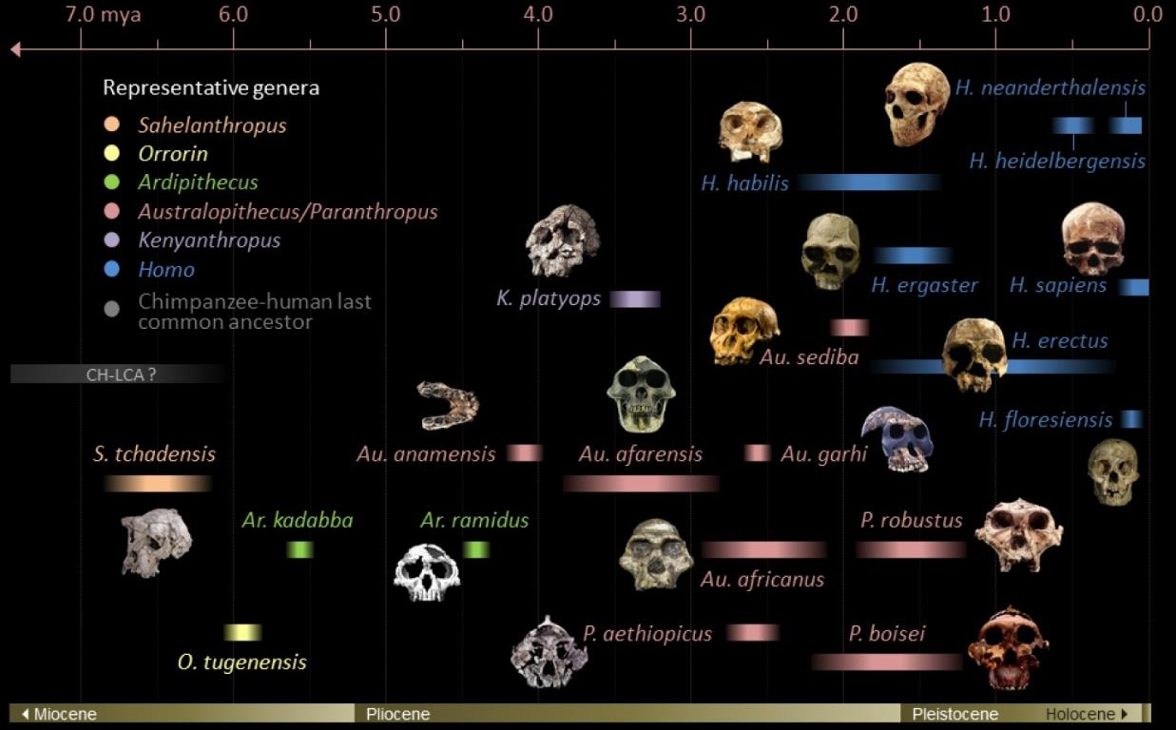
What Happened When?
Gathering & Scavenging
Lomekwian
Oldowan
Acheulean
Mous’n
Homo naledi
Fire &
Cooking
Precision grip
&
Power grip

Slide 9
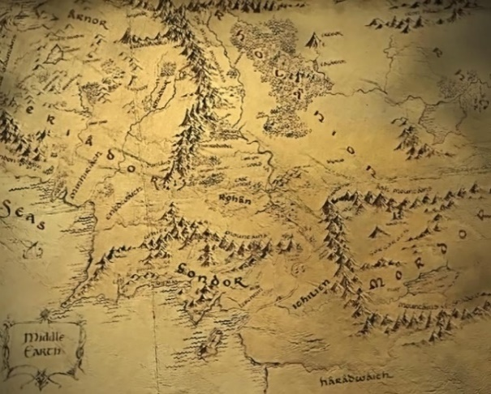
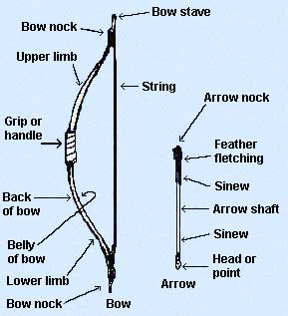
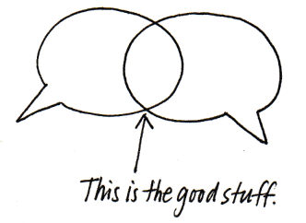
Cognitive Complexity Makes Communicative Complexity?
Cognitive Complexity
Telling about
Negotiation toward meaning
Self-sharing
Cognitive complexity
Mental time travel

Slide 10
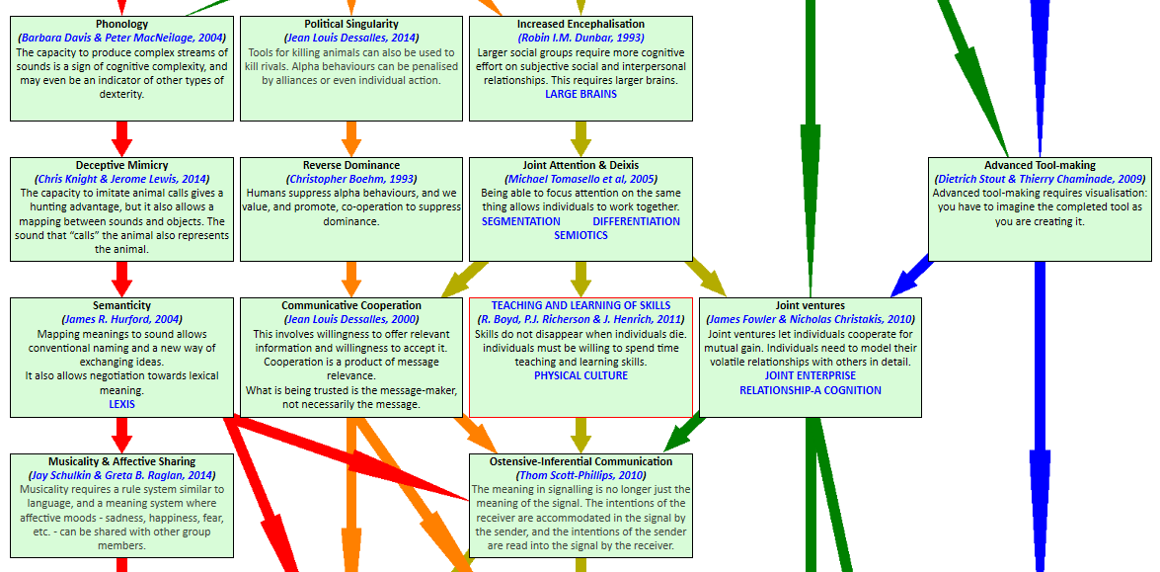
Working Together – Next Week
Joint Attention and Deixis allow us to see the world through the eyes of others.
Communicative Co-operation lets us discuss rather than just tell-about. It begins negotiation toward meaning.
Teaching and Learning of Skills defines the information we are able to share, and how we share it.
Joint Ventures allow us to work together to produce outcomes we cannot produce by ourself.
Ostensive-Inferential Communication brings together the other skills into a coherent system.

Slide 11
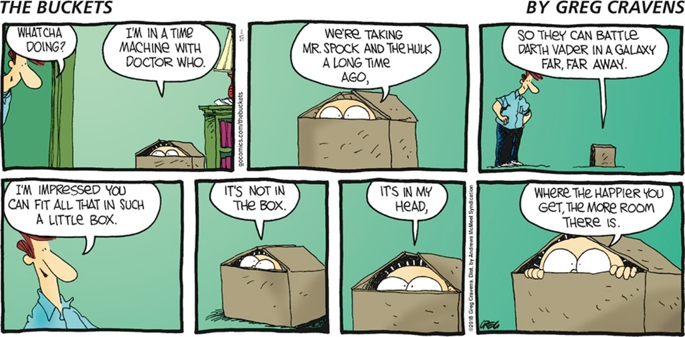
And finally ...

