Slide 1
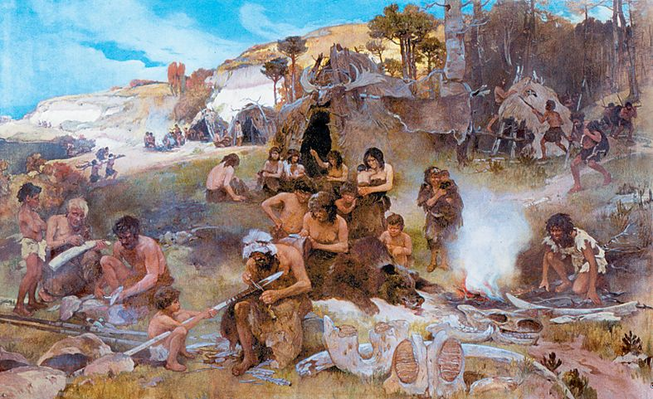
6SSEL045 – Language Origins Lecture 8 Co-operation and Sharing

Slide 2
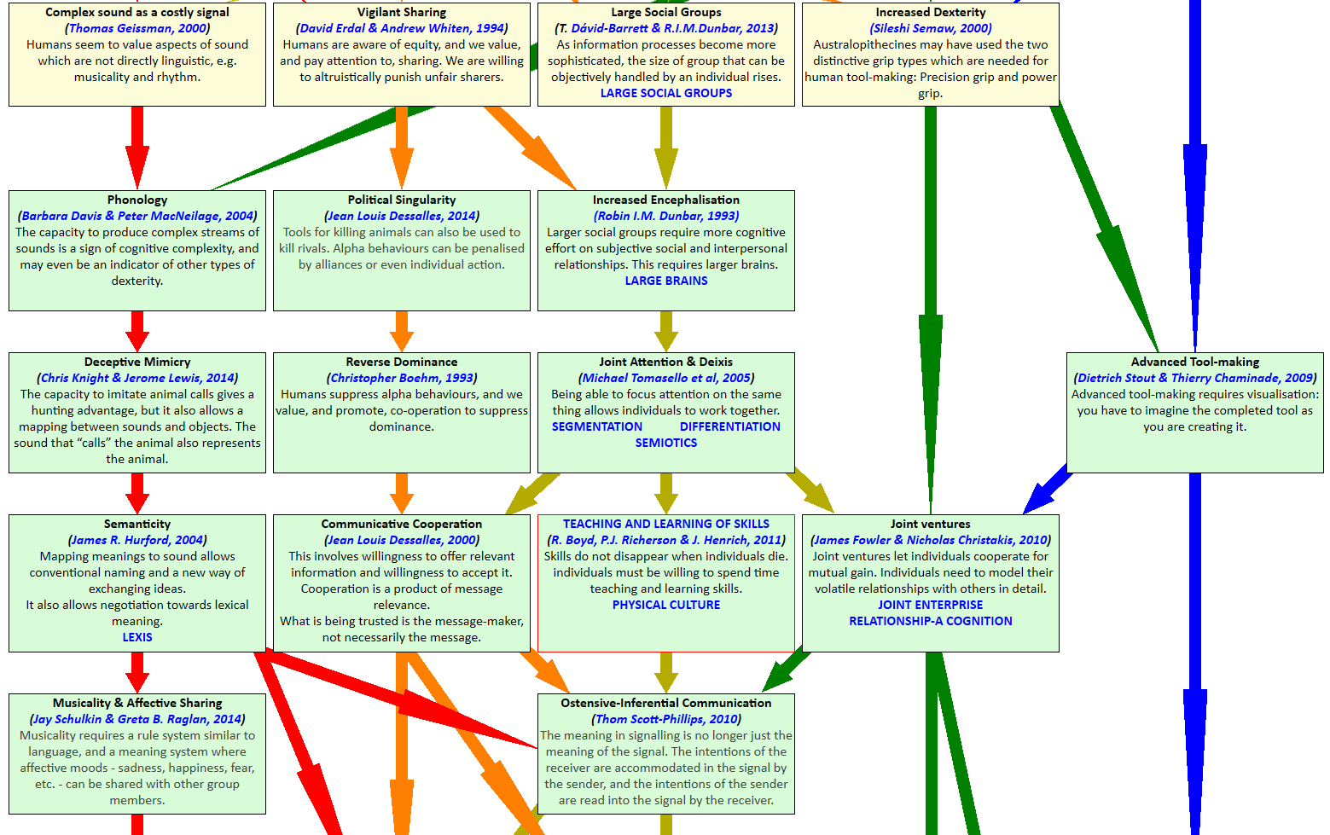
From Australopithecus to Ostensive-Inferential Comms

Slide 3
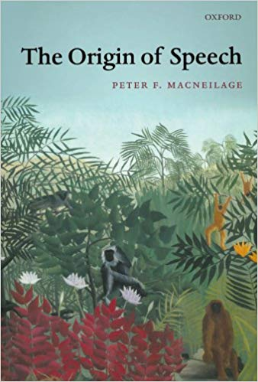
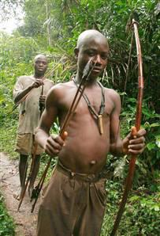
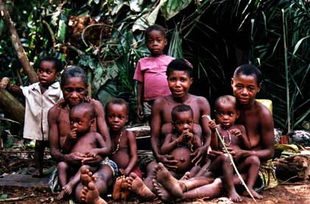
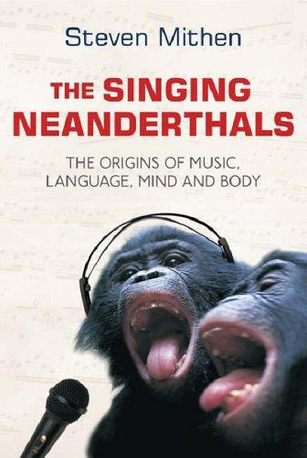
(1) Complex Sound, Phonology & Deceptive Mimicry
M’Baka tribespeople with Jerome Lewis
Chris Knight

Slide 4
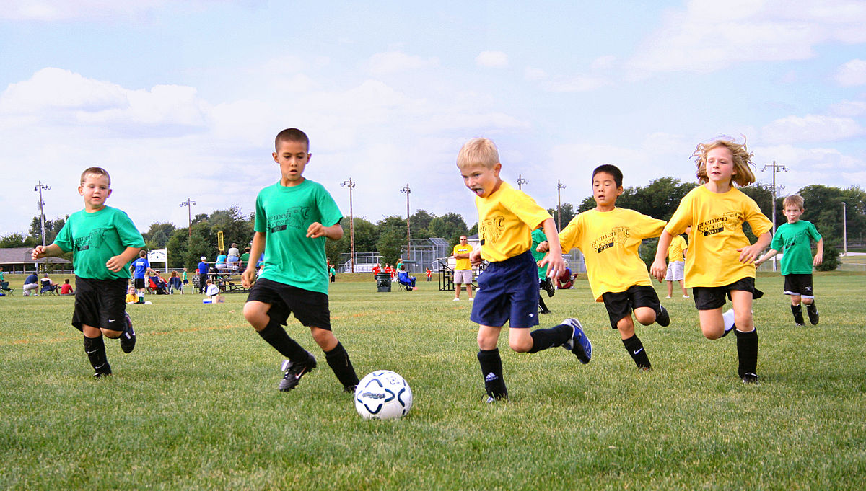
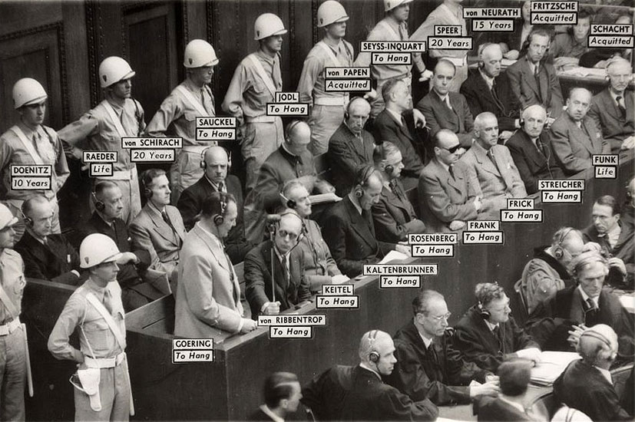
(2) Vigilant Sharing

Slide 5
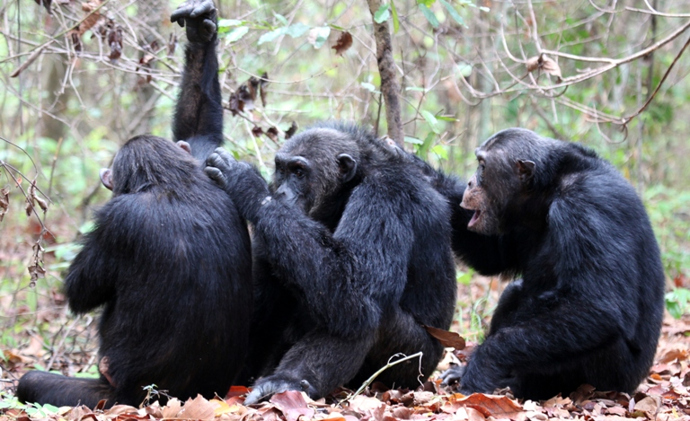
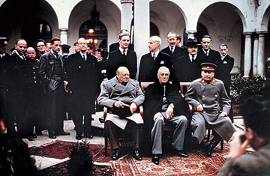
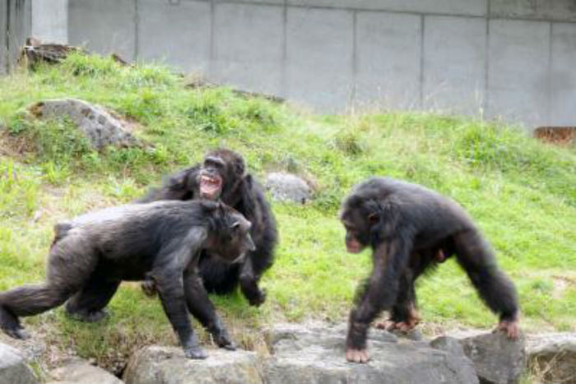
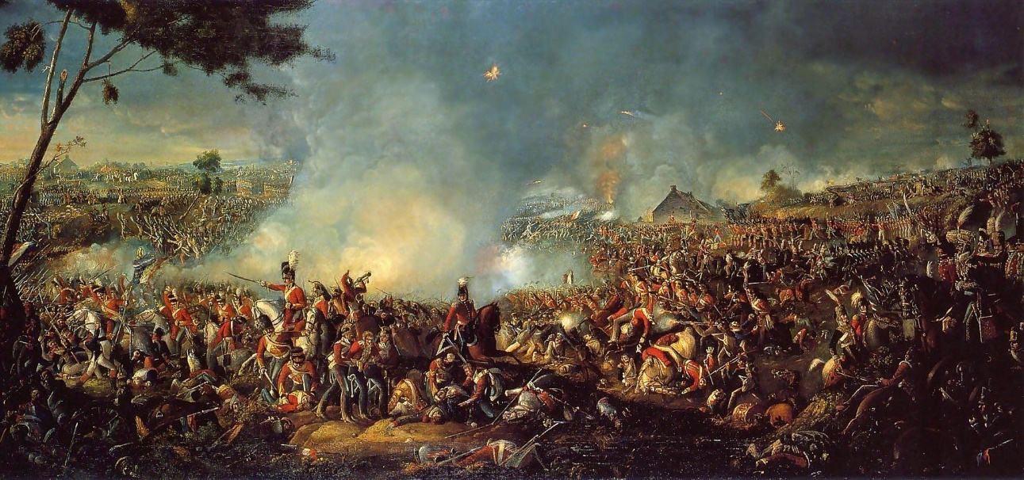
(2) Political Singularity: Suppressing the Alphas
Alliance
Conflict

Slide 6
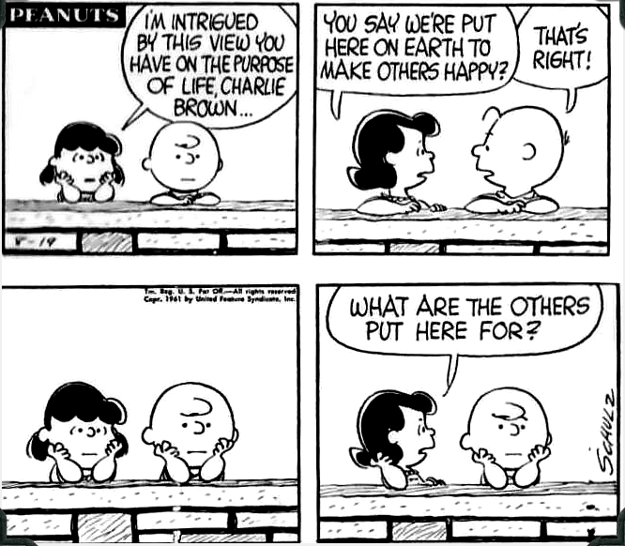
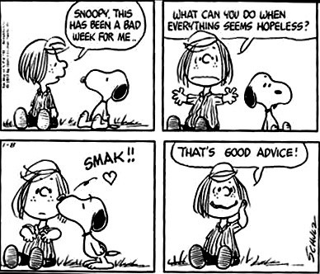
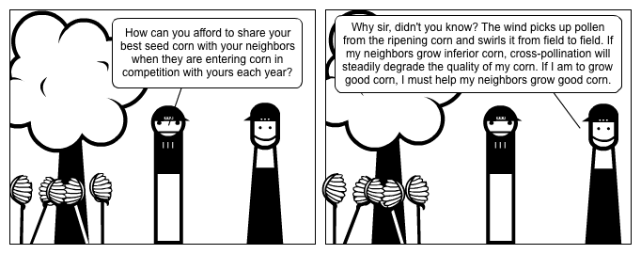
(2) Reverse Dominance
Altruism
Benevolence
Generosity
Reverse Dominance

Slide 7
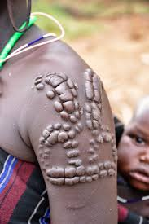
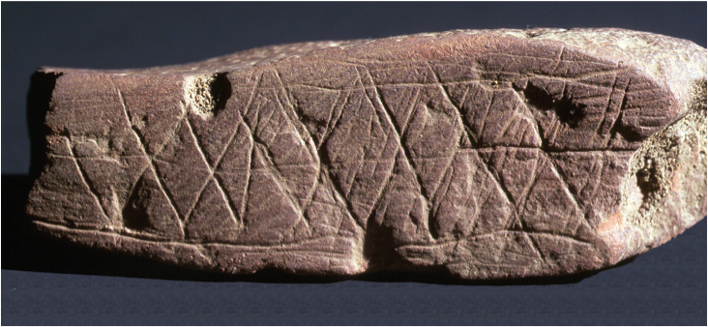
(2) Communicative Co-operation
Communicating Co-operation can be costly
Co-operative does not mean Uncompetitive
Communicative Co-operation does not preclude ownership and possession
Communicative does not mean Conversational

Slide 8
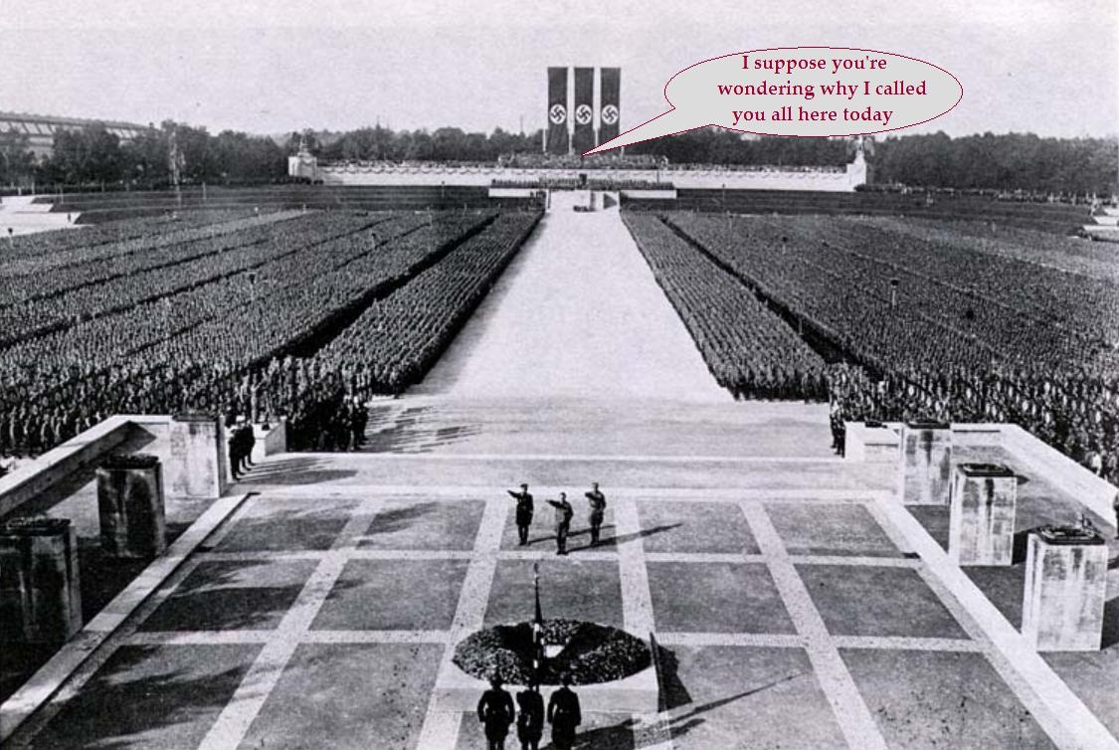
(3) Large Social Groups
What actually happened on Inauguration day, 2017
How the Malevolent Satsuma remembers it happening

Slide 9
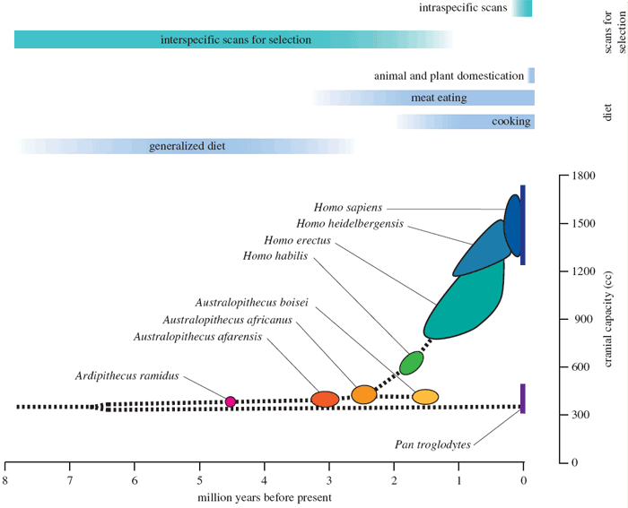
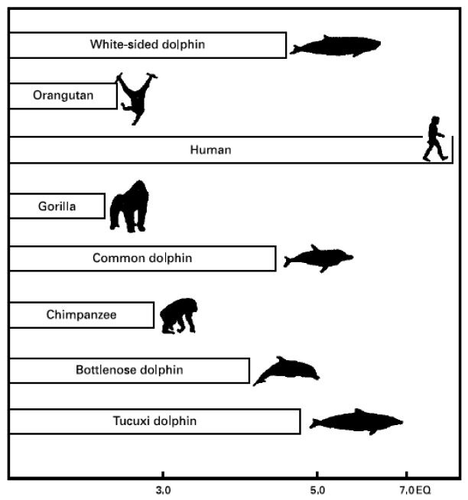
(3) Increased Encephalisation
The EQ (Encephalization Quotient) is an attempt to explain intelligence by the relative brain and body sizes.
The size of the brain by itself tells us nothing – big animals have big brains whether dumb or clever.
The diet helps us to understand how larger brains could develop in a species.

Slide 10
(3) Joint Attention & Deixis
Joint attention
Deixis
Joint attention
Deixis

Slide 11
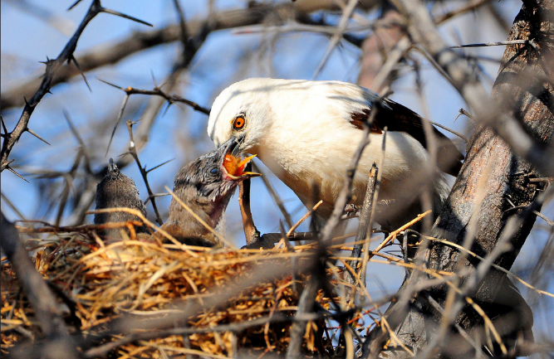
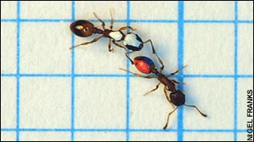
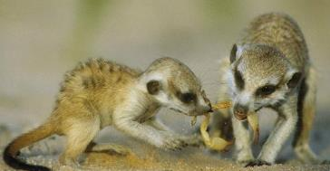
(3) Teaching and Learning of Skills
+
+
=
?

Slide 12
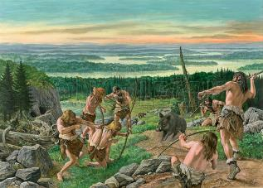
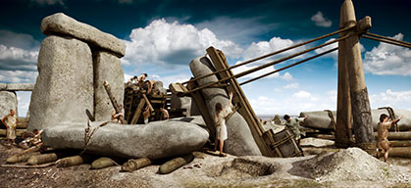
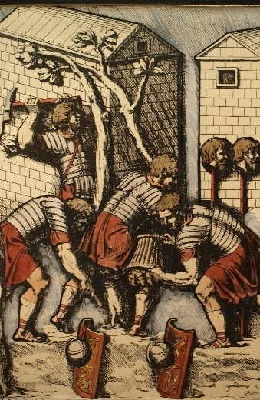
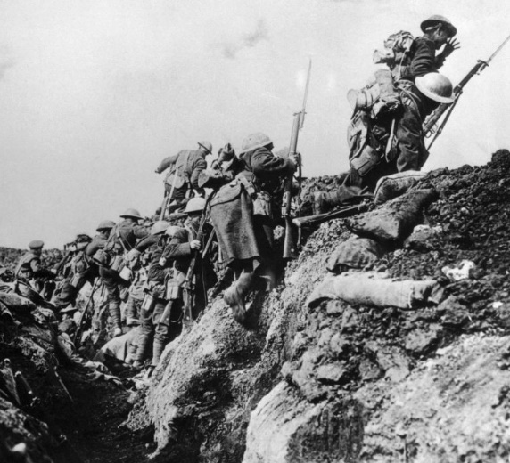
(4) Joint Ventures & Planning

Slide 13
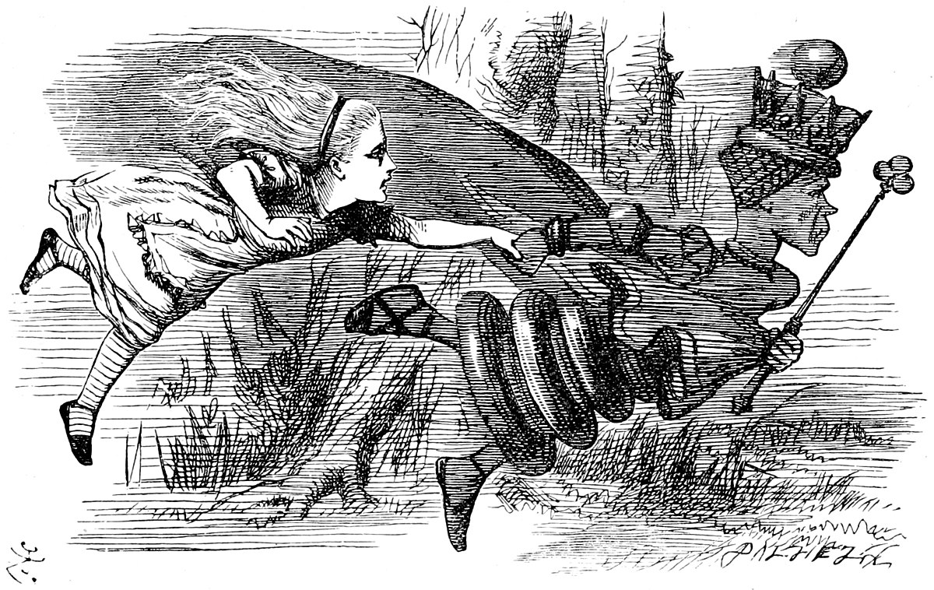
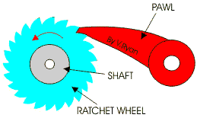
(4) Red Queens & Ratchets
Many animal species live in complex social groups; only humans live in cultures. Cultures are most clearly distinguished from other forms of social organization by the nature of their products - for example, material artifacts, social institutions, behavioral traditions, and languages. These cultural products share, among other things, the characteristic that they accumulate modifications over time. Once a practice is begun by some member or members of a culture others acquire it relatively faithfully, but then modify it as needed to deal with novel exigencies. The modified practice is then acquired by others, including progeny, who may in turn add their own modifications, and so on across generations. This accumulation of modifications over time is often called the "ratchet-effect,” because each modification stays firmly in place in the group until further modifications are made. No cultural products exhibiting anything like the ratchet effect have ever been observed in the ontogenetically acquired behaviors or products of nonhuman animals. (Tomasello, Kruger & Ratner 1993, p495).
Alice looked round her in great surprise. ‘Why, I do believe we’ve been under this tree the whole time! Everything’s just as it was!’
‘Of course it is,’ said the Queen, ‘what would you have it?’
‘Well, in our country,’ said Alice, still panting a little, ‘you’d generally get to somewhere else—if you ran very fast for a long time, as we’ve been doing.’
‘A slow sort of country!’ said the Queen. ‘Now, here, you see, it takes all the running you can do, to keep in the same place. If you want to get somewhere else, you must run at least twice as fast as that!’
Lewis Carroll: Through the Looking-Glass & What Alice Found There, Ch.2

Slide 14
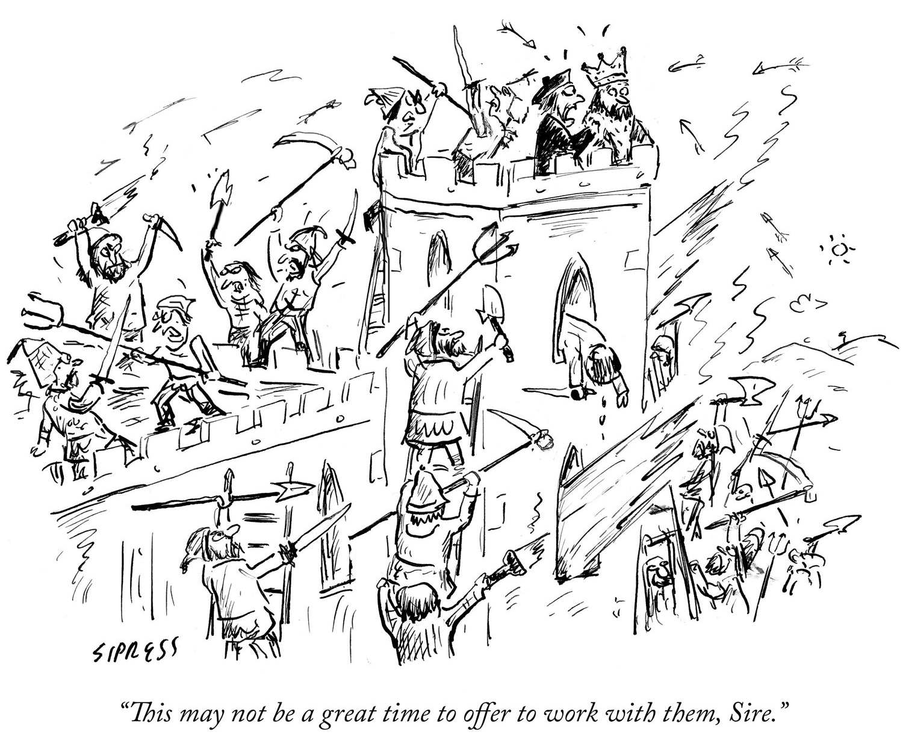
And finally ...

