Slide 1
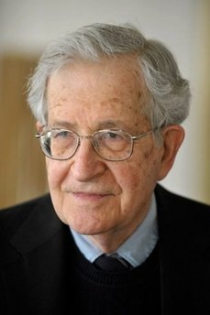
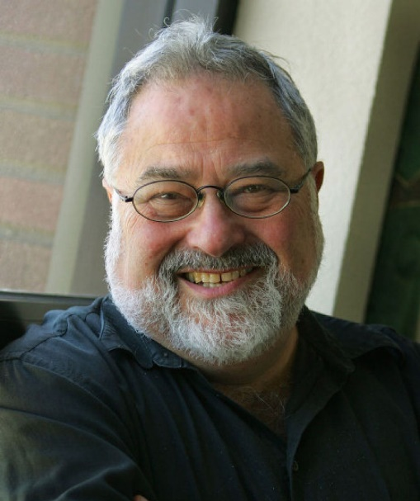
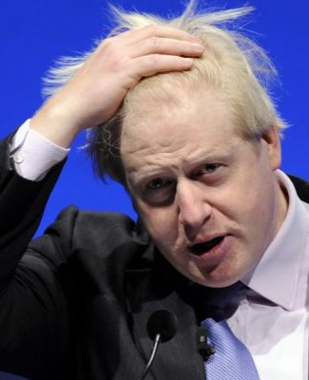
6SSEL045 – Language Origins Lecture 9 Socialisation and Culture
It's perfectly obvious that there is some genetic factor that distinguishes humans from other animals and that it is language-specific. The theory of that genetic component, whatever it turns out to be, is what is called universal grammar.
What is real for an individual as a member of a culture is a product both of his social reality and of the way in which that shapes his experience of the physical world.
Well … er … no …
yes, quite so … er … fwah … er …
what was the question again?
Noam Chomsky
George Lakoff
Bogus Johnson

Slide 2
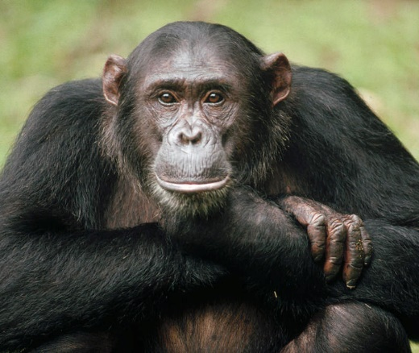
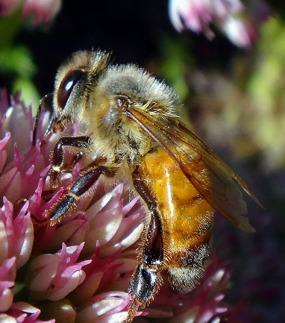
How Human Culture Is Different
Generalist roles
Tool use
Insecure social order
Group association
= Ad hoc culture
Specialist roles
Tool use
Stable social order
Social dependency
= Formalised culture
Specialist roles
Tool dependency
Stable social order
Social dependency
= Formalised culture
Conscious choice
Personal agenda
Social calculation
No conscious choice
Hive agenda
Innate socialisation
Conscious choice
Personal agenda
Social calculation
I do what I can …
I do what I must …
I do what I should …
… to stay on top …
… because I must.
… to be accepted …
… until somebody stops me.
… as part of the collective.

Slide 3
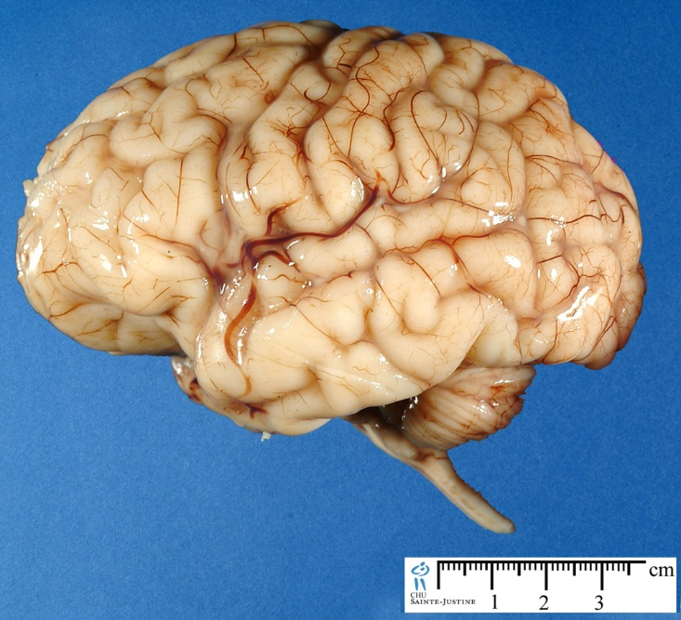
The Social Brain
dorsolateral prefrontal cortex
Brodmann 9
Action
Shared intentionality & joint enterprise?
Action
Angular gyrus
Brodmann 39
Supramarginal gyrus
Brodmann 40
Modelling of others?
Language?
Planning?
Fronto-polar cortex
Brodmann 10
Selfhood?
Language
Orbitofrontal cortex
[Inferior frontal gyrus]
Brodmann 11

Slide 4
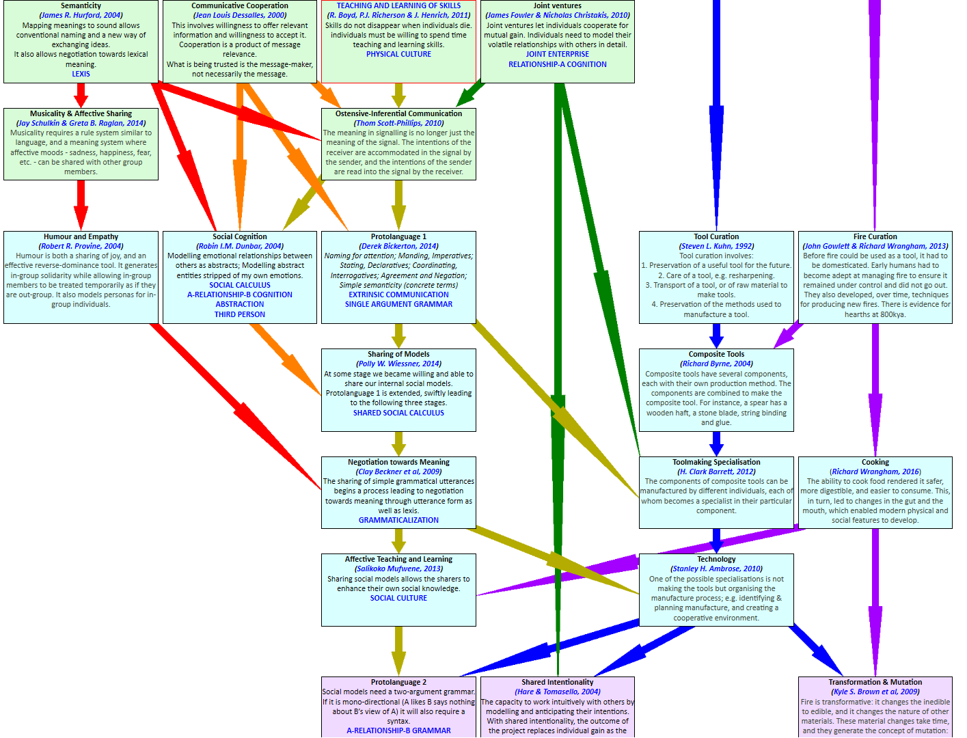
The Road to Human Culture

Slide 5
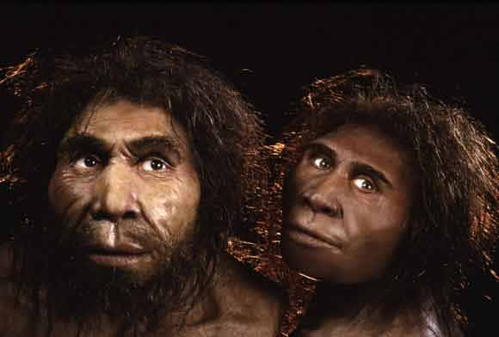
(1) Semanticity
This sound is a phonological tag
He’s looking at the mammoth
/gæk/
means mammoth
/gæk/
The previous thing/event has a phonological tag
This thing/event maps to a previous thing/event
This thing/event has meaning for me

Slide 6
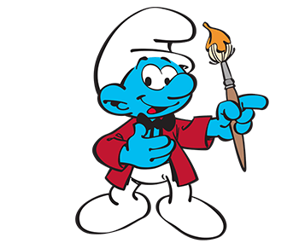
(1) Social Cognition
No Smurfs were harmed in the making of this slide
Mmmm
Mmmm
Mmmm
Mind-reading
RELATIONSHIP-A
1st Order Intentionality
Iterative Mind-reading
A-RELATIONSHIP-B
2nd order Intentionality
Mental state

Slide 7
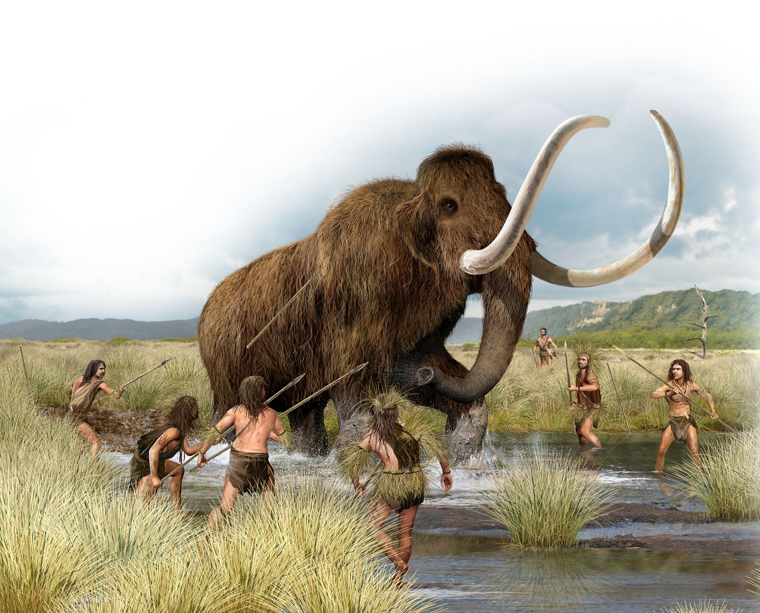
(2) Protolanguage 1
/ꓥg/
Naming for attention
[Stab!]
Manding, Imperatives
[Yes!]
Agreement & Negation
/gæk/
Stating, Declaratives
[Dead?]
Coordinating, Interrogatives
[No!]
Agreement & Negation
[Food]
Simple semanticity using concrete terms

Slide 8
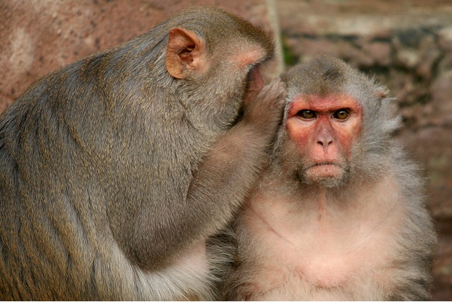
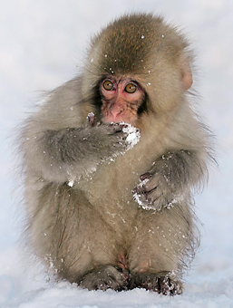
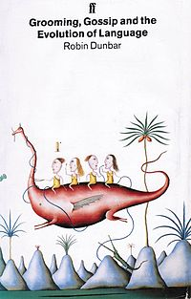
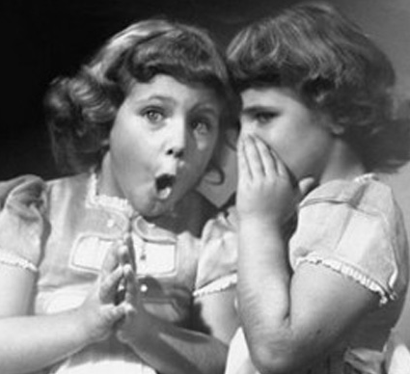
(2) Sharing of Models
What I know I cannot share
The similarity – and difference – between grooming … and gossip

Slide 9
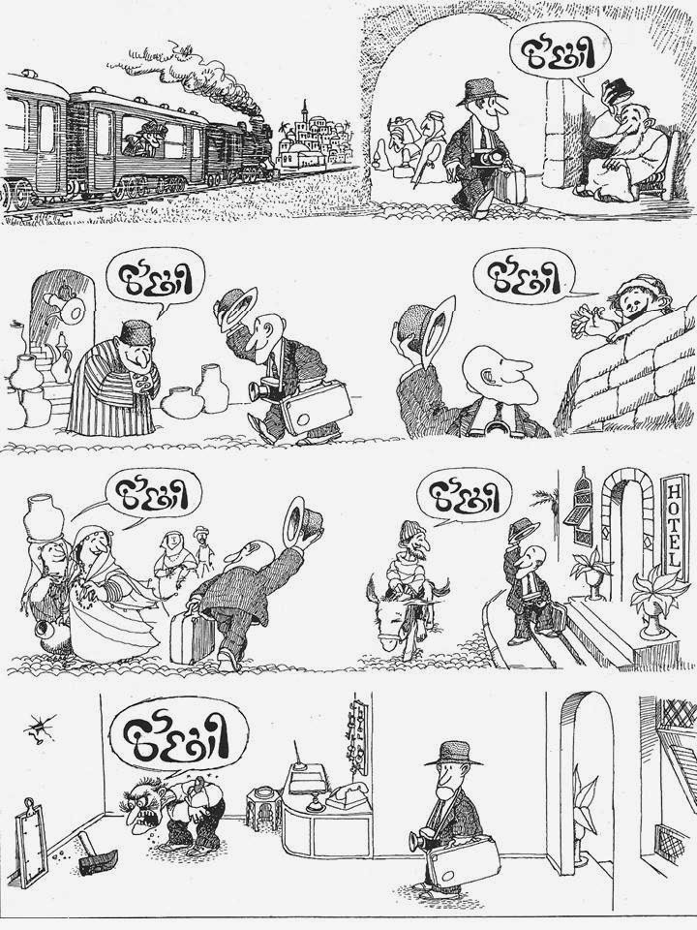
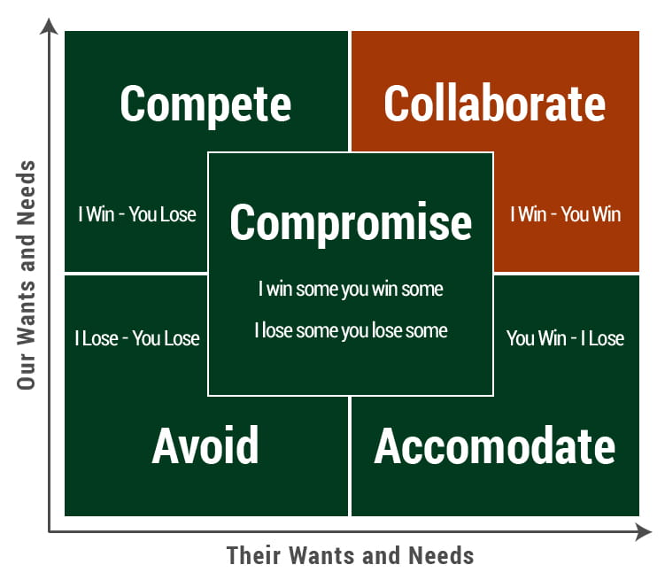
(2) Negotiation toward Meaning
The Five Negotiation Styles
Kenneth W. Thomas & Ralph Kilmann (2002). Thomas Kilmann Conflict Mode Instrument. CPP Inc: Sunnyvale, CA, USA.
Do you understand?
No, but I’ve heard enough.

Slide 10
(2) Affective Teaching & Learning
Bloom’s Taxonomy of “Language in Action”
[David R. Krathwohl, Benjamin S. Bloom & Bertram B. Masia (1964). Taxonomy of Educational Objectives. Handbook II: Affective. David McKay Company, New York, NY, USA.]
Teacher
Synthesis
Reformulates
Learner
Reformulates
Evaluation
Assesses
Assesses
Analysis
Deconstructs
Reconstructs
Application
Assists
Uses
Comprehension
Negotiates
Negotiates
Knowledge
Provides
Receives

Slide 11
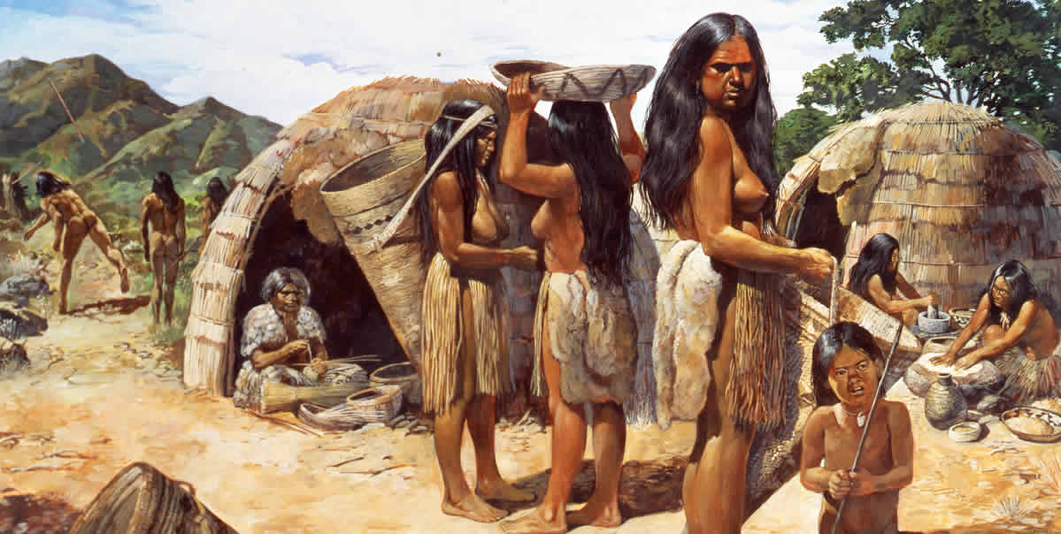
(2) Protolanguage 2
Establishing Complex Society:
The social group [A-relationship-B]
Social duties
[A-governs-B]
Making & changing
[A-makes-B]
Social Activities
[A-does-B]
Social Roles
[A-is-B]

Slide 12
Nearly There …
Protolanguage 2
A↔B Grammar
Opinion
A↔B↔C Cognition
Awareness of Receiver
Awareness of absence
Awareness of Self
Coming next week:
The gripping series finale
Recognition of Receiver
2nd Person
Reputation
A↔B↔C Grammar
Aware Memory
Past
Egalitarian Awareness
Planning
Future
Projection of self
1st Person
Complex Language 1
Recursive Social Cognition
“Merge”
Complex Language 2

Slide 13
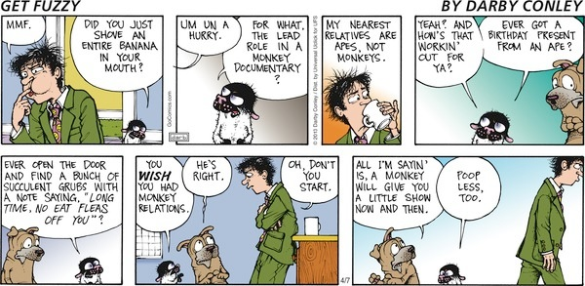
And finally ...

