Slide 1
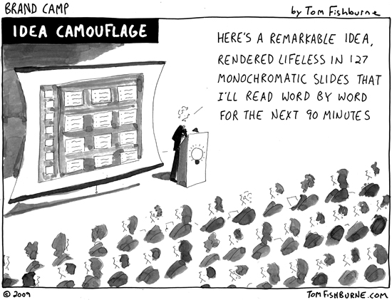
Posters and PowerPoint Martin P.J. Edwardes
Notes:
This is a short introduction to using PowerPoint to prepare presentations. The presentation you will mainly have in mind is the poster presentation of your dissertation, but you will find that this is far from the last presentation you will have to make in your lifetime.
Have no doubt that what you learn here is not a skill that will last a lifetime, because the apps for making presentations will change considerably over the next 40 years. So treat what you learn here on three levels:
It is practical information to help you give one presentation.
It is useful information to get you into the habit of making presentations – giving presentations will get easier because of the skills you will be acquiring today.
It is background information to help you make presenting just another thing you do – and, hopefully, it make you want to keep improving your presentation skills.

Slide 2
About the Lecturer
Educationally defined as …
Martin P.J. Edwardes
he / she / they / it / whatever
Academically defined as …
Economist
Linguist
Anthropologist
Anthropological Linguist
Cognitive Linguist
Grammatician
Evolutionary Anthropologist
Language Origins Researcher
Professionally defined as …
Officially Retired
BUT
Not yet ready
to go gentle
into that good night
Writer
Editor
Lecturer
Researcher
Technologist
Designer
Manager
Retired
Self-defined
as …
Left-handed
Civil partnered
Queer
Mild Aspergers

Slide 3
How to Contact the Lecturer
Email:
martin.1.edwardes@kcl.ac.uk
k1216036@kcl.ac.uk
Checked at least once a day
Phone/Text:
07588 730403
I’m not good at answering the phone, but I check messages at least once a day
By Appointment:
Email or text me and we can arrange a face-to-face session.
I will keep Thursdays 4pm to 6pm free for F-T-F every week, but other times can be arranged

Slide 4
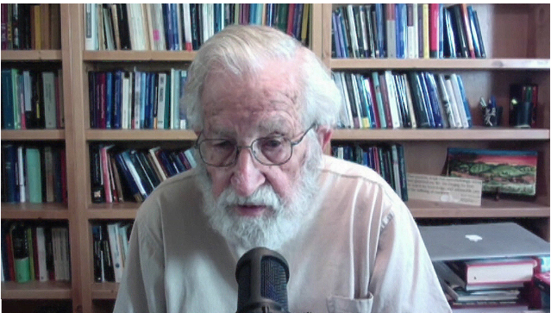
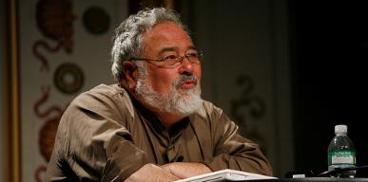
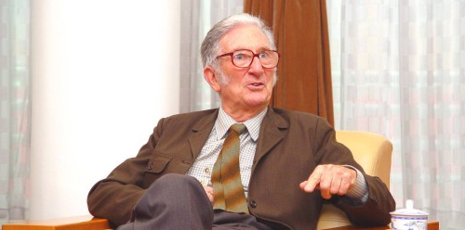
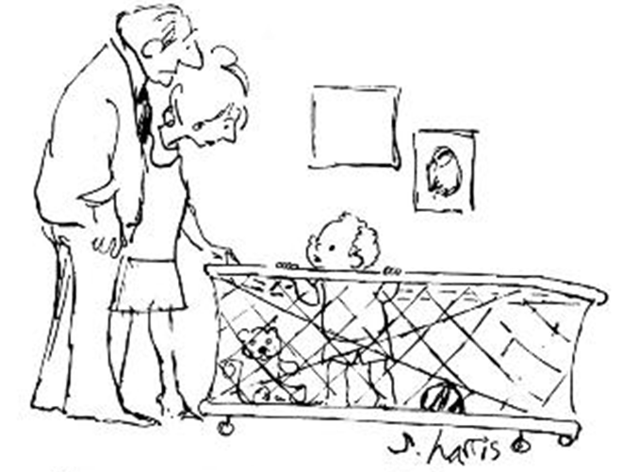
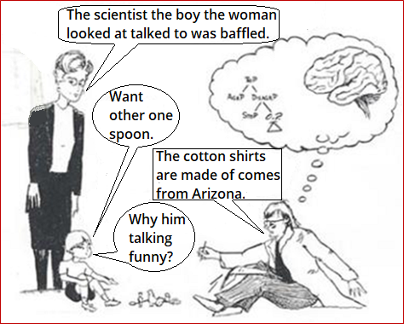
Language as Communication Three Views from Linguistics
Most thought is unconscious. It doesn’t work by mathematical logic. You can’t reason directly about the world - because you can only conceptualise what your brain and body allow, and because ideas are structured using frames … all words are defined in terms of conceptual frames, not in terms of some putative objective, mind-free world. George Lakoff
[On language:] First, it is transmitted physically, by sound waves travelling through the air; secondly, it is produced and received biologically, by the human brain and its associated organs of speech and hearing; thirdly it is exchanged socially, in contexts set up and defined by the social structure; and fourthly it is organized semiotically as a system of meanings. M.A.K. Halliday
In fact a very tiny part of language is externalized – what comes out of your mouth, or from your hands if you’re using sign. But even that part is often not used for communication in any independently meaningful sense of the term “communication”.
Noam Chomsky, 2012
“What’s the big surprise? All the latest theories of linguistics say we’re born with the innate capacity for generating sentences.”
You only think you’re barking at nothing. We’re all barking at something.
Notes:
Some linguists say that 99% of language use is cognitive and never leaves the head in which it is conceived. Chomsky, in particular, takes this view. However, other linguists take a very different approach, seeing communication as vital to the purpose of languaging. Certainly, Chomsky’s position is of no help at all in the design of effective presentations. To illustrate the problem with Chomsky’s approach, consider the question, “What is a ship?”
[PAUSE FOR ANSWERS]
Like any complex object, a ship can be defined by its structure (a large metal vehicle) or by its function (to carry freight and passengers); but it is also defined by its environment (an ocean-going vessel), which includes a vital detail of its successful design: it keeps the water out. Without this aspect of “shippiness” about the ship, you don’t have a ship.

Slide 5
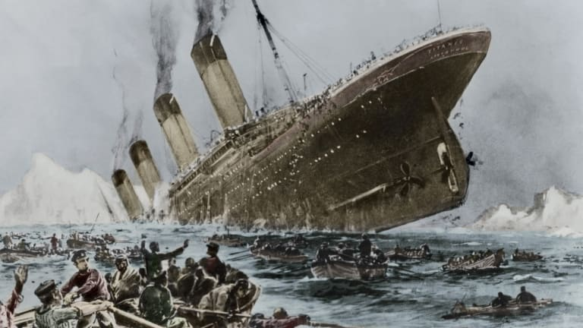
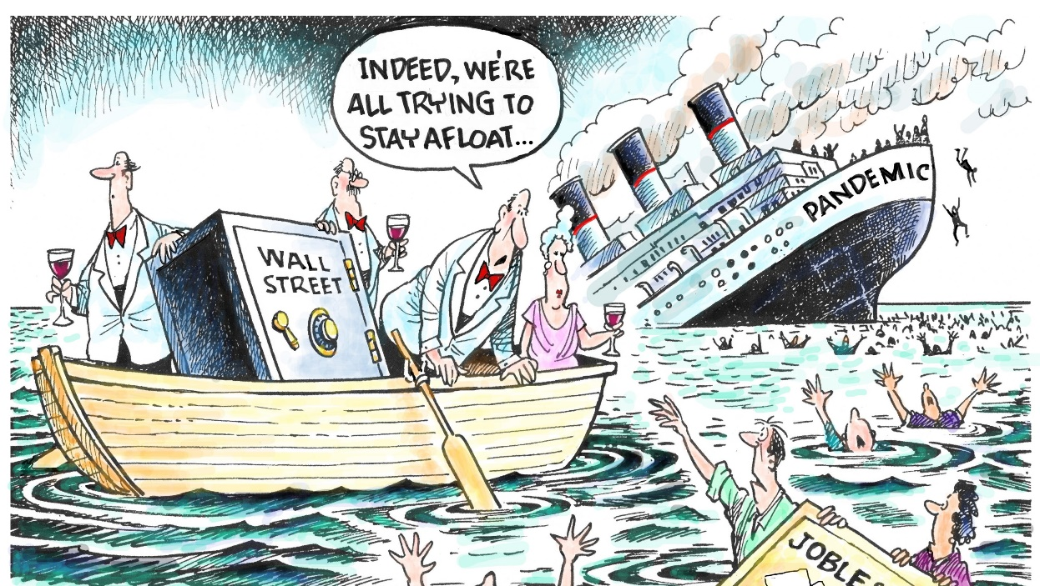
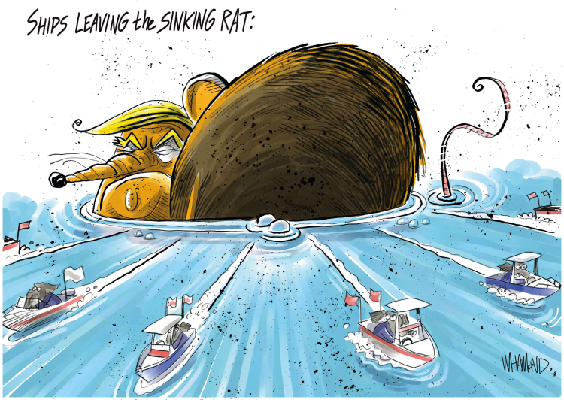
Floating Is Important … Communication Is Important, too
Notes:
This is why I see communication, and not cognition, as the primary role of language. Just as a non-floating ship really misses the point of shippiness, so non-communicative language really misses the point of language.
Besides which, language-as-cognition does selfhood a disservice, too: I have a self because I am able to cognitively make a model of a human and reflexively treat it as a model of me. In which case, cognitive language is not that different from communicated language: there is a constant dialogue between the I-who-is-thinking and the me-who-is-modelled-as-thinking; and that dialogue is as much communication as any explicit use of words between different humans.
Or, to put it another way, always remember that you always have an audience!

Slide 6
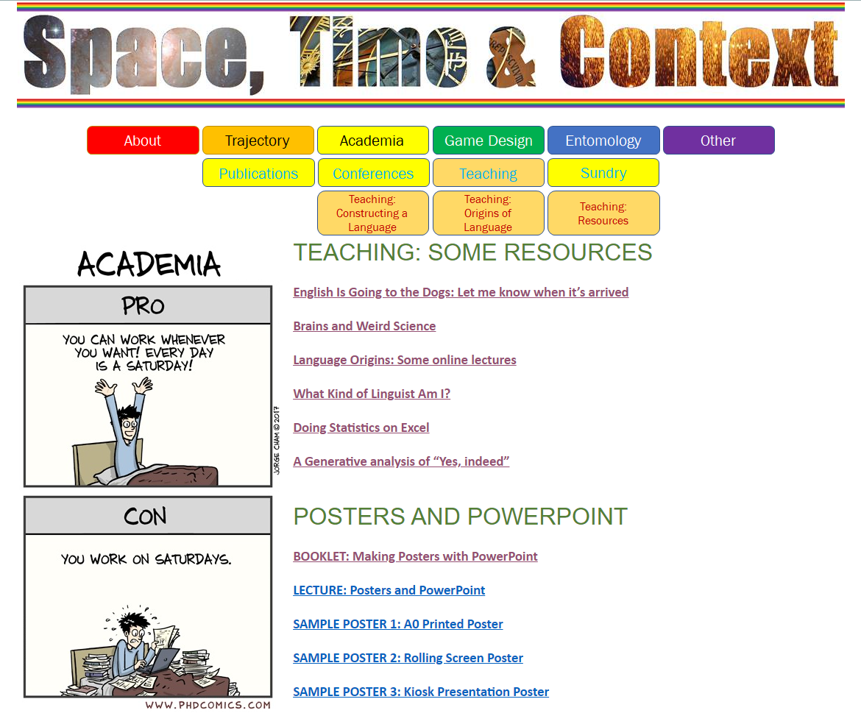
Resources: Online
Go to http://martinedwardes.me.uk/academia_teach_resources.html
to download the Poster Competition Resources
The Resources

Slide 7
Resources: Instruction Booklet

Slide 8
Resources: Sample Posters

Slide 9
Resources: This Lecture

Slide 10
Sample Slide 1: Pravic: The Construction of Words
Sentential words
Adjectival suffix
[-y]
Definite article prefix
[a-]
Negators
[ma-,mo-, mi-]
Adposition prefixes
Number prefixes
Foreign word marker
Noun Root
[+ plural suffix –i]
Verb tense suffixes
[-ym-,-a,-e,-o]
Adverbial suffix
[-u]
Conjunctions

Slide 11
Sample Slide 2: Types of Knowledge, Ways of Learning
Learned
Intentional Learning
Explicit
Learned
Explication
Explicable Production
Incidental Learning
Learned
Innate
Sublimation
Implicit
Examples:
Phonological production: We are born with the capacity to produce a wide range of vocalisations
Accent: Incidentally learned as implicit knowledge
1st & 2nd person pronoun use: Incidentally learned as explicit knowledge then sublimated
Past tense –ed rule: Intentionally learned as explicit knowledge then sublimated

Slide 12
Sample Slide 3: What You Do
EITHER
Create a language
Lexis
Imagination,
Ideas,
Experiments,
Construction,
Engagement,
Discovery
Grammar
Phonology
Culture
OR
Create yet another essay
Reading, Composition, Argumentation, Structure, Breadth, Completeness, Referencing …

Slide 13
Sample Slide 4: Social Calculus, Agentive Grammar and the Beginnings of Language
Social Calculus: A-RELATIONSHIP-B Shared
Gemma
[SELF]
Shares …
Beth
Alf
Beth
Relationship +
Relationship ++
Relationship ++
The self has a working RELATIONSHIP-A with Beth
Gemma shares an A-RELATIONSHIP-B model with me of the relationship between Alf and Beth
BUT … I am Alf
SO… To incorporate Gemma’s model into my social calculus I need a third-person model of myself
AND… I need to be aware of the intimate relationship between my model of me and my [SELF]
AND… What does Gemma’s model tell me about my relationship with Beth?

Slide 14
And Finally …
Email: martin.1.edwardes@kcl.ac.uk
Phone: 07588 730403
Resources:
http://martinedwardes.me.uk/academia_teach_resources.html

