Slide 1
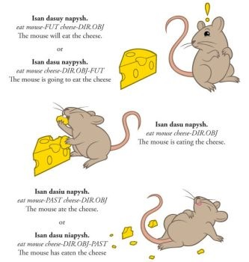
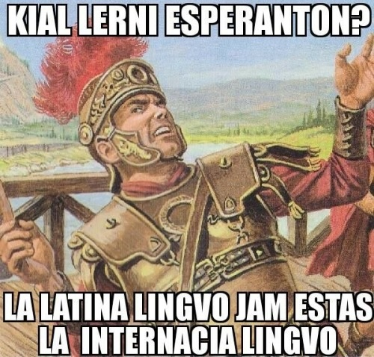
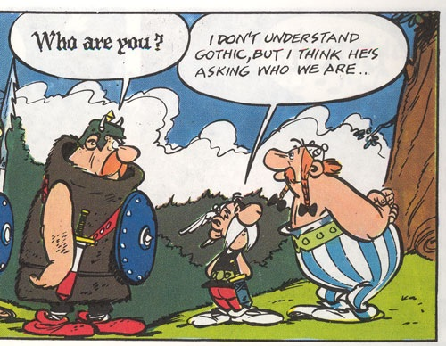
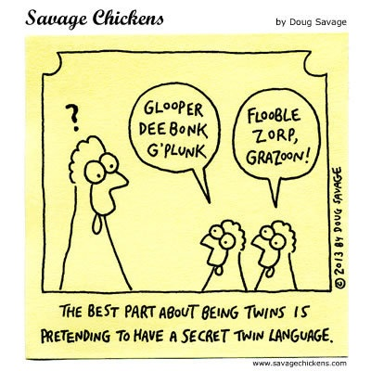
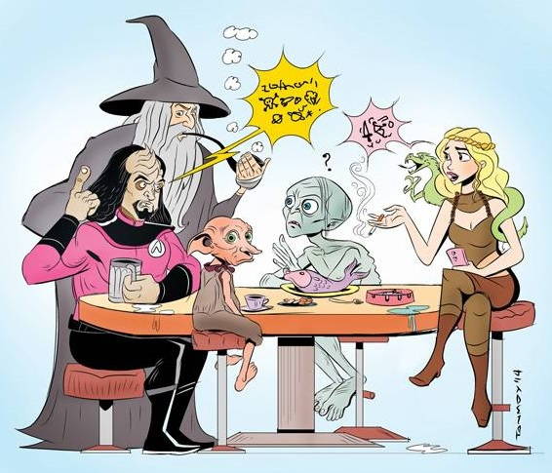
A0 Poster for Printing on Paper
This type of poster has to present everything at once.
It has to provide an order to the content.
It does not use animation or transitions.
This is the traditional poster you see at conferences.
You can use a range of visual presentation devices...
…and pictures help to break up the text.
If you really need vast acres of text then you can break it up with colour, emphasis, or even fonts. A good poster does need to explain itself, but it does not need to contain the same information as an essay.
Remember the key questions you need to keep asking yourself as you prepare your poster:
WHO is this poster for?
WHAT is the poster intended to show?
HOW can I best present the WHAT to the WHO?
WHY am I producing this poster in this way?
(… and don’t forget WHEN and WHERE you will be presenting.)
A new way of working
Which together indicate that …
… And before you know it you have the beginnings of a poster
Leading to…
Remember your references:
Doug Lowe (2019). PowerPoint 2019 for Dummies. John Wiley & Sons: Hoboken, NJ, USA.

