Slide 1
PowerPoint Poster for Kiosk Display

Slide 2
What it does
This type of poster must present everything in sequence.
It must provide an order to the content.
It uses separate slides, animation and transition to establish order.
It also uses auto advance and continuous loop.
This is the traditional poster you see at conferences, but it is presented electronically.
It can be presented on an ordinary PC, laptop, or tablet.
Pictures should be used to help break up the text.

Slide 3
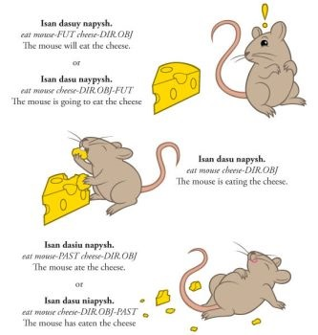
Pictures can be used to add interest

Slide 4
Which together indicate that …

Slide 5
Leading to a new way of working
If you really need vast acres of text then you can break it up with colour, emphasis, or even fonts. A good poster does need to explain itself, but it does not need to contain the same information as an essay.
Remember the key questions you need to keep asking yourself as you prepare your poster:
WHO is this poster for?
WHAT is the poster intended to show?
HOW can I best present the WHAT to the WHO?
WHY am I producing this poster in this way?
(… and don’t forget WHEN and WHERE you will be presenting.)

Slide 6
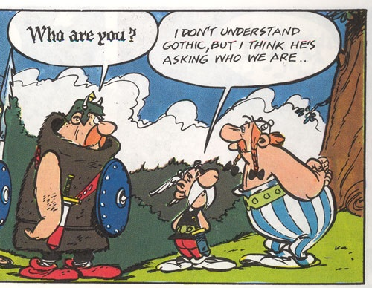
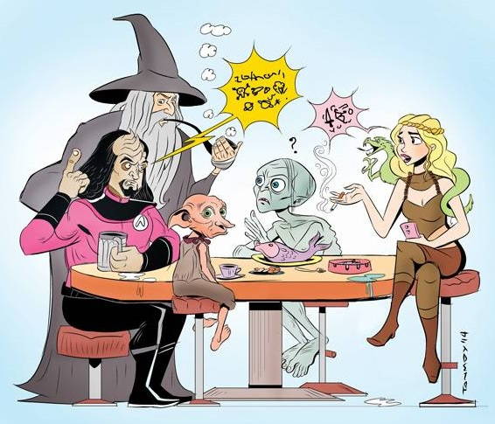
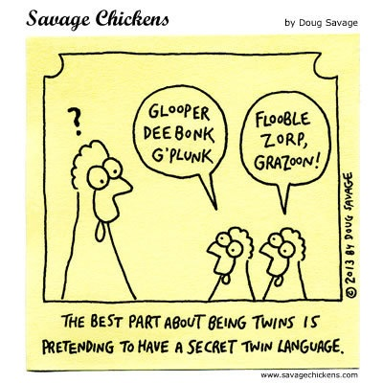
Which together indicate that …

Slide 7
… And before you know it you have the beginnings of a poster

Slide 8
Remember your references
Doug Lowe (2019). PowerPoint 2019 for Dummies. John Wiley & Sons: Hoboken, NJ, USA.

