Slide 1
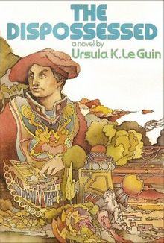
Nothing is yours.
It is to use. It is to share.
If you will not share it
you cannot use it.
Martin Edwardes
King’s College London
martin.edwardes@btopenworld.com

Slide 2
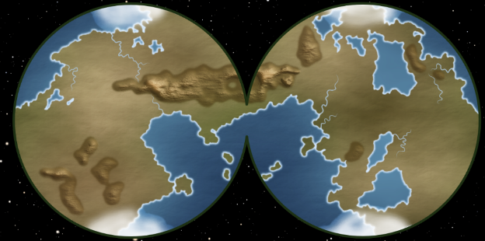
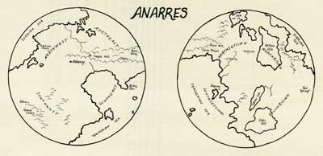
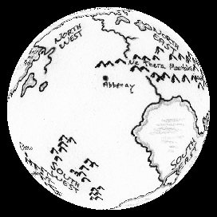
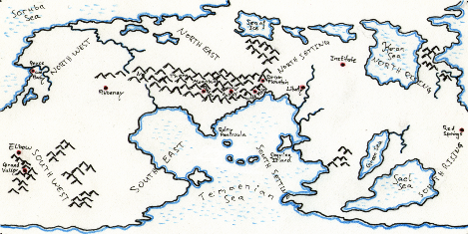
Anarres

Slide 3
Anarresti (Pravic?) words
Person Names | Person Names | Place Names
Shevek | Simas | Sorruba [Sea]
Takver | Farigv (Pravic creator) | Ne Theba [mountains]
Bedap | Terrus | Chalar
Palat | Richat | Rolny Pan
Rulag | Bunub | Grana [Valley]
Pipar | Labeks | Temaenian [Sea] {tema’eni’an}
Tirin | Shipeg | Segvina [Island]
Kadagv | Pilun | Keraw [Sea]
Gibesh | Ferdaz | Cyreen [Sea] {čaɪre’en}
Kvetur | Trepil | Sael [Sea] {sa’el}
Pesus | Skovan | Abbenay [city] {ab’bena’aɪ, not abenaɪ}
Gimar | Gezach | Ne Theras [mountains]
Shevet | Terzol | Chakar
Rovab | Tinan | Chatar
Beshun | Kvigot | Other Pravic words
Vokep | Turib | Ammar, ammari : brother, brothers; the general term of address, like comrade
Sabul | Words not in Pravic | Holum : plants native to Anarres
Sadik | Forest (p25) | Mamme : female carer. An Anarresti child can have several mammes [mammi?]
Mitis | Splendour (p27) | Tadde : Male carer. There can be several taddes [taddi?]
Gvarab |  | Kleggich : drudgery; work which is not also play; necessary nonvocational tasks.
Tober |  | Abbenay : the-mind [special meaning]
Kokvan |  | Pravic : The language
Pegvur |  | [profiteer] : Iotic word used as an insult
Desar |  | [diseased] : socially disaffected, discontented, alienated
Sessur |  | [work] = [play] : same word in Pravic (p83)
Salas |  | [wallowing] : coating continually and thickly with excrement (p274)

Slide 4
The Pravic alphabet
Roman Symbol | Sound | Terminator
a | bat | barn
e | bet | bake
i | bit | beet
o | pot | bone
u | but | boot
y | byte | byte
Letter | Sound | Type
B | bat
BB | grab bag | Duple
C | loch
CH | chat | Digraph
D | dad
DD | red dog | Duple
F | fat
G | get
GG | big gap | Duple
GR | green | Digraph
GV | gv | Digraph
H | home
K | kind
KL | clutch | Digraph
KS | links | Digraph
KV | kv | Digraph
L | links
LN | ln | Digraph
M | mat
Letter | Sound | Type
MM | home made | Duple
N | net
P | pet
PR | price | Digraph
R | real
RD | hard | Digraph
RR | arroyo | Duple
RZ | bars | Digraph
S | sat
SH | shape | Digraph
SK | ask | Digraph
SS | moss side | Duple
ST | stop | Digraph
T | tab
TH | thin | Digraph
TR | trick | Digraph
V | vet
Z | zit
The root syllables are emphasised, the prefix and suffix syllables are reduced.
So miSTerretu is pronounced
mi- Sterret -u.
Phonology problems
What is a Y?
What to do with vowel digraphs (e.g. Cyreen, Abbenay, Temaenian)
Lengthened terminator vowels
What is a C?
How to sound double consonants

Slide 5
The construction of words
Sentential words
Adjectival suffix
[-y]
Definite article prefix
[a-]
Negators
[ma-,mo-, mi-]
Adposition prefixes
Number prefixes
Foreign word marker
Noun Root
[+ plural suffix –i]
Verb tense suffixes
[-ym-,-a,-e,-o]
Adverbial suffix
[-u]
Conjunctions
the-coat
was-put
on-John
John
put on
the coat
the-coat
was-put-on-by
John

Slide 6
An example word
Pon
An existing thing
aPoni
The existing things
Pone
Am, is, are
Pony
Existing, real
Ponu
In a real way
amiganoPoni
Despite the four unreal things
miPona
Was not,
were not
miPony
Nonexistent, unreal
Ponymodo
Will perhaps be going to be
Pon
True

Slide 7
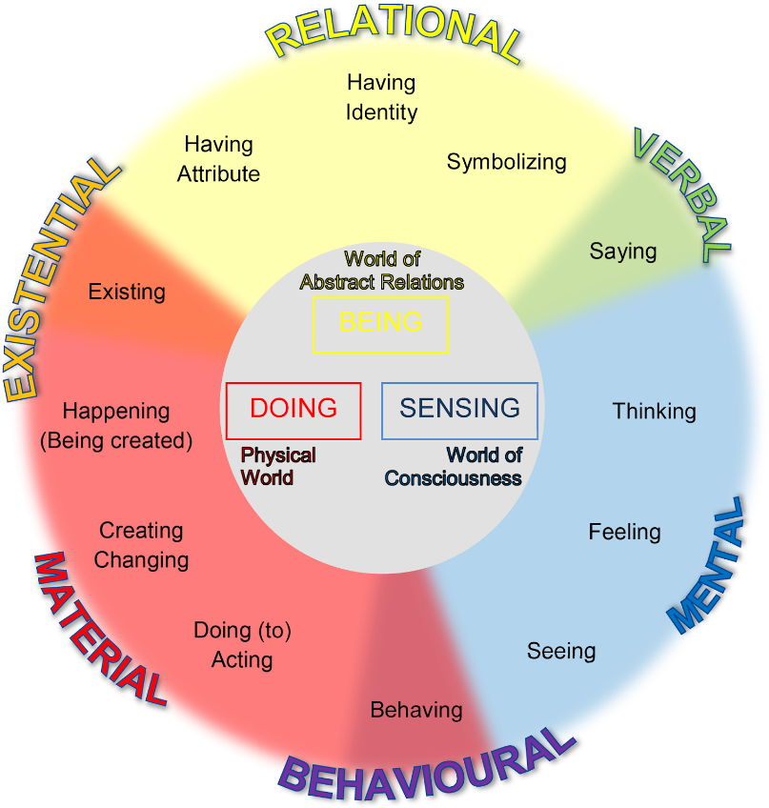
Verbs and passivisation
The-book
was-put-[by]
on-the-table
John
Grammatical subject
S
Passivised verb
V
Grammatical & Logical indirect object
I
Grammatical object
O
Logical
Object
O
Logical
Subject
S
Pravic constructs should be seen …
… Grammatically as SVIO
… Logically as OVIS
John offered Mary a cake
a-cake was-offered-by to-Mary John
John offered a cake to Mary

Slide 8
The construction of sentences
Definite article prefix
[a-]
Definite article prefix
[a-]
Definite article prefix
[a-]
Other prefixes
Other prefixes
Other prefixes
Other prefixes
Other prefixes
Other prefixes
Noun Root
Noun Root
Noun Root
Noun Root
Noun Root
Noun Root
Noun Suffix
[-i, blank]
Adjectival suffix
[-y]
Verb tense suffixes
[-ym-, -a, -e, -o]
Adverbial suffix
[-u]
Noun Suffix
[-i, blank]
Noun Suffix
[-i, blank]
Subject
(Noun)
[Logical object]
Adjective
Passivised Verb
Adverb
Indirect Object
(Noun)
Direct Object
(Noun)
[Logical subject]
The-book
red
was-put-[by]
carefully
on-the-table
John
aPilil
Romy
SHorda
PRemu
atiZammen
goCHon
John put the red book on the table carefully

Slide 9
Other grammatical features
Pseudo-Pronominals
a-speaker is-hurt-by of-the-speaker the-hand
My hand hurts
a-speaker is-hurt-by the-hand
a-pain is-caused-by the-hand
Reflexives
I see myself
John sees himself
a-speaker is-seen-by the-speaker
John is-seen-by John
a-known-person is-seen-by the-speaker
the-known-person is-seen-by John
a-self-person is-seen-by the-speaker
the-self-person is-seen-by John
Negatives
World 1
Objects & Events
Actuality
World 3
Information & Data
Reality
World 2
Cognition & Imagination
Virtuality
-mi-: Reversed actuality
miTys: This isn’t possible
-mo-: Reversed reality
moTys: This isn’t what I know
-ma-: Reversed virtuality
maTys: This isn’t what I think

Slide 10
The three-column translation
English | Pravlish | Pravic
“We aren’t, except biologically, mother and son, of course.” | “A-mother and the-child are-not us. Yet a-biological-parent and the-child are us.” | “Mamme Tyg aCHavok miPone Seksot. Sheb Lalav Tyg aCHavok Pone Seksot.”
She had regained her faint smile. | A-smile small had-been-found-again-by the-known-person. | PRekvem Piny raSHugvada aTRuv.
“You don’t remember me, and the baby I remember isn’t this man of twenty. | “The-known-person is-not-remembered-by the-listener, and the-listener twentying is-not the-baby remembered. | “aTRuv miraVogyra aSeln, Tyg aSeln Nemady miPone aPivok raVogyry.
All that is time past, irrelevant. | The-known-thing is a-gone-thing and a-not-now-thing. | aTRum Pone Dep Tyg maMurr.
But we are brother and sister, here and now. | But comrades are now us. | Sed aMMari Pone Murru Seksot.
Which is what really matters, isn’t it?” | And the-important-thing is the-this-thing.” | Tyg aDissig Pone aDupel.”

Slide 11
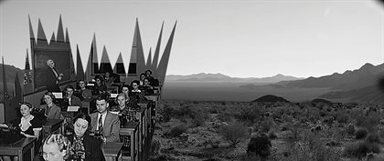
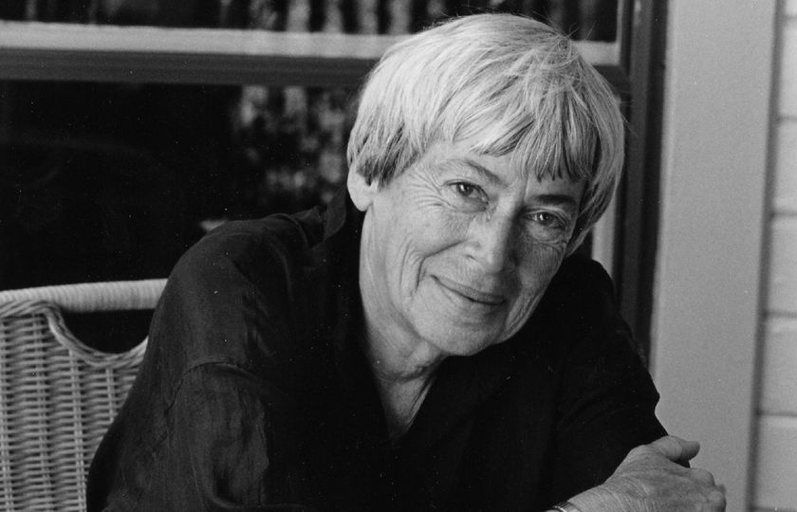
Night School on Anarres

Slide 12
Selni TRune gruGVeti [the-listeners are-thanked for-attentions] thank you for your attention
Martin Edwardes
King’s College London
martin.edwardes@btopenworld.com

